Slide 2
Meeting Our Obligations

Slide 3
1. Obligations To God

Slide 4
1. Obligations To God
To Know God
“…when the Lord Jesus is revealed from heaven with His mighty angels, in flaming fire taking vengeance on those who do not know God, and on those who do not obey the gospel of our Lord Jesus Christ” (2 Thess. 1:7-8).

Slide 5
1. Obligations To God
To Know God
To Fear the Lord
“Let us hear the conclusion of the whole matter: fear God and keep His commandments,
for this is man’s all” (Eccl. 12:13).

Slide 6
1. Obligations To God
To Know God
To Fear the Lord
To Keep His Commandments
“Let us hear the conclusion of the whole matter: fear God and keep His commandments,
for this is man’s all” (Eccl. 12:13).

Slide 7
1. Obligations To God
To Know God
To Fear the Lord
To Keep His Commandments
To Love God
“And you shall love the Lord your God with all your heart, with all your soul, with all your mind, and with all your strength. This is the first commandment” (Mark 12:30).

Slide 8
2. Obligations To Our Parents

Slide 9
2. Obligations To Our Parents
Obey Our Parents
Honor Our Parents
Children, obey your parents in the Lord, for this is right.
“Honor your father and mother,” which is the first commandment with promise:
“that it may be well with you and you may live long on the earth.” (Ephesians 6:1-3)

Slide 10
2. Obligations To Our Parents
Obey Our Parents
Honor Our Parents
“A foolish son is a grief to his father, and bitterness to her who bore him.” (Proverbs 17:25)
Children, obey your parents in the Lord, for this is right.
“Honor your father and mother,” which is the first commandment with promise:
“that it may be well with you and you may live long on the earth.” (Ephesians 6:1-3)

Slide 11
2. Obligations To Our Parents
Obey Our Parents
Honor Our Parents
“A foolish son is a grief to his father, and bitterness to her who bore him.” (Proverbs 17:25)
“But if any widow has children or grandchildren, let them first learn to show piety at home and to repay their parents; for this is good and acceptable before God… If any believing man or woman has widows, let them relieve them…” (1 Tim. 5:4, 16).

Slide 12
3. Obligations To Our Spouse

Slide 13
3. Obligations To Our Spouse
Husband
Provide loving headship
Love wife as Christ loves the church
Do not be bitter, but understanding
Honor his wife
Eph. 5:22-33; Col. 3:18-19; Titus 2:4-5; 1 Pet. 3:1-7

Slide 14
3. Obligations To Our Spouse
Husband
Wife
Provide loving headship
Love wife as Christ loves the church
Do not be bitter, but understanding
Honor his wife
Submit to the headship of her husband
Respect her husband
Love her husband
Obey her husband
Eph. 5:22-33; Col. 3:18-19; Titus 2:4-5; 1 Pet. 3:1-7

Slide 15
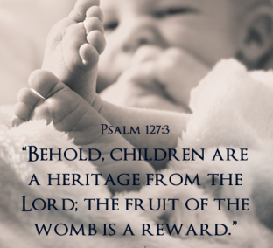
4. Obligations To Our Children

Slide 16
4. Obligations To Our Children
Provide for them
Physical necessities, protection, time, good example, etc.
“But if anyone does not provide for his own, and especially for those of his household, he has denied the faith and is worse than an unbeliever.” (1 Tim. 5:8)

Slide 17
4. Obligations To Our Children
Provide for them
Raise them
“And you, fathers, do not provoke your children to wrath, but bring them up in the training and admonition of the Lord” (Eph. 6:4).

Slide 18
4. Obligations To Our Children
Provide for them
Raise them
Love them
“That they admonish the young women to love their husbands, to love their children.” (Titus 2:4)

Slide 19
4. Obligations To Our Children
Provide for them
Raise them
Love them
Discipline them
“He who spares his rod hates his son, but he who loves him disciplines him promptly… Chasten your son while there is hope, and do not set your heart on his destruction.” (Prov. 13:24; 19:18)

Slide 20
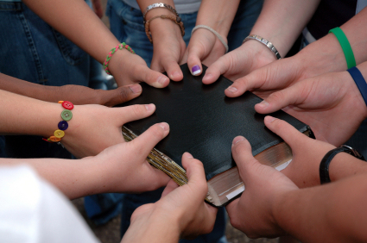
5. Obligations To Our Brethren
Love Our Brethren - 1 John 4:20-21
Consider and Exhort Them - Heb. 10:24-25
Do Good To Them - Gal. 6:10; Titus 3:14
Restore Them - Gal. 6:1; James 5:19-20

Slide 21
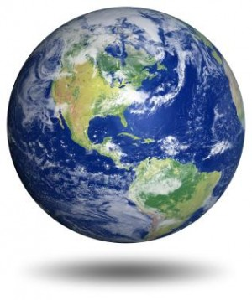
6. Obligations To The World
Be a Good Example - Matt. 5:13-16
Be a Good Citizen - Rom. 13:1-7
Be a Good Neighbor - Rom. 13:8-10; Matt. 7:12
Be a Good Employee - Col. 3:22-24
Be a Soul Winner - Prov. 11:30

Slide 22
Meeting Our Obligations
Therefore we make it our aim, whether present or absent, to be well pleasing to Him.
For we must all appear before the judgment seat of Christ, that each one may receive the things done in the body, according to what he has done, whether good or bad.
2 Corinthians 5:9-10

