Slide 2
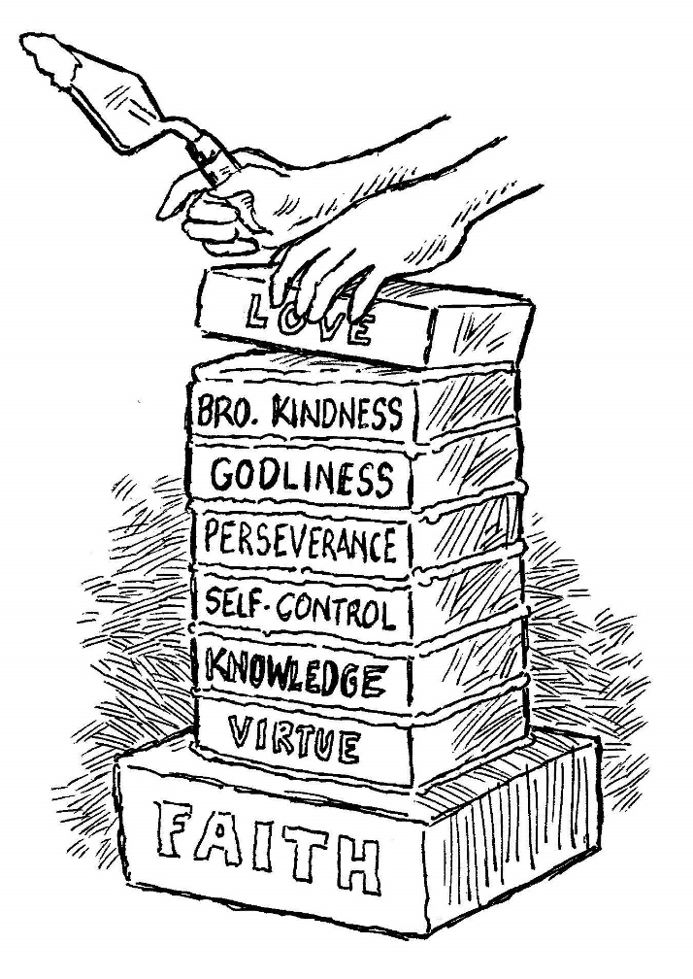
add to your faith… Self Control
2 Peter 1:5-7

Slide 3
Self-Control, Temperance
To keep ourselves in check by mastering our desires, passions and appetites.
This self-mastery is accomplished by harmonizing our personal desires with God’s revealed will.
Self-control has to do with self-mastery; the ability to hold ourselves in check and tell ourselves “NO!”

Slide 4
Self-Control, Temperance
A sign of great character.
Prov. 16:32; 25:28
A mark of maturity.
Titus 1:8
Part of the Fruit of the Spirit.
Galatians 5:22-23
A lack of self-control is a sign of apostasy.
2 Tim. 3:3

Slide 5
Why Add Self-Control?
First Step of Discipleship
Matthew 16:24
To Win An Incorruptible Crown
1 Cor. 9:24-27
God’s Grace Teaches It
Titus 2:11-12
To Live Unspotted In This World
James 1:27

Slide 6
How To Develop Self-Control
Dethrone Self and Enthrone Christ
Matt. 16:24; Gal. 2:20; Phil. 2:5-8
Submit To God’s Will
James 4:7
View Self-Control In Light Of Judgment
Acts 24:25; 2 Cor. 5:10
View Self-Control In Light Of Our Influence
Matt. 5:13; 1 Cor. 10:32

Slide 7
We Must Give All Diligence To Add Self-Control To Our Faith
Do you not know that those who run in a race all run, but one receives the prize? Run in such a way that you may obtain it.
And everyone who competes for the prize is temperate in all things. Now they do it to obtain a perishable crown, but we for an imperishable crown.
Therefore I run thus: not with uncertainty. Thus I fight: not as one who beats the air.
But I discipline my body and bring it into subjection, lest, when I have preached to others, I myself should become disqualified.

