Slide 2
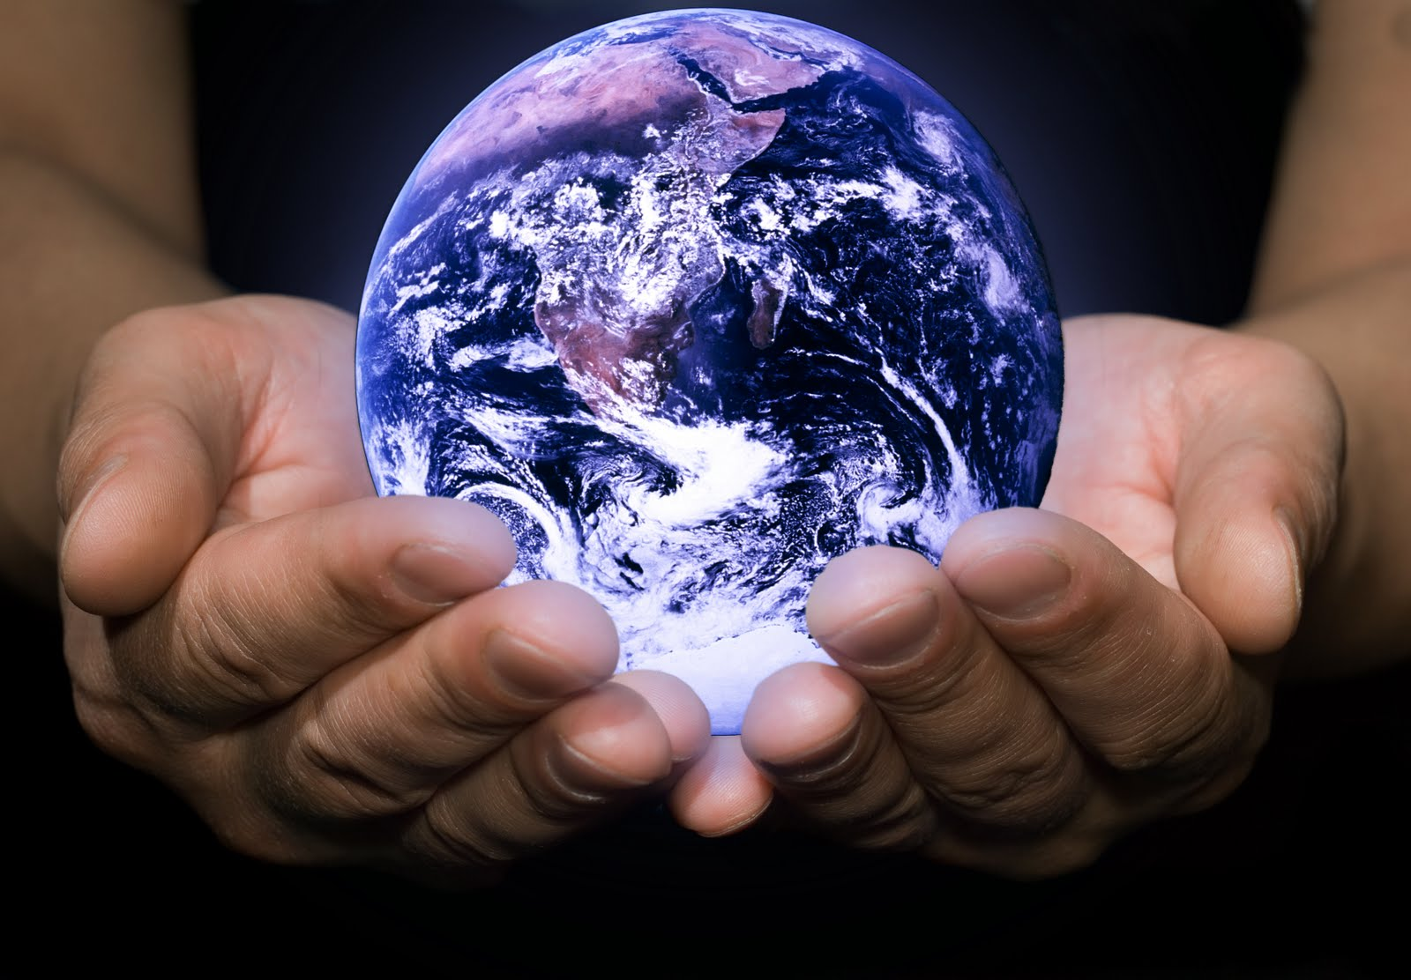
The Incomparable Greatness of God
Isaiah 40:12-31

Slide 3
Our God Is Great! Isaiah 40:12-17

Slide 4
Our God Is Great! Isaiah 40:12-17
“Now to Him who is able to do exceedingly abundantly above all that we ask or think, according to the power that works in us”
Ephesians 3:20

Slide 5
Our God Is Great! Isaiah 40:12-17
“But will God indeed dwell on the earth? Behold, heaven and the heaven of heavens cannot contain You. How much less this temple which I have built!”
1 Kings 8:27

Slide 6
Our God Is Great! Isaiah 40:12-17
“When I consider Your heavens, the work of Your fingers, the moon and the stars, which You have ordained, what is man that You are mindful of him, and the son of man that You visit him?”
Psalm 8:3-4

Slide 7
Because Our God Is Great…
Idolatry is Foolish (vs. 18-20)
Human Pride is Foolish (vs. 21-25)
God is our Power, Strength and Deliverance (vs. 26-31)

