Slide 2
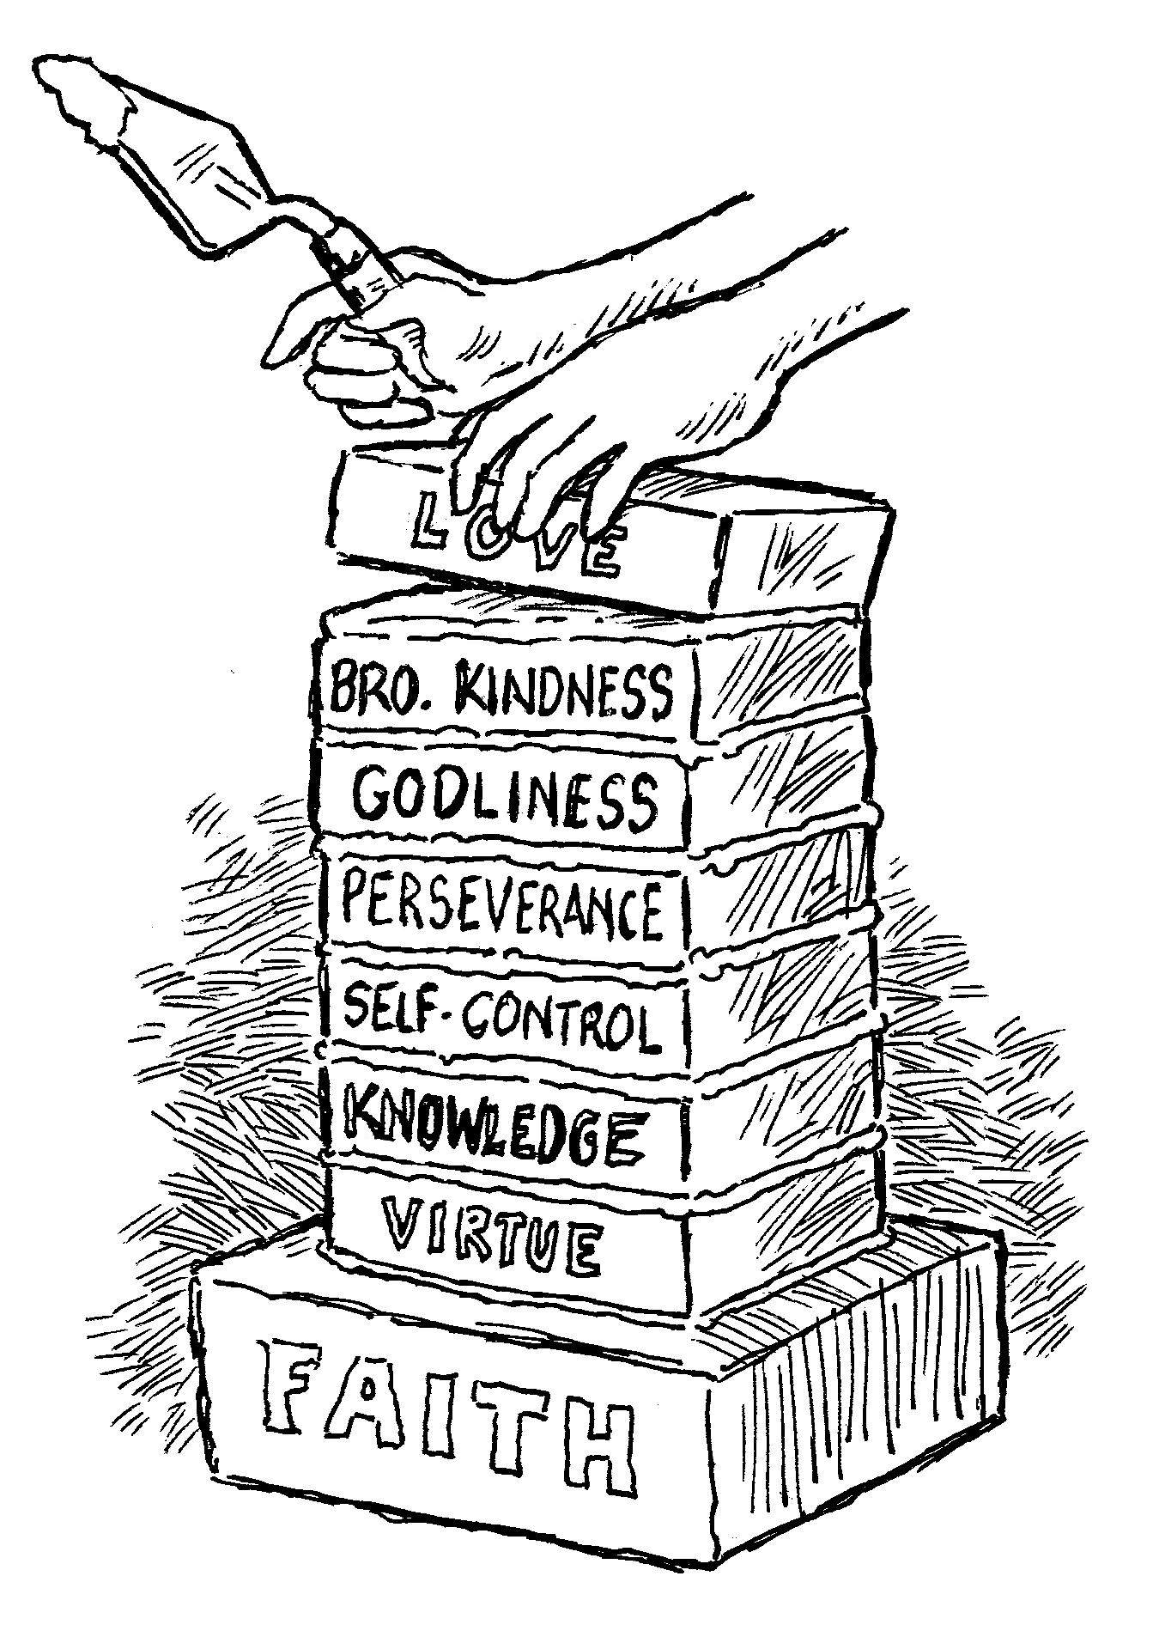
add to your faith… Virtue
2 Peter 1:5-7

Slide 3
Virtue - arete
“any excellence of a person (in body or mind) or of a thing, an eminent endowment, property or quality (Thayer’s).
“properly denotes whatever procures preeminent estimation for a person or thing, hence, ‘intrinsic eminence, moral goodness, virtue’” (Vine’s).
“To Greek philosophers, it meant ‘the fulfillment of a thing.’ When anything in nature fulfills its purpose, that is ‘virtue – moral excellence’” (Warren Wiersbe).

Slide 4
Virtue - arete
Many people want to define “virtue” as having courage.
“Virtue,” as it applies to our faith, is the resolute determination to do what is right in the sight of God, regardless of the consequences.

Slide 5
Virtue Is Shown When…
Overcoming Temptation
James 1:12; Gen. 39:7-12
We Are In The Minority
Matt. 7:13-14; Num. 13-14; 1 Kings 18
Obedience Seems Unreasonable
1 John 5:3; Heb. 11:17-19

Slide 6
Virtue Is Shown When…
Man’s Law Conflicts With God’s Law
Rom. 13:1-5; Acts 4:18-20, Dan. 3:15-18
Reproving Those In Sin
Gal. 6:1; James 5:19-20; 2 Sam. 12:1-7

Slide 7
Virtue is excellence, preeminent estimation, the state of being praiseworthy.
God’s divine nature makes Him praiseworthy.
Christ’s perfect, selfless sacrifice on the cross makes Him praiseworthy.
Our determination to do what is right in the sight of God, regardless of the consequences of man, is what makes our faith praiseworthy to God.

