Slide 1
Faces of Faith
Hebrews 12:1
A Great Faith
Luke 7:9
Hebrews 11:1

Slide 2
Faces of Faith
Hebrews 12:1
Great…
Vast, much, large
Remarkable or outstanding in magnitude
Superior in character

Slide 3
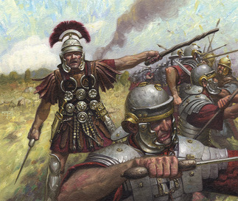
The Centurion’s Faith
Luke 7:1-10
John 12:49
Matthew 5:13
A Great Faith
Recognizes Supreme Authority

Slide 4
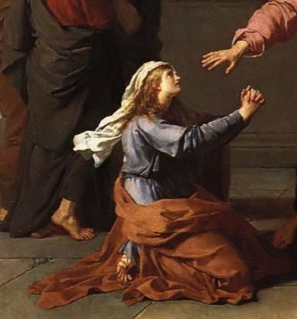
The Canaanite Woman’s Faith
Matthew 15:21-28
A Great Faith
Is Wise

Slide 5
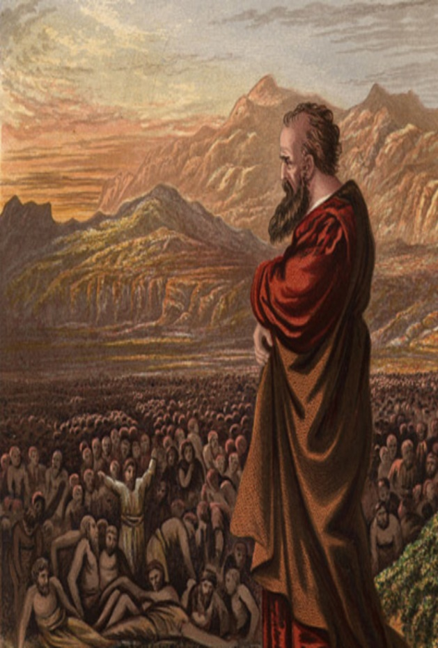
Ezekiel’s Faith
Ezekiel 4:1-7
Ezekiel 5
Ezekiel 24:15-17
Acts 6:5
A Great Faith
Is Full of Faith

Slide 6
Faces of Faith
Hebrews 12:1
A Great Faith
Luke 7:9
Recognizes Supreme Authority
Is Wise
Is Full of Faith

