Slide 1
Faces of Faith
Hebrews 12:1
A Courageous Faith
Psalms 31:24
Hebrews 11:1

Slide 2
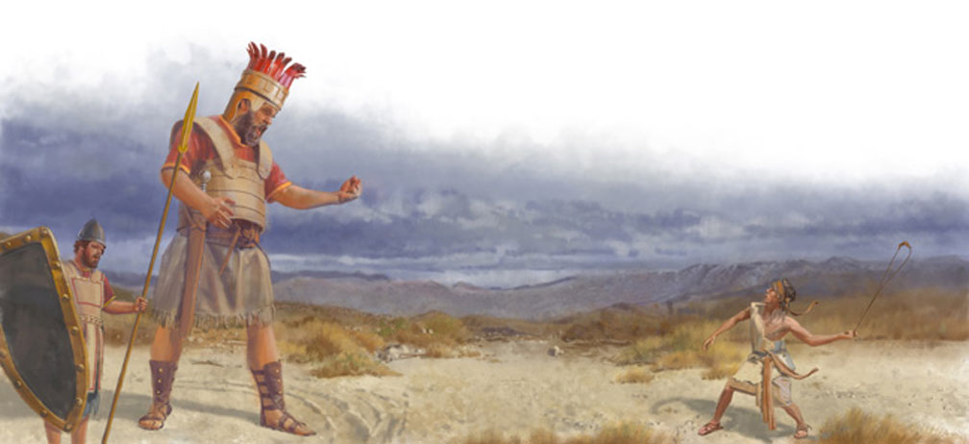

Slide 3
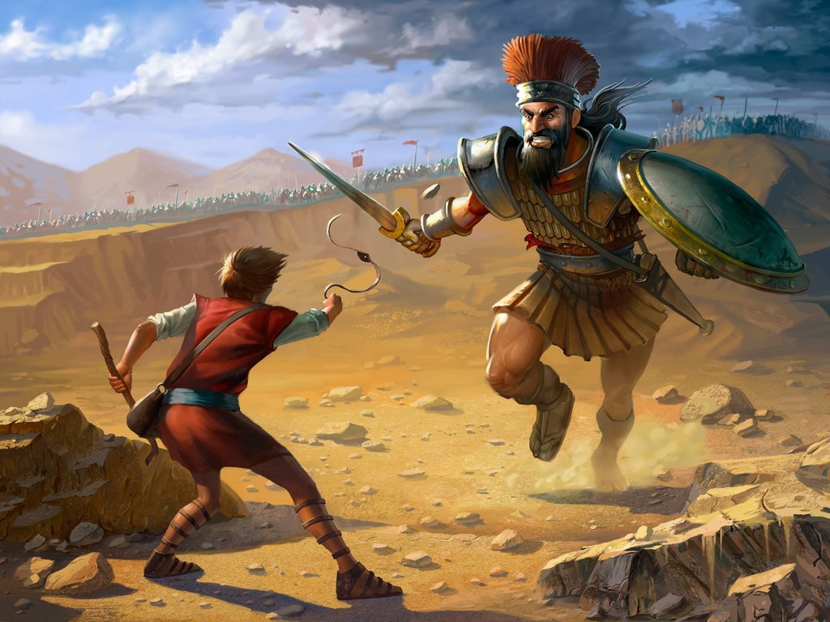
Erik Bragalyan

Slide 4
“Be strong and of good courage, for to this people you shall divide as an inheritance the land which I swore to their fathers to give them. Only be strong and very courageous, that you may observe to do according to all the law which Moses My servant commanded you; do not turn from it to the right hand or to the left, that you may prosper wherever you go.”
Joshua 1:6-7
A Courageous Faith

Slide 5
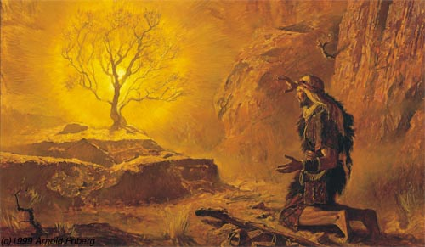
Moses’ Faith
Hebrews 11:24-25
Hebrews 11:27
A Courageous Faith
Sees the Unseen

Slide 6
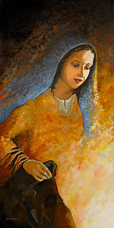
Mary’s Faith
Luke 1:26-33
Luke 1:46-55
Luke 1:38
A Courageous Faith
Is Virtuous & Submissive

Slide 7
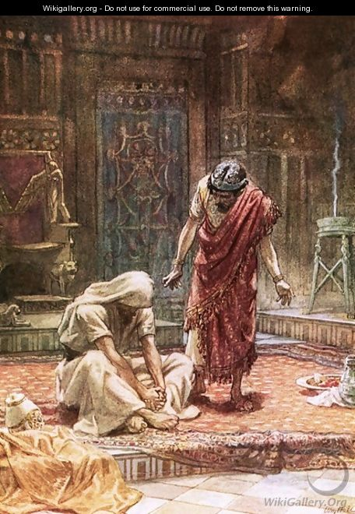
David’s Faith
Acts 13:22-23
Psalm 32:5
Psalm 51:1-4
A Courageous Faith
Is Humble & Penitent
The sorrow of king David
by William Brassey Hole

Slide 8
Faces of Faith
Hebrews 12:1
A Courageous Faith
Psalms 31:24
“Be of good courage, And He shall strengthen your heart, All you who hope in the LORD.”

Slide 9
Faces of Faith
Hebrews 12:1
A Courageous Faith
Sees the Unseen
Is Virtuous & Submissive
Is Humble & Penitent

