Slide 1
Faces of Faith
Hebrews 12:1
A Genuine Faith
Hebrews 11:1

Slide 2
Faces of Faith
Hebrews 12:1
Genuine…
Is unfeigned, sincere
Free from hypocrisy
Not disguised or masked

Slide 3
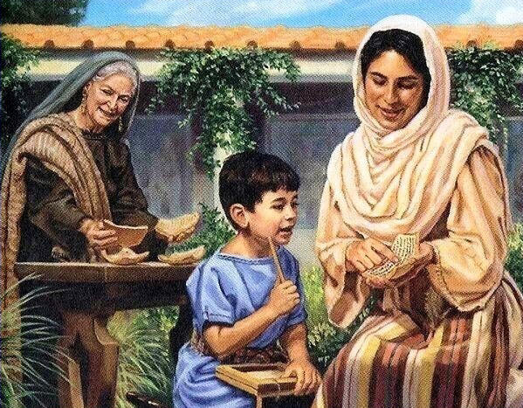
Eunice & Lois’Faith
1 Timothy 1:2
Acts 16:1-2
Romans 16:21
1 Corinthians 4:17
2 Timothy 1:3-5
2 Timothy 3:13-15
A Genuine Faith
Is Sincere

Slide 4
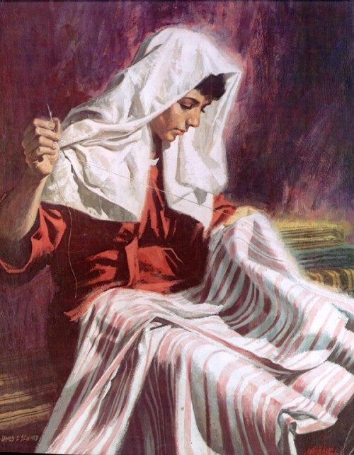
Tabitha’s Faith
Acts 9:36-42
A Genuine Faith
Is Active in Good Deeds

Slide 5
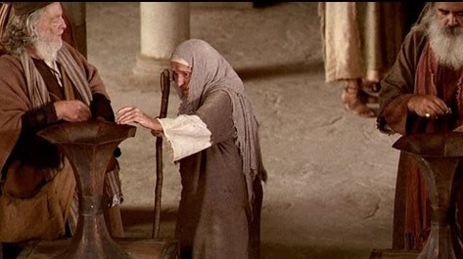
The Widow’s Faith
Luke 21:1-4
A Genuine Faith
Is Giving and Willing to Make Sacrifice

Slide 6
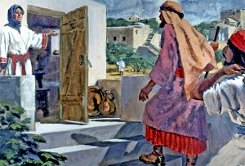
The Shunammite Woman’s Faith
2 Kings 4:8-17
Acts 16:15
1 Peter 4:9
1 Corinthians 9:14
A Genuine Faith
Is Persuasive & Persistent

Slide 7
Faces of Faith
Hebrews 12:1
A Genuine Faith
Is Sincere
Is Active in Good Deeds
Is Giving and Willing to Sacrifice
Is Persistent and Perceptive
Hebrews 11:1

