Slide 1
Faces of Faith
Hebrews 12:1
A Fixed Faith
Hebrews 11:1

Slide 2
Faces of Faith
Hebrews 12:1
Conviction…
A Firmly Held Belief
A belief you hold and will not change

Slide 3
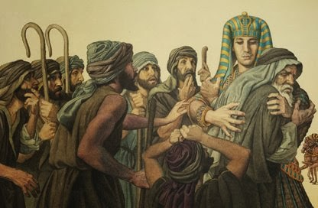
Joseph’s Faith
Genesis 37-50
Genesis 37:2-4
Genesis 39:1-12
Genesis 45:7-8
Hebrews 11:22
A Fixed Faith
Is Unwavering

Slide 4
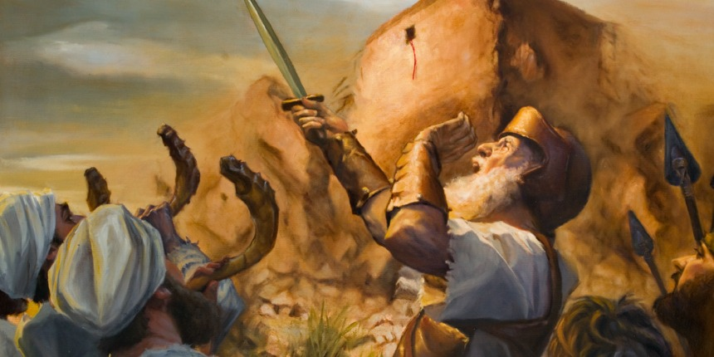
Joshua’s Faith
Numbers 32:10-12
Joshua 1:1
Exodus 24:13-18
Exodus 33:11
Hebrews 11:30
A Fixed Faith
Wholly Follows the Lord

Slide 5
Joshua’s Faith
Joshua 1:7
Joshua 11:15
Joshua 24:14-15
A Fixed Faith
Wholly Follows the Lord

Slide 6
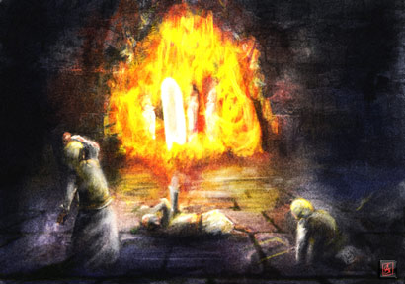
Shadrach, Meshach and
Abed-Nego’s Faith
Daniel 3:1
A Fixed Faith

Slide 7
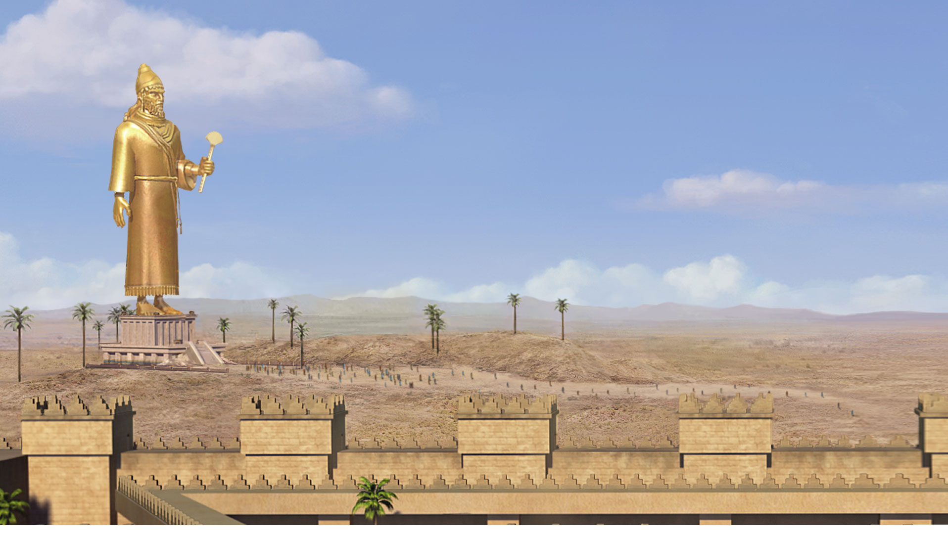
90 Feet

Slide 8
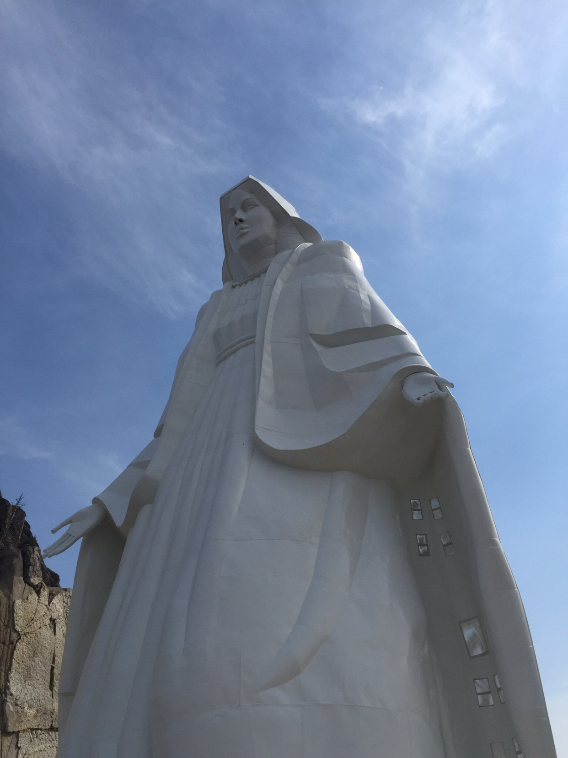
90 Feet

Slide 9
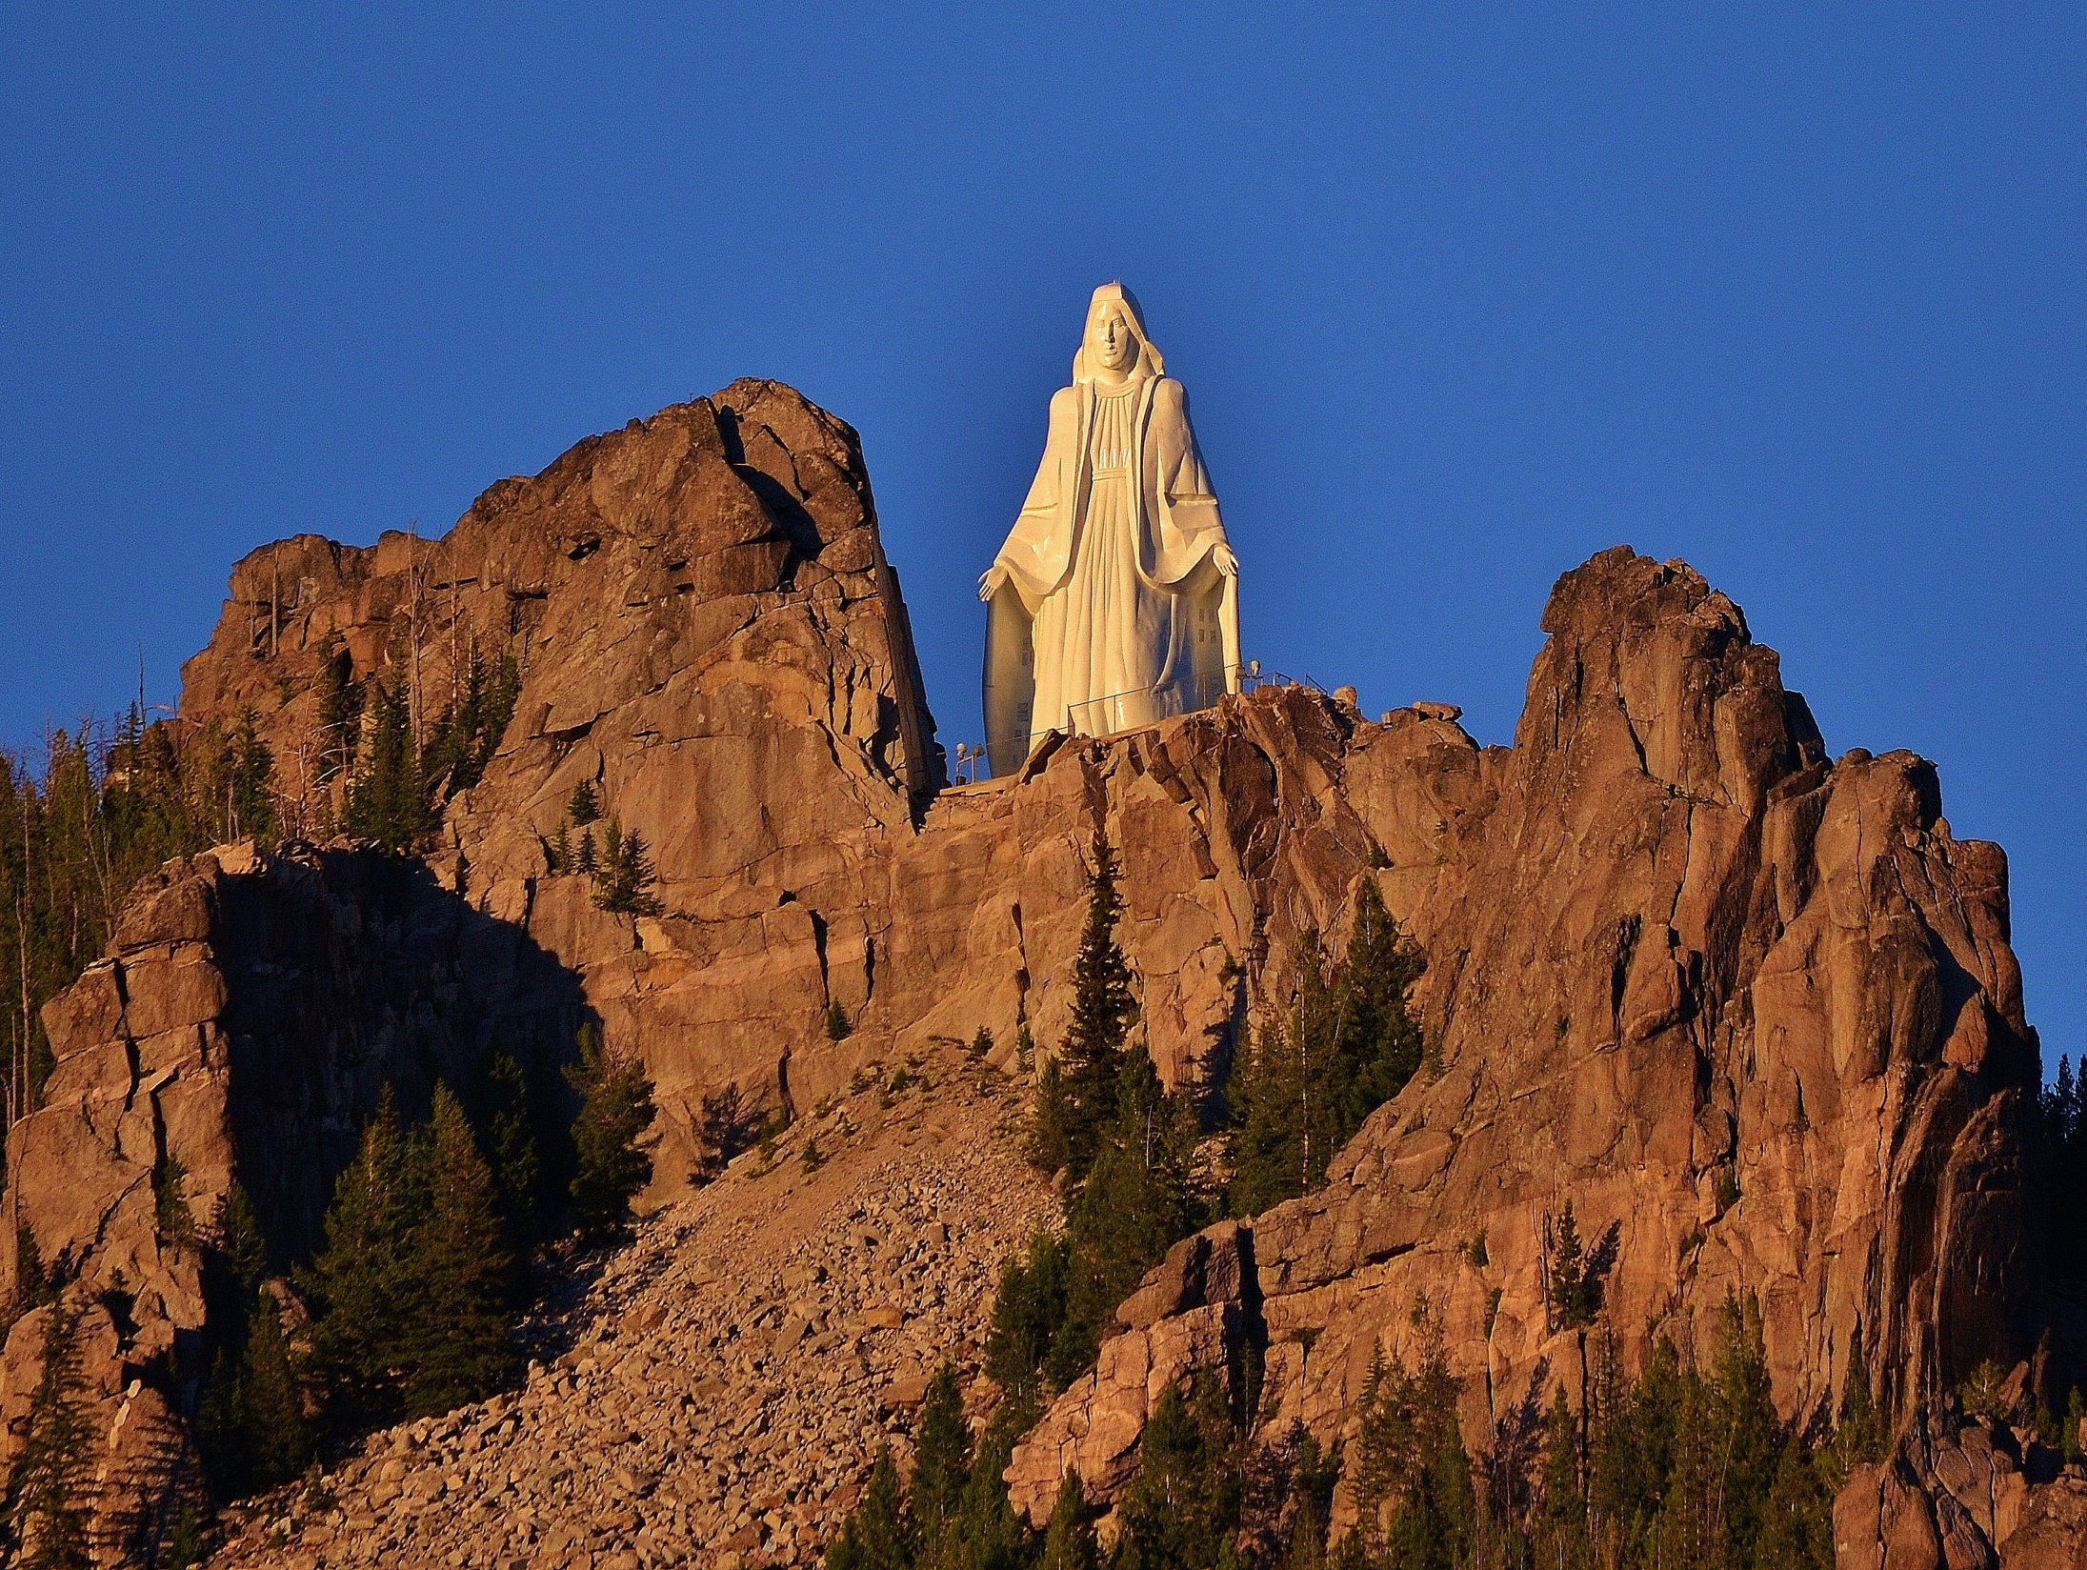

Slide 10
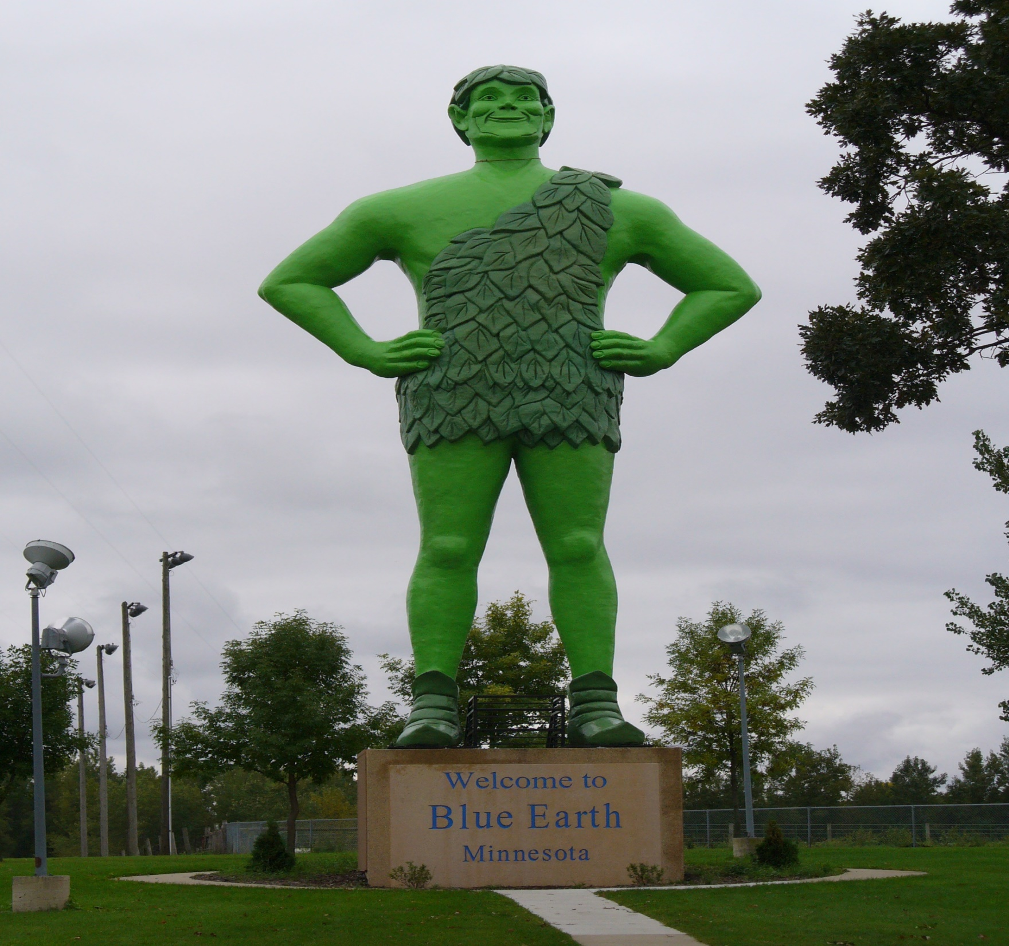
55 ½ feet

Slide 12
Shadrach, Meshach and
Abed-Nego’s Faith
Daniel 3:1
Daniel 3:5-6
Daniel 3:16-17
Daniel 3:28-29
A Fixed Faith
Is Totally Dedicated

Slide 13
Faces of Faith
Hebrews 12:1
A Fixed Faith
Is Unwavering
Wholly Follows the Lord
Is Totally Dedicated
Hebrews 11:1

