Slide 2

Whatever Happened
To Sin?

Slide 3
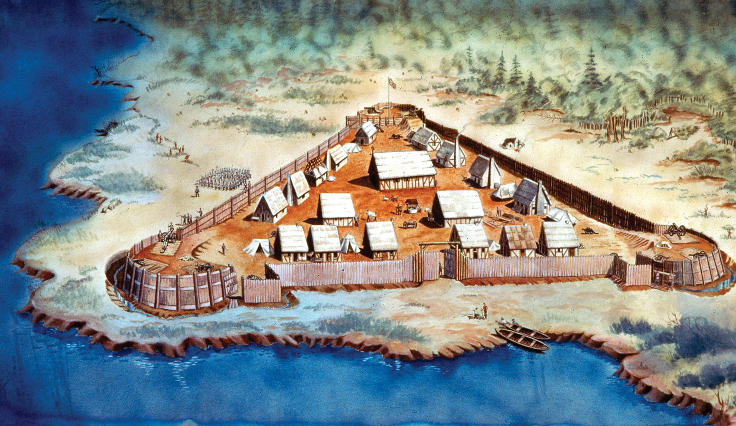

Slide 4
Sin is Serious!
The Bible reveals sin for what it really is.
  Romans 7:13
The devil always tries to minimize the seriousness of our sin.
  Genesis 2:15-17; 3:1-5

Slide 5
How Do We Minimize the Seriousness of Sin?
Familiarity
Euphemisms
Humor
Pop Psychology
False Doctrine
Comparisons

Slide 6
Greed
White Lies
Envy
Gossip
Cowardice
Indifference

Slide 7
The Sins That Killed Jesus
Greed Matt. 26:15
White Lies Matt. 26:60
Envy Matt. 27:18
Gossip Matt. 27:20
Cowardice Matt. 27:22-24
Indifference Luke 23:35

Slide 8
Sin is Seriousness!
Sin is a violation against God’s will and God’s nature.
The wages of sin are always death.
Jesus gave His life on the cross so we could be saved from our sins.
Why not obey the gospel today!

