Slide 2
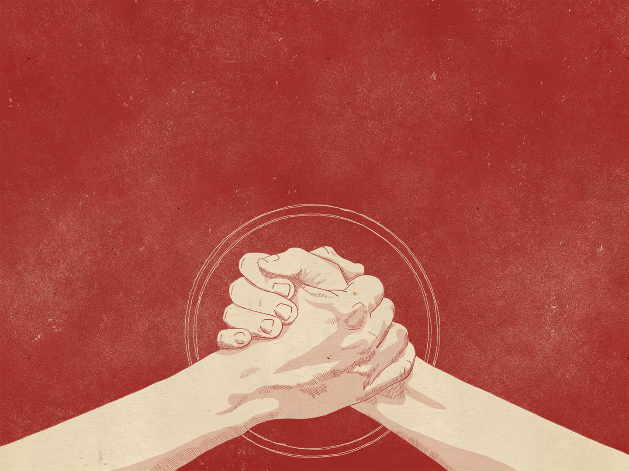
Jonathan: Son of Saul
An unlikely leader who stepped up in courage and glorified God

Slide 3
1 Samuel 23:16–17 (ESV)
¹⁶And Jonathan, Saul’s son, rose and went to David at Horesh, and strengthened his hand in God.
¹⁷And he said to him, “Do not fear, for the hand of Saul my father shall not find you. You shall be king over Israel, and I shall be next to you. Saul my father also knows this.”

Slide 4
Israel Demands a King
1 Samuel 8

Slide 5
1 Samuel 8.6-8 (ESV)
⁶But the thing displeased Samuel when they said, “Give us a king to judge us.” And Samuel prayed to the Lord.
⁷And the Lord said to Samuel, “Obey the voice of the people in all that they say to you, for they have not rejected you, but they have rejected me from being king over them.
⁸According to all the deeds that they have done, from the day I brought them up out of Egypt even to this day, forsaking me and serving other gods, so they are also doing to you.

Slide 6
1 Samuel 9.1-3 (ESV)
¹There was a man of Benjamin whose name was Kish, the son of Abiel, son of Zeror, son of Becorath, son of Aphiah, a Benjaminite, a man of wealth.
²And he had a son whose name was Saul, a handsome young man. There was not a man among the people of Israel more handsome than he. From his shoulders upward he was taller than any of the people.
³Now the donkeys of Kish, Saul’s father, were lost. So Kish said to Saul his son, “Take one of the young men with you, and arise, go and look for the donkeys.”

Slide 7
1 Samuel 9.20 (ESV)
²⁰As for your donkeys that were lost three days ago, do not set your mind on them, for they have been found. And for whom is all that is desirable in Israel? Is it not for you and for all your father’s house?”

Slide 8
1 Samuel 9.1-2 (ESV)
¹There was a man of Benjamin whose name was Kish, the son of Abiel, son of Zeror, son of Becorath, son of Aphiah, a Benjaminite, a man of wealth.
²And he had a son whose name was Saul, a handsome young man. There was not a man among the people of Israel more handsome than he. From his shoulders upward he was taller than any of the people.

Slide 9
Jonathan’s Opening Act
1 Samuel 13-14

Slide 10
1 Samuel 13.1-4 (ESV)
¹Saul lived for one year and then became king, and when he had reigned for two years over Israel,
²Saul chose three thousand men of Israel. Two thousand were with Saul in Michmash and the hill country of Bethel, and a thousand were with Jonathan in Gibeah of Benjamin. The rest of the people he sent home, every man to his tent.
³Jonathan defeated the garrison of the Philistines that was at Geba, and the Philistines heard of it. And Saul blew the trumpet throughout all the land, saying, “Let the Hebrews hear.”
⁴And all Israel heard it said that Saul had defeated the garrison of the Philistines, and also that Israel had become a stench to the Philistines. And the people were called out to join Saul at Gilgal.

Slide 11
1 Samuel 13.5-9 (ESV)
⁵And the Philistines mustered to fight with Israel, thirty thousand chariots and six thousand horsemen and troops like the sand on the seashore in multitude. They came up and encamped in Michmash, to the east of Beth-aven.
⁶When the men of Israel saw that they were in trouble (for the people were hard pressed), the people hid themselves in caves and in holes and in rocks and in tombs and in cisterns,
⁷and some Hebrews crossed the fords of the Jordan to the land of Gad and Gilead. Saul was still at Gilgal, and all the people followed him trembling.
⁸He waited seven days, the time appointed by Samuel. But Samuel did not come to Gilgal, and the people were scattering from him.
⁹So Saul said, “Bring the burnt offering here to me, and the peace offerings.” And he offered the burnt offering.

Slide 12
1 Samuel 13.11-14 (ESV)
¹¹Samuel said, “What have you done?” And Saul said, “When I saw that the people were scattering from me, and that you did not come within the days appointed, and that the Philistines had mustered at Michmash,
¹²I said, ‘Now the Philistines will come down against me at Gilgal, and I have not sought the favor of the Lord.’ So I forced myself, and offered the burnt offering.”
¹³And Samuel said to Saul, “You have done foolishly. You have not kept the command of the Lord your God, with which he commanded you. For then the Lord would have established your kingdom over Israel forever.
¹⁴But now your kingdom shall not continue. The Lord has sought out a man after his own heart, and the Lord has commanded him to be prince over his people, because you have not kept what the Lord commanded you.”

Slide 13
1 Samuel 14.1-4 (ESV)
¹One day Jonathan the son of Saul said to the young man who carried his armor, “Come, let us go over to the Philistine garrison on the other side.” But he did not tell his father.
²Saul was staying in the outskirts of Gibeah in the pomegranate cave at Migron. The people who were with him were about six hundred men,
³including Ahijah the son of Ahitub, Ichabod’s brother, son of Phinehas, son of Eli, the priest of the Lord in Shiloh, wearing an ephod. And the people did not know that Jonathan had gone.
⁴Within the passes, by which Jonathan sought to go over to the Philistine garrison, there was a rocky crag on the one side and a rocky crag on the other side. The name of the one was Bozez, and the name of the other Seneh.

Slide 14
1 Samuel 14.6 (ESV)
⁶Jonathan said to the young man who carried his armor, “Come, let us go over to the garrison of these uncircumcised. It may be that the Lord will work for us, for nothing can hinder the Lord from saving by many or by few.”

Slide 15
1 Samuel 14.13-15 (ESV)
¹³Then Jonathan climbed up on his hands and feet, and his armor-bearer after him. And they fell before Jonathan, and his armor-bearer killed them after him.
¹⁴And that first strike, which Jonathan and his armor-bearer made, killed about twenty men within as it were half a furrow’s length in an acre of land.
¹⁵And there was a panic in the camp, in the field, and among all the people. The garrison and even the raiders trembled, the earth quaked, and it became a very great panic.

Slide 16
1 Samuel 14.23 (ESV)
²³So the Lord saved Israel that day. And the battle passed beyond Beth-aven.

Slide 17
1 Samuel 14.43-46 (ESV)
⁴³Then Saul said to Jonathan, “Tell me what you have done.” And Jonathan told him, “I tasted a little honey with the tip of the staff that was in my hand. Here I am; I will die.”
⁴⁴And Saul said, “God do so to me and more also; you shall surely die, Jonathan.”
⁴⁵Then the people said to Saul, “Shall Jonathan die, who has worked this great salvation in Israel? Far from it! As the Lord lives, there shall not one hair of his head fall to the ground, for he has worked with God this day.” So the people ransomed Jonathan, so that he did not die.
⁴⁶Then Saul went up from pursuing the Philistines, and the Philistines went to their own place.

Slide 18
Jonathan’s Second Act
1 Samuel 18-23

Slide 19
1 Samuel 18.1–4 (ESV)
¹As soon as he had finished speaking to Saul, the soul of Jonathan was knit to the soul of David, and Jonathan loved him as his own soul.
²And Saul took him that day and would not let him return to his father’s house.
³Then Jonathan made a covenant with David, because he loved him as his own soul.
⁴And Jonathan stripped himself of the robe that was on him and gave it to David, and his armor, and even his sword and his bow and his belt.

Slide 20
1 Samuel 20.30-34 (ESV)
³⁰Then Saul’s anger was kindled against Jonathan, and he said to him, “You son of a perverse, rebellious woman, do I not know that you have chosen the son of Jesse to your own shame, and to the shame of your mother’s nakedness?
³¹For as long as the son of Jesse lives on the earth, neither you nor your kingdom shall be established. Therefore send and bring him to me, for he shall surely die.”
³²Then Jonathan answered Saul his father, “Why should he be put to death? What has he done?”
³³But Saul hurled his spear at him to strike him. So Jonathan knew that his father was determined to put David to death.
³⁴And Jonathan rose from the table in fierce anger and ate no food the second day of the month, for he was grieved for David, because his father had disgraced him.

Slide 21
1 Samuel 20.42 (ESV)
⁴²Then Jonathan said to David, “Go in peace, because we have sworn both of us in the name of the Lord, saying, ‘The Lord shall be between me and you, and between my offspring and your offspring, forever.’ ” And he rose and departed, and Jonathan went into the city.

Slide 22
1 Samuel 20.42 (ESV)
⁴²Then Jonathan said to David, “Go in peace, because we have sworn both of us in the name of the Lord, saying, ‘The Lord shall be between me and you, and between my offspring and your offspring, forever.’ ” And he rose and departed, and Jonathan went into the city.

Slide 23
1 Samuel 23:16–17 (ESV)
¹⁶And Jonathan, Saul’s son, rose and went to David at Horesh, and strengthened his hand in God.
¹⁷And he said to him, “Do not fear, for the hand of Saul my father shall not find you. You shall be king over Israel, and I shall be next to you. Saul my father also knows this.”

Slide 24
Jonathan’s Final Act
1 Samuel 31

Slide 25
2 Samuel 1.25-27 (ESV)
²⁵“How the mighty have fallen in the midst of the battle! “Jonathan lies slain on your high places.
²⁶I am distressed for you, my brother Jonathan; very pleasant have you been to me; your love to me was extraordinary, surpassing the love of women.
²⁷“How the mighty have fallen, and the weapons of war perished!”

Slide 26
1 Samuel 20.14-16 (ESV)
¹⁴If I am still alive, show me the steadfast love of the Lord, that I may not die;
¹⁵and do not cut off your steadfast love from my house forever, when the Lord cuts off every one of the enemies of David from the face of the earth.”
¹⁶And Jonathan made a covenant with the house of David, saying, “May the Lord take vengeance on David’s enemies.”

Slide 27
Jonathan: Son of Saul
An unlikely leader who stepped up in courage and glorified God

Slide 28
1 Samuel 14.6 (ESV)
⁶Jonathan said to the young man who carried his armor, “Come, let us go over to the garrison of these uncircumcised. It may be that the Lord will work for us, for nothing can hinder the Lord from saving by many or by few.”
1 Samuel 23:16–17 (ESV)
¹⁶And Jonathan, Saul’s son, rose and went to David at Horesh, and strengthened his hand in God.
¹⁷And he said to him, “Do not fear, for the hand of Saul my father shall not find you. You shall be king over Israel, and I shall be next to you. Saul my father also knows this.”

Slide 29
Jonathan: Son of Saul
An unlikely leader who stepped up in courage and glorified God

