Slide 1
A Study of
Psalm 39

Slide 2
1. Controlling Our Anger and Our Speech vs. 1-3
Take heed to our ways.
Gen. 4:7; Eph. 5:15
Keep our mouth shut.
Prov. 10:19; 17:27-28; James 1:26
Think before we speak.
“musing” v. 3; Prov. 15:28
Then speak… if necessary.

Slide 3
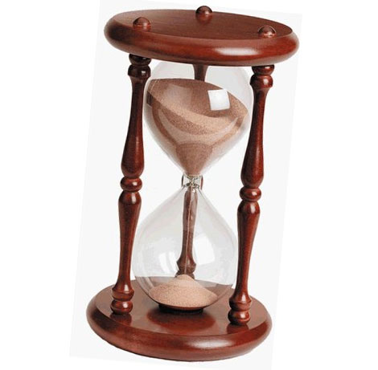
2. Realizing Our Mortality vs. 4-6
Our days on this earth are limited.
Ps. 90:10-12
We are frail, a vapor, a handbreadth.
Life without God is vain.

Slide 4
3. Realizing Our Need For God vs. 7-11
Without God we have no hope.
1 Peter 1:3-5
Without God we have no deliverance.
Transgressions
Reproach of fools - v. 8; Rom. 12:17-19
God’s correction - vs. 9-11; Heb. 12:5-11
Without God we have no perspective.

Slide 5
4. Accepting Our Place in This World vs. 12-13
Stranger - one that has his abode in a foreign country. One who is not a native or a citizen of the place in which he dwells.
Sojourner - one that does not intend to settle, but is only passing through a place; is in motion traveling homeward.

Slide 6
4. Accepting Our Place in This World vs. 12-13
The Patriarchs lived as strangers and pilgrims.
Hebrews 11:13-16
We must do the same.
1 Pet. 1:17, 2:11; Phil. 3:20
We are not to love or befriend this world.
1 John 2:15; James 4:4
We are to lay up treasures in Heaven.
Matthew 6:19-21

Slide 7
A mature Christian realizes…
The importance of controlling his temper and his tongue.
Without God there is no hope, no deliverance, and no meaning to life.
Life in this world is short, temporary and preparatory.

