Slide 2
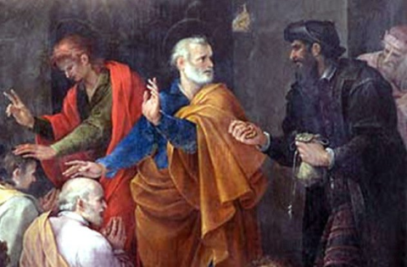
Some Things Simon Saw
Acts 8:5-24

Slide 3
1. Difference Between Genuine Miracles and Counterfeits
Simon was a sorcerer who had deceived the people with his magical arts (Acts 8:9-11)
The Samaritans saw the difference between Simon’s illusions and the miracles Philip performed by the power of God (vs. 6-7)
Simon was able to see the difference as well (v. 13)

Slide 4
2. What To Do To Be Saved
Gave heed to the word (v. 6)
Believed the word (v. 13)
Quit practicing sorcery - repented (v. 11-13)
Was baptized (v. 13)
Continued with the disciples (v. 13)

Slide 5
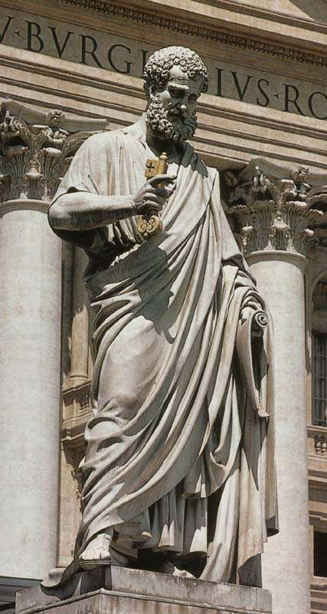
3. Peter Was Not A Pope
Peter was married (Matt. 8:14; 1 Cor. 9:5)
Peter did not permit men to honor him (Acts 10:25-26)
The brethren contended with Peter after he went to Cornelius (Acts 11:1-3)
Paul withstood Peter to his face (Gal. 2:11-13)
Peter and John were sent by the other apostles (Acts 8:14)

Slide 6
4. Miraculous Gifts Were Given By the Laying On of the Apostle’s Hands
This is why Peter and John had come to Samaria (Acts 8:14-15, 17)
This is what Simon saw them doing (v. 18)
This is the power Simon tried to purchase from them (vs. 18-19)
Other Scriptures confirm this truth
Acts 19:6; Rom. 1:11; 2 Tim. 1:6

Slide 7
5. A Saved Man Can Fall From Grace
Peter told Simon he was destined to perish, his heart was not right in the sight of God, he was in the gall of bitterness and the bond of iniquity (Acts 8:20-23).
Simon was saved (vs. 12-13)
Peter told Simon to repent and pray (v. 22)
We can fall from grace (Gal. 5:4)

