Slide 2
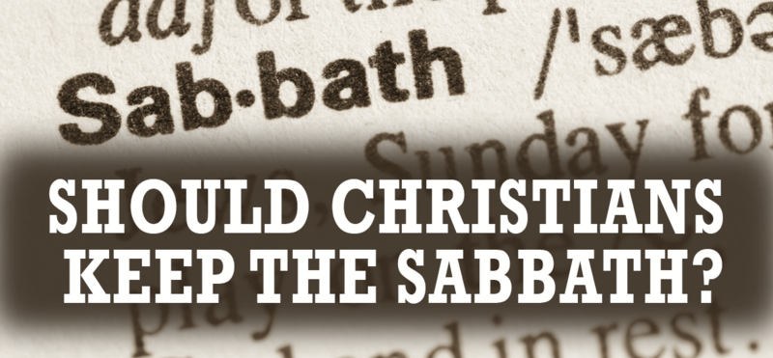

Slide 3
Purpose of the Sabbath Day
From the Hebrew word shabath which means “to cease to do.”
It was to be observed as a memorial of God’s rest after the six days of creation (Ex. 20:8-11).
To be observed as a day of rest for everyone in Israel (Deut. 5:12-14).
It was a time to remember their deliverance from slavery in Egypt (Deut. 5:15).
It was given for the benefit of man (Mark 2:27).

Slide 4
Sabbath Day Observance Was Given To Israel; Not All People
Given as a sign between God and the nation of Israel.
Ex. 31:16-17; Ezek. 20:10-13
Given to help Israel remember their experiences in and deliverance from Egypt.
Deut. 5:15

Slide 5
Sabbath Law Given at Mt. Sinai
The Sabbath was not set apart for man to observe until the Law of Moses was given at Mt. Sinai.
Neh. 9:13-14
If it was commanded to be observed from the time of creation, why don’t we read of Adam, Noah, Abraham, Isaac, or Jacob keeping it?
Deut. 5:1-3
It isn’t mentioned by name until the time of Moses.
Ex. 16:22-30

Slide 6
The Sabbath Day Observance Was Taken Away
All of the Law of Moses was taken out of the way when Jesus died on the cross.
Col. 2:14
It was a part of the law “written and engraved on stones” which has passed away.
2 Cor. 3:7-16
The Old Covenant has been fulfilled and replaced by the new and better covenant.
Heb. 8:6-13

Slide 7
No Distinction Between “Law of Moses” and “Law of God”
Some claim there is a difference between the Law of Moses and the Law of God, which means the Sabbath is still binding today.
The Bible makes no such distinction.
Luke 2:22-24

Slide 8
Christians Are Not To Be Judged By Jewish Laws
Galatians 5:1-4
Keeping one part of the Old Law indebted one to keep the entire law.
Colossians 2:14-17
Since the Law of Moses was taken away at the cross, we are not to let anyone “judge” (condemn) us for refusing to keep any part of that law.

Slide 9
The First Day of the Week
Resurrection of Christ (Mark 16:9).
Jesus met with His disciples (John 20:19, 26).
Events of Pentecost (Lev. 23:15-16, Acts 2).
Spirit poured out, gospel preached for first time as the keys were used to grant admission to the kingdom, church began.
The church assembled (Acts 20:7, 1 Cor. 16:1-2).
John was in the Spirit on “the Lord’s Day” (Rev. 1:10).

