Slide 2
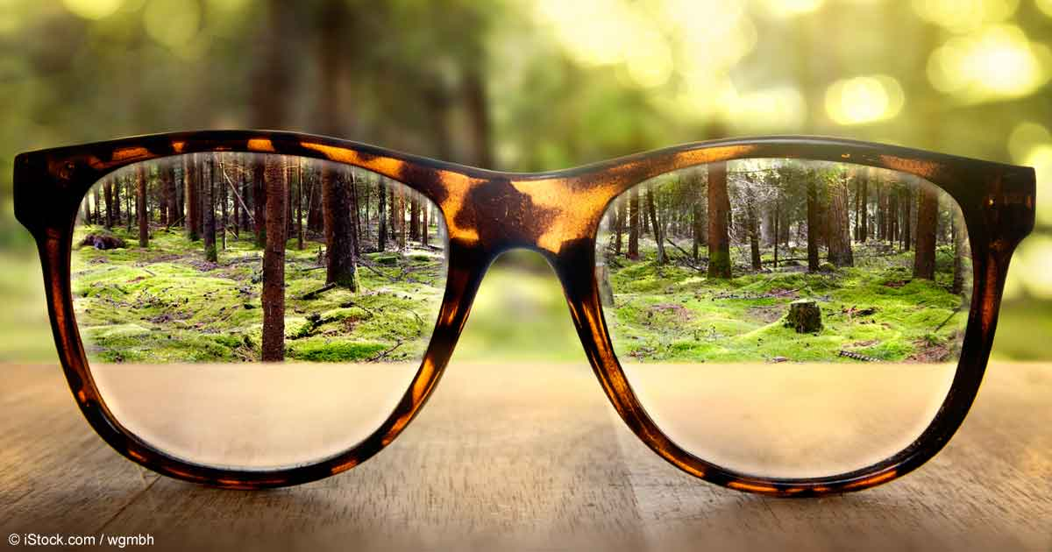
Spiritual Nearsightedness

Slide 3
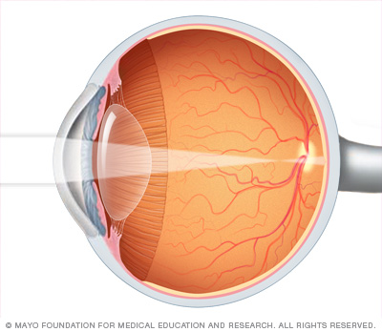
Nearsightedness
“Nearsightedness (myopia) is a common vision condition in which you can see objects near to you clearly, but objects farther away are blurry.”
mayoclinic.org
With normal vision, an image is sharply focused onto the retina. In nearsightedness (myopia), the point of focus is in front of the retina, making distant objects appear blurry.

Slide 4
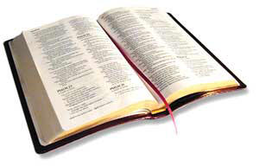
Consequences of Spiritual Nearsightedness
2 Peter 1:8-11
Will be barren and unfruitful!
Will stumble!
Will not be supplied with an entrance into Heaven!

Slide 5
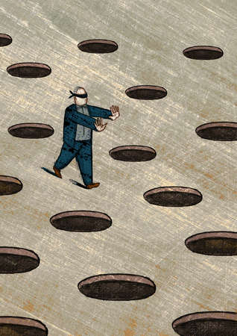
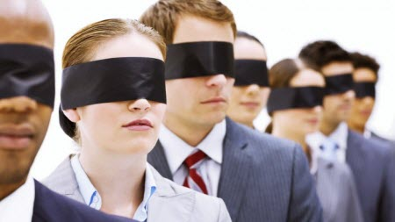
What causes spiritual blindness or shortsightedness?
the devil (2 Cor. 4:4)
How does the devil get us to lose sight of our spiritual goals?
the lust of the flesh
the lust of the eyes
the pride of life
1 John 2:16

Slide 6
Esau Hebrews 12:15-17
Genesis 25:29-34
Esau came in from the field weary and famished, “about to die.”
Jacob made a condition: “sell me your birthright.”
Esau sold his birthright for “one morsel of food” (Heb. 12:16).
He ate, drank, and went his way as if nothing significant had happened. The Bible says he “despised his birthright” (Gen. 25:34).

Slide 7
Esau Hebrews 12:15-17
Esau lost sight of the importance of his birthright because of the lust of the flesh.
He was hungry. He couldn’t imagine anything in the future being more important than satisfying his immediate physical desire.
Some Christians are all too willing to cash in their inheritance to fulfill an immediate lust of the flesh (Heb. 11:24-26).

Slide 8
King David 2 Samuel 11:2-5
David looked and saw a beautiful woman bathing.
This accidental glance turned into a lustful stare.
David acted upon his desire, called for her and committed adultery with her.
She became pregnant. David compounded his sin by trying to cover it up.

Slide 9
King David 2 Samuel 11:2-5
Satan got David to lose his focus through the lust of the eyes.
David “blindly” pursued what he saw and he paid dearly for it (Prov. 7:21-23).
We can’t help what we see, but we can help what we stare at (Job 31:1, 9-12).
pornography, people enjoying money, power, etc.

Slide 10
Can’t you see what you have to do in order to be saved?
Believe
Repent
Confess
Baptized
John 8:24
Luke 13:3
Rom. 10:9-10
Mark 16:16

