Slide 2
Ready With An Answer
1 Peter 3:15

Slide 3
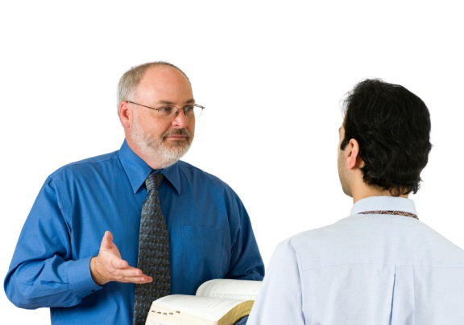
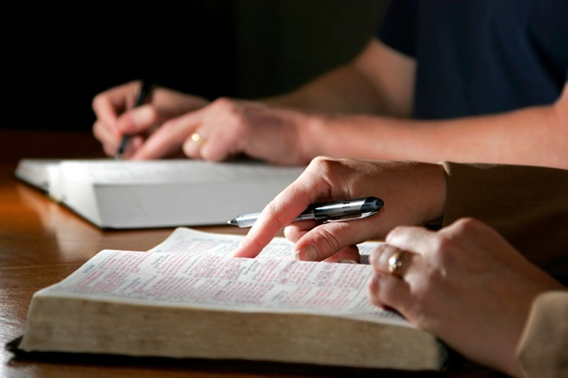
“But sanctify the Lord God in your hearts, and always be ready to give a defense to everyone who asks you a reason for the hope that is in you, with meekness and fear.”
1 Pet. 3:15, NKJV

Slide 4
1. Sanctify the Lord in Our Hearts
“to consecrate or set apart”
We must set the Lord upon the throne of our heart and make Him the center of our life.

Slide 5
2. Always Be Ready
Readiness requires preparation:
2 Tim. 2:15; 2 Pet. 3:18; Heb. 5:12-14
Such preparation will strengthen our faith and give us confidence.

Slide 6
3. To Give a Defense
Be ready to give a reasoned, intelligent explanation regarding the things we believe or practice.
This explanation must be based upon the Word of God, not our ideas or opinions.

Slide 7
4. To Everyone Who Asks You
We must be ready and willing to answer anyone who asks. The gospel is for all.
However, some questions and people are not deserving of an answer.
1 Tim. 6:3-5; Matt. 7:6

Slide 8
5. A Reason for the Hope in You
The nature, object, and basis of our hope:
1 Peter 1:3-4

Slide 9
5. A Reason for the Hope in You
The existence of God
The inspiration of the Bible
The deity of Christ
Why we believe in Heaven and Hell
What one must do to be saved
Why we do not use musical instruments

Slide 10
6. With the Proper Attitude
Meekness
Fear
Good Conscience

