Slide 2
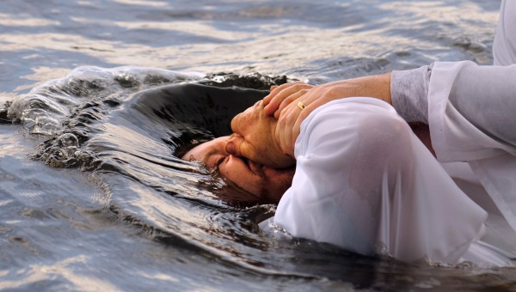
He who believes and is baptized will be saved. Mark 16:16

Slide 3
1 + 1 = 2
1 and 1 = 2
Blue + Red = Purple
Blue and Red = Purple
Believes + Baptized = Saved
Believes and Baptized = Saved
Believes and accept Jesus as Savior = Saved

Slide 4
It’s Commanded
Jesus commanded baptism
Matthew 28:18-20; Mark 16:15-16
The apostles commanded baptism
Acts 2:38, 10:48

Slide 5
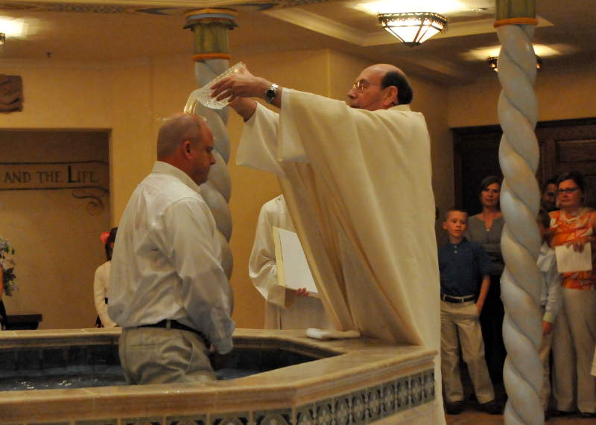
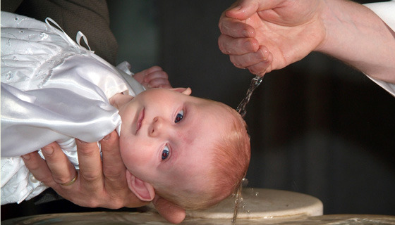
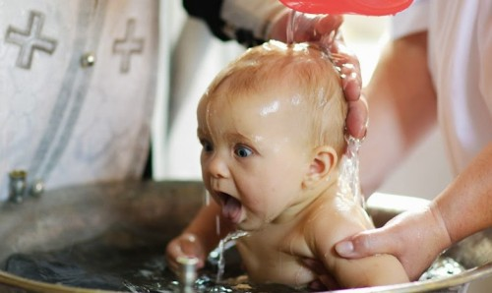
The Mode
It involves water
Acts 8:35-38; 10:47-48; John 3:5; Titus 3:5
It involves a burial
Romans 6:4; Colossians 2:12

Slide 6
Necessary prior actions
Must believe in Jesus
Mark 16:16; Romans 1:16; Acts 8:36-37
Must have repented of sins
Luke 24:47; Acts 2:38
Must confess belief in Jesus
Acts 8:37; Romans 10:9
BelIEVE + Repent + CONFESS

Slide 7
Purpose
For the remission of sins
Acts 2:38, 22:16; Ephesians 1:7
To be united with Christ
Romans 6:3,5; Galatians 3:26-27
To have newness of life
Romans 6:4; Colossians 2:12-13; Titus 3:5
To be saved
Mark 16:16; 1 Peter 3:21

Slide 8
Is it necessary?
Consider the examples of conversion, found in the book of Acts illustrating the preaching of the gospel, telling what people were told, what they did.
In every example, people were baptized! Baptism was the culmination of responding in faith!

Slide 10
Its result
Receive remission of sins (Acts 2:38)
Sins are washed away (Acts 22:16)
United with Christ (Romans 6:3-6)
Clothed with Christ (Galatians 3:27)
Made alive with Christ (Colossians 2:12-13)
Washing of regeneration and renewing of the Holy Spirit (Titus 3:5)
Make an appeal for a good conscience (1 Peter 3:21)

Slide 11
What is your condition without baptism?
Mark 16:16 "He who believes and is baptized will be saved;
but he who does not believe will be condemned."

