Slide 2
Freedom in Christ
“Stand fast therefore in the liberty by which Christ has made us free…”
Galatians 5:1

Slide 3
Christ Has Set Us Free From…
Sin - John 8:31-36; Rom. 6:17-18
Ignorance - Gal. 4:8-11; John 18:37
Error/False Religion - Col. 2:16-23
Traditions of Men - Gal. 1:14; Mark 7:6-13; 1 Pet. 1:18-19

Slide 4
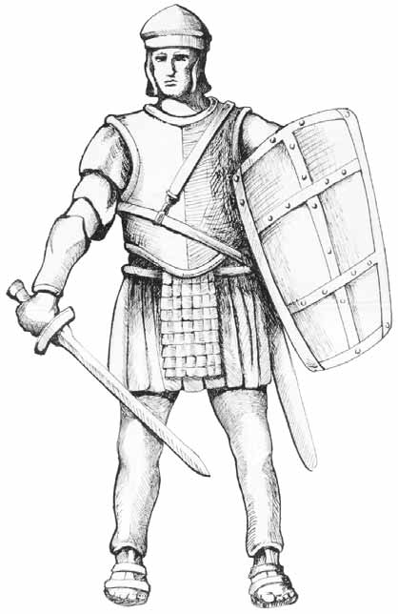
What We Are To Do With This Freedom
“Stand Fast”
To be stationary, to keep one’s standing, to persevere.
1 Cor. 16:13, 15:58
Ephesians 6:10-17

Slide 5
Why Stand Fast In Our Freedom?
Christ Died For Us - Rom. 5:6-10
Freedom Cannot Be Found Any Other Way - John 8:36; Acts 4:12
We Are Children of the “Free Woman” - Gal. 4:21-31
We Can Become Entangled Again - Gal. 5:1

Slide 6
How To Be Set Free From Sin
Believe in Jesus - John 8:36
Repent of your sins - Acts 17:30
Confess your faith - Romans 10:9-10
Be Baptized - Mark 16:16

