Slide 2
The Role of the Family in the Local Church

Slide 3
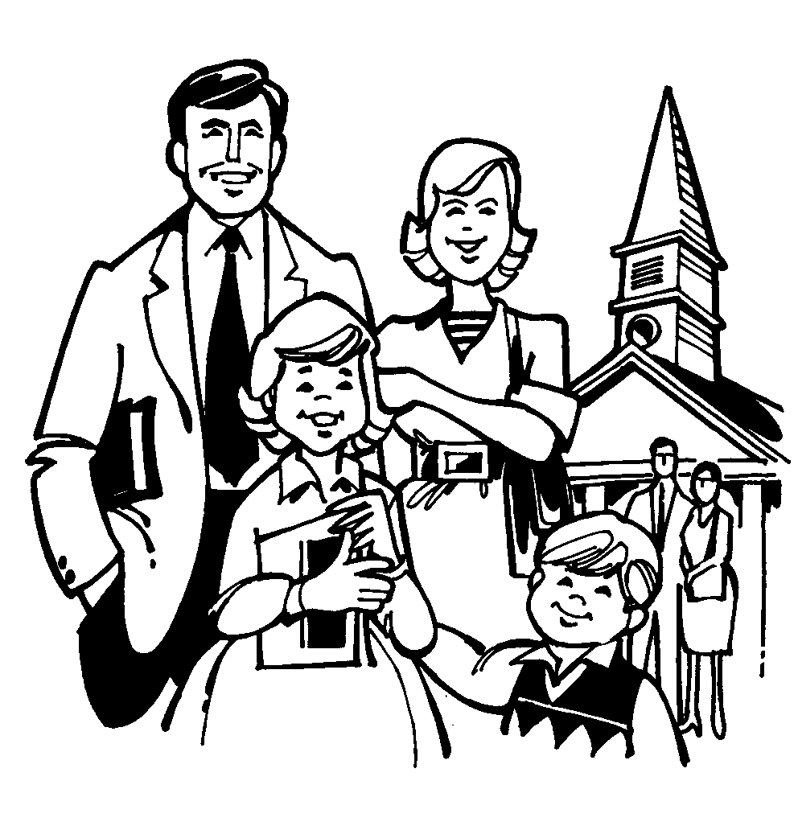
The Family and the Local Church
Contribute to the Work and Worship of the Church
Visitation
Hospitality
Evangelism
Qualify Elders and Deacons

