Slide 2
suicide
A Biblical Perspective and Appeal

Slide 3
“Suicide” and the Bible
The word “suicide” does not appear in the Bible, but there are a few occurrences:
King Saul - 1 Sam. 31:4-5
King Zimri - 1 Kings 16:18-19
Judas Iscariot - Matt. 27:3-7
None of these are positive examples of godly people resolving their problems.

Slide 4
Things Contributing To Suicide Epidemic
Devaluation of Human Life
Glamorization of Suicide
Drugs and Alcohol
Unfair Expectations
Overemphasizing Relationships
False Philosophies and Religious Doctrines
Cultural Practices

Slide 5
The Sacredness of Human Life
We have been specially made in the image of God - Gen. 1:26-27
Life is to be respected, not destroyed - Gen. 9:6
Our life is not our own. It belongs to God - 1 Cor. 6:19-20

Slide 6
Suicide Robs Man of the Opportunity to Repent
Repentance is essential if we are to receive forgiveness of sins - Acts 2:38, 8:22, 17:30
The opportunity to repent is a gift from God - 2 Peter 3:9
Godly sorrow produces repentance - 2 Cor. 7:8-10

Slide 7
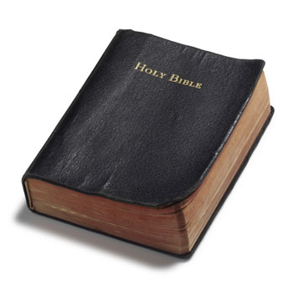
A Biblical Appeal
The Bible addresses and even answers many of the common reasons some give for wanting to end their lives.

Slide 8
“The Pain is Too Much”
Job felt this way - Job 3:1, 11-13, 16-17
We see Job’s life as a complete picture, but he faced it in the moment.
We must learn to look beyond the present pain to see our life as a series of events - both good and bad.

Slide 9
“I Want To Run Away”
King David felt this way - Ps. 55:4-7
Running away from this life may appear to be an attractive option, but it is not the way a faithful child of God handles his problems.
“Cast your burden on the Lord, and He shall sustain you; He shall never permit the righteous to be moved” (v. 22).

Slide 10
“This Is Not How I Wanted Things To Turn Out”
Jonah felt this way - Jonah 4:1-3
Things in life do not always turn out the way we think they should. Life does not revolve around us.
Jonah was angry. Decisions made in anger are often regretted; suicide is a permanent decision.

Slide 11
“I Can’t Do Anything Right”
Elijah felt this way - 1 Kings 19:4
Life consists of moments of success and failure - neither of which define who we truly are.
Our character is shown in the way we choose to respond to moments of failure.

Slide 12
“This Is Too Much For Me To Handle”
Moses felt this way - Numbers 11:11-15
Moses was overwhelmed and had lost hope.
God gave Moses seventy men to help him with this task (v. 16).
God has given us brethren and friends to help us (Gal. 6:2).

