Slide 2
Studies in the
Sermon on the Mount

Slide 3
The Danger of Self-Deception
Matthew 7:21-23

Slide 4
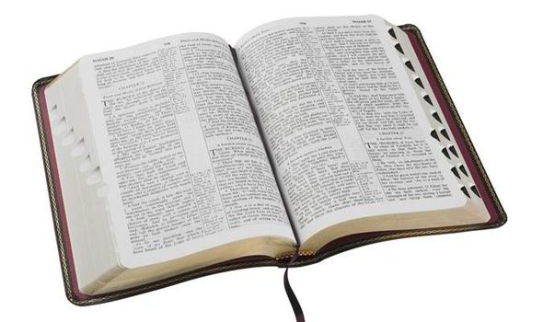
Entrance Requires Obedience
“Not everyone who says to Me, ‘Lord, Lord,’ shall enter the kingdom of heaven, but he who does the will of My Father in heaven” (Matthew 7:21).
Luke 6:46
James 1:21-22
1 Peter 1:22
Hebrews 5:9

Slide 5
The Tragedy of Self-Deception
“Many will say to Me in that day, ‘Lord, Lord, have we not prophesied in Your name, cast out demons in Your name, and done many wonders in Your name?’ And then I will declare to them, ‘I never knew you; depart from Me, you who practice lawlessness!’”
Matthew 7:22-23

Slide 6
The Tragedy of Self-Deception
There is no substitution for true obedience (1 Samuel 15:20-23).
King Saul did his own will, obeying the parts he wanted to obey.
What Saul called “obedience” God called “stubbornness” and “rebellion.”
We prevent self-deception with honest self-examination (2 Cor. 13:5).

Slide 7
Are We Known By the Lord?
“I Never Knew You”
2 Tim. 2:19; Matt. 18:3
“Depart From Me”
Matt. 25:41
“You Who Practice Lawlessness”
1 John 3:4; Matt. 23:27-28

