Slide 1
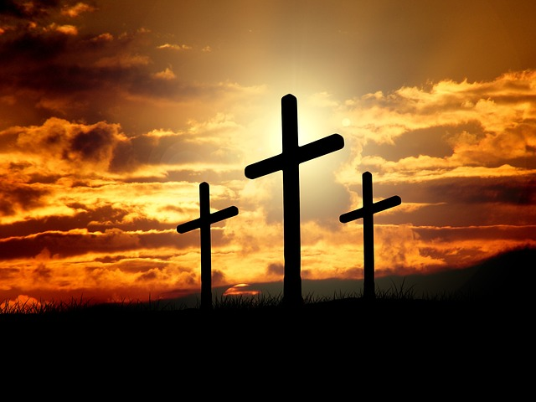
The Glory and The Shame

Slide 2
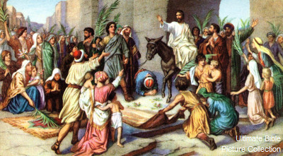
The Glory
His Triumphal Entry- Mt. 21:1-11
Jesus demonstrates His omniscience v1-3
Fulfillment of prophecy v4-5
Treated as a King v6-9
The colt (Mk. 11:2, Lk. 19:30)
Disciples clothes laid on the colt, then Jesus placed on the colt
Multitude lay their clothes and palm branches on the road
Multitude praised and worshipped Jesus (Lk. 19:37-40)
Recognized as a prophet
(Jn. 12:17-18)

Slide 3
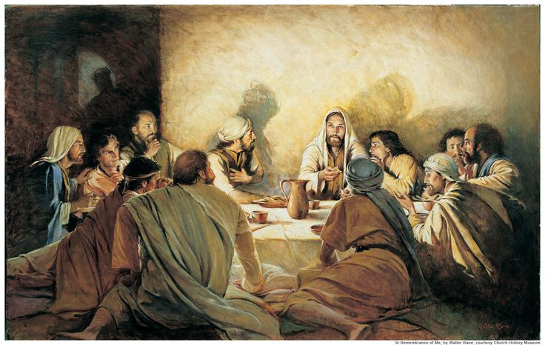
The Glory
Other prophecies fulfilled
Fulfillment of God’s Plan- 1 Pt. 1:19-21
Before the world existed
Jesus institutes the Lord Supper- Mt. 26:26-30
Gives a way for man to honor Him after His death
 | Where it was prophesied | Where it was fulfilled
Betrayal | Ps. 41:9, Ze. 11 | Mt. 26 & 27
Cast Lots | Ps. 22:18 | Mt. 27:35, Jn. 19:24
Numbered with transgressors | Is. 53:12 | Mk. 15:28
World's Hatred | Ps. 69:4 | Jn. 15:18-25
Bones not broken | Ex. 12:46, Nu. 9:12, Ps. 34:20 | Jn. 19:36

Slide 4
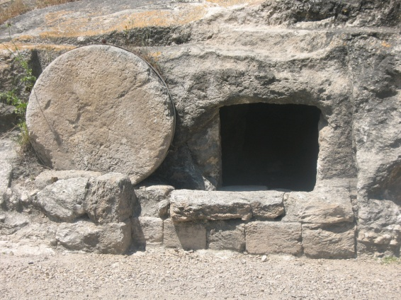
The Glory
Events after Jesus’ death
Immediately after
Earthquake, temple veil torn, rocks split, and graves open and dead raised- Mt. 27:45-55
Joseph of Arimathea prepares Jesus’ body and buries Jesus-Mt. 27:57-61
Three days later
Earthquake, angel of the Lord descended and roll back the stone- Mt. 28:2-3
Revealed the empty tomb- Mt. 28:5-6
As the Angel said, Jesus meets women and disciples on the road to Galilee- Mt. 28:7-10, Mk. 16:9-13, Lk. 24:13-27
Jesus is risen-victory over death- Ac. 2:22-36,
Mk. 16:19
Brought salvation to man- Ro. 5:6-11

Slide 5
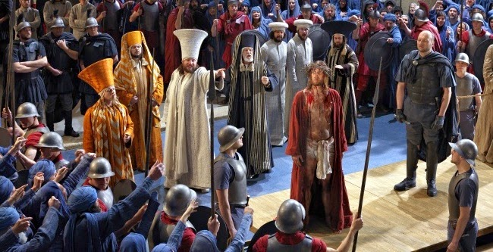
The Shame
Events up to Jesus’ crucifixion- Mt. 26-28
Plotted against by chief priests, scribes, and elders-26:1-5
Anointing at Bethany by poor woman-26:6-13
Betrayed by Judas-26:14-16, 21-25, 47-56, 27:3-10
Denied by Peter-26:31-35, 69-74
Accused of blasphemy-26:57-66
Verbally and physically abused-
Spat on and beat 26:67, 27:30-31
Mocked 26:68, 27:29, 39-44
Scourged 27:26
Robe, crown of thorns, and reed placed on Him 27:27-29
Stripped of the robe 27:31
Crucified 27:35

Slide 6
The Shame
Unfairly Tried-
Caiaphas and the Sanhedrin council- Mt. 26:57-68
Pilate- Mt. 27:11-14, 15-25, Lk. 23:1-5, 13-25
Herod- Lk. 23:6-12
Jesus’ Crucifixion-
An innocent man crucified on the cross, punished as a criminal- Mt. 27:35, Is. 53:9
Hung between two robbers- Mt. 27:38
Verbal abuse from crowd and robbers- Mt. 27:39, 44
Post Crucifixion-
Pharisees request Jesus’ tomb be sealed & guarded- Mt. 27:62-66
Jesus rebukes His 11 apostles due to unbelief- Mk. 16:14

Slide 7
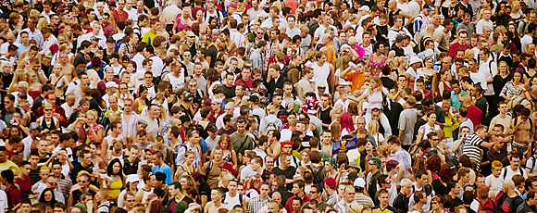
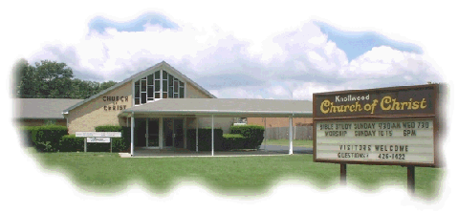
How do we bring shame to Jesus today?
The world
Shame poured on the cross
Sneer at blood atonement
Mock at the idea of innocent dying
for the guilty
Shame placed on God’s design and plan
Creation
Marriage
Plan of salvation
Eternal destination
Us
Set our minds on worldly things- Ph. 3:17-19
Continuing in sin- He. 10:26, Ja. 4:17
Half hearted service- Re. 3:14-16, Ec. 9:10
Hypocritical conduct- Mt. 23, I Jo. 1:6
Do what we choose, not what the Bible tells us- Pr. 1:22-31, Ro. 1:18-32
Not partaking of the Lord Supper properly- I Co. 11:27-29
Not spreading the gospel- Mt. 28:18-20

Slide 8
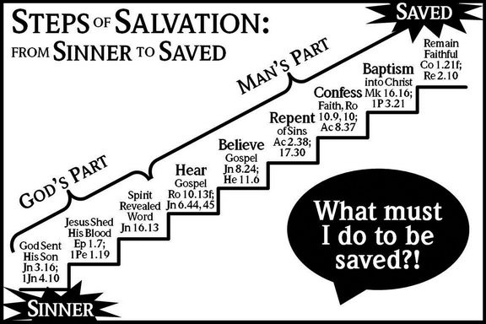
How do we bring glory to Jesus today?
Deny self (pride)- Mt. 16:24, Lk. 9:23-24, Ga. 2:20
Help Others- He. 13:16, 1 Jn. 3:17
Spread the gospel- Mt. 28:18-20, Ro. 1:16, 10:13-14
Let your light shine- Mt. 5:14-16, Ph. 2:15-16
Worship Him- Lk. 4:8, He. 12:28-29
Obey His word- Jn. 14:21, Lk.11:28
Hear- Ro. 10:17
Believe- Mk. 16:16
Repent-Ac. 2:38
Confess- Ro. 10:9-10
Baptized- Mk. 16:16
Live faithfully- Re. 2:10

