Slide 2
Studies in the
Sermon on the Mount

Slide 3
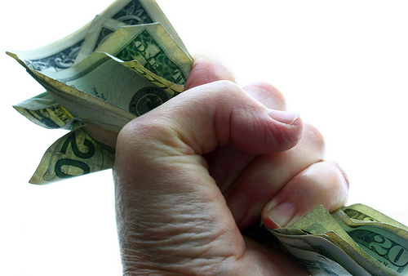
Materialism
Matthew 6:19-34

Slide 4
What is Materialism?
“an outlook on life leaving God out or making Him secondary to this material world. It casts man’s spiritual nature into second place and his physical desires into first” (Randy Blackaby, “Blessed To Bless,” p. 53).
A preoccupation or stress upon the material rather than the intellectual or spiritual.
The concept that life’s highest value is to be achieved in material pursuits and progress.

Slide 5
The Christian’s Priorities
Matthew 6:19-21
The “treasure” in this passage is that which we value above all other things; the supreme focus of man’s heart.

Slide 6
The Christian’s Priorities
Physical things are subject to theft and decay.
Material possessions can be taken from us (Prov. 23:4-5).
They bring no lasting satisfaction (Eccl. 5:10-12).
We are not to trust in uncertain riches, but in God (1 Tim. 6:17).

Slide 7
The Christian’s Priorities
To lay up treasures in heaven…
Is to submit oneself completely to that which is in heaven – the rule and authority of God.
It is a life-long pursuit of spiritual things.

Slide 8
The Christian’s Outlook
Matthew 6:22-23
Jesus warned against the deceitfulness of riches (Matt. 13:22).
Materialism gives one…
A distorted sense of worth and security.
A distorted view of life – material things matter most.
A distorted view of people – their worth is determined by their wealth.

Slide 9
The Christian’s Loyalty
Matthew 6:24
The word for “serve” comes from the Greek term for “slave.”
“Mammon” was the common Aramaic word for wealth.
No man can be a slave to two owners. Total loyalty cannot be divided between two masters.

Slide 10
The Christian’s Peace
Matthew 6:25-34
Worry over material things is a subtle but legitimate form of materialism.
Some people aspire to wealth, while others are in terror of poverty. Both individuals are equally governed by materialism.
Satan does not care whether we are consumed by greed or by worry – just so long as we are focused on material things and not on God.

Slide 11
“Do Not Worry”
God gave us life; we can trust Him to sustain our life.
God cares for the most humble of His creations, we are more valuable than birds and flowers.
Worrying is what the Gentiles do.
Worry is a thief.

Slide 12
“Do Not Worry”
“But seek first the kingdom of God and His righteousness, and all these things shall be added to you.”

Slide 13
The Bitter Fruits of Materialism
We wastefully invest our lives on things that will not last.
We are blinded to spiritual realities and priorities.
We are rendered incapable of properly serving God.
We are robbed of our peace; worrying about things we don’t have.

