Slide 2
Studies in the
Sermon on the Mount

Slide 3
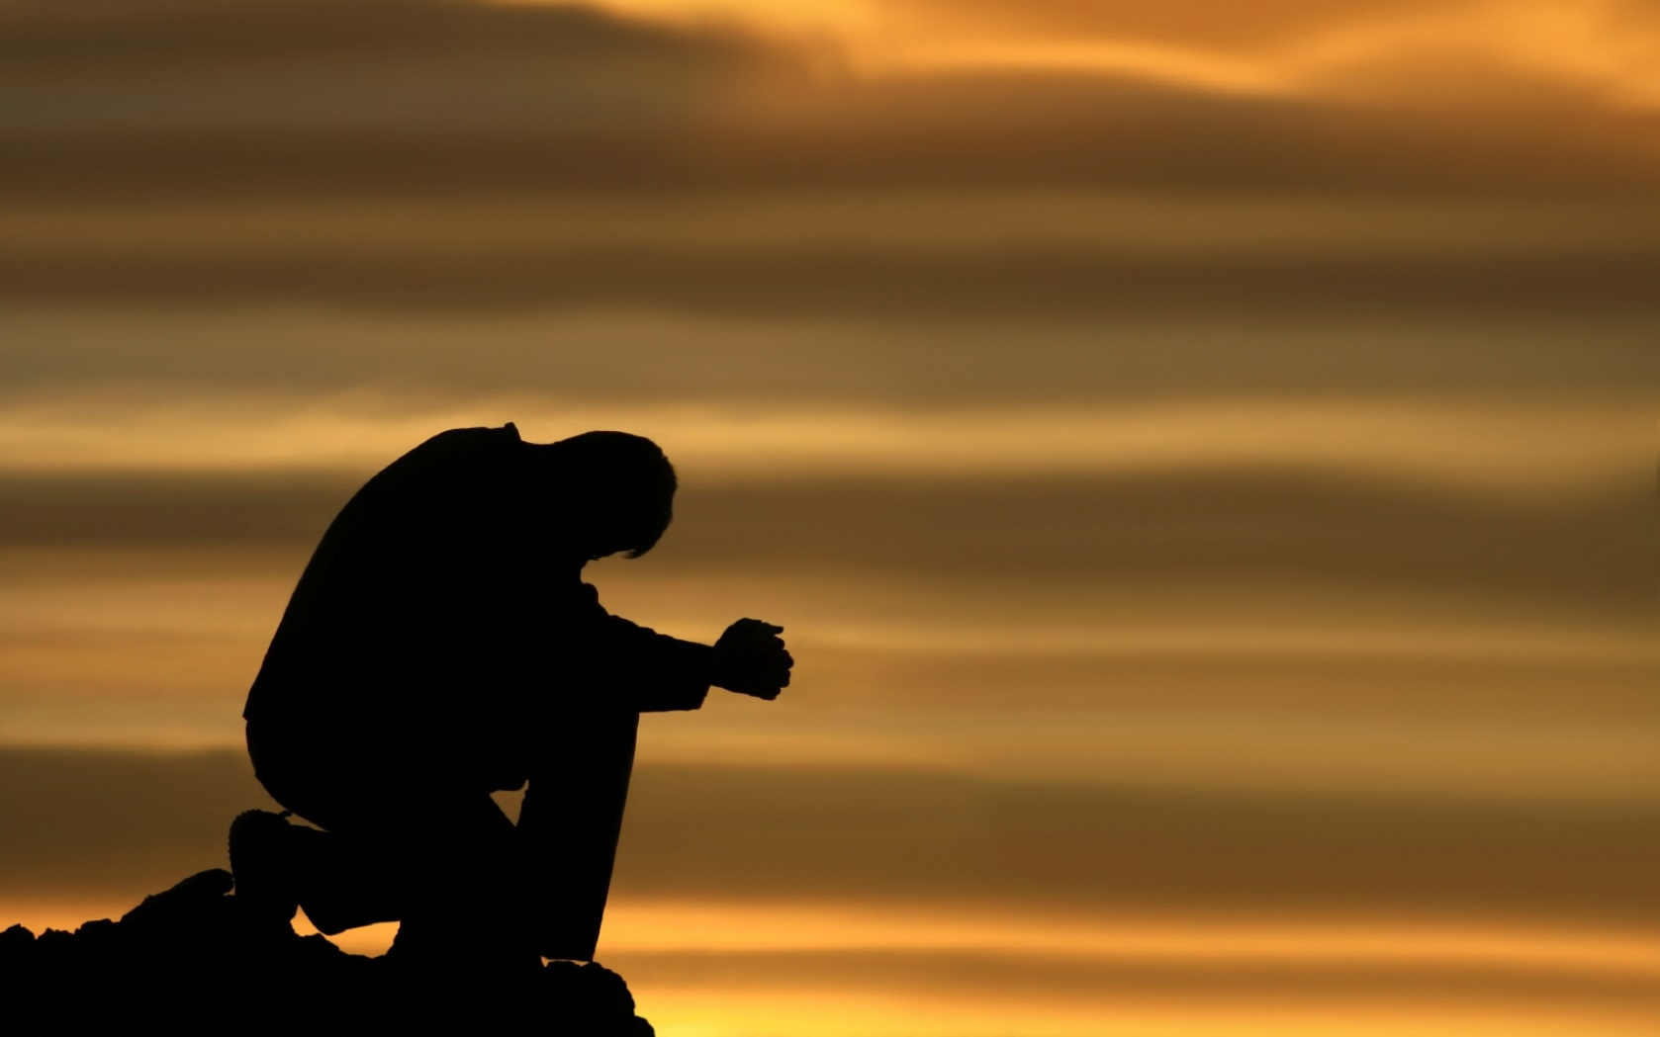
The Lord’s Prayer
Matthew 6:9-13

Slide 4
Praise
v. 9
“After this manner therefore pray ye:
Our Father which art in heaven,
Hallowed be thy name.”
This prayer is a model used by Jesus to teach His disciples how to pray.
We are to address our prayers to God the Father.
We are to praise and reverence God’s authority.

Slide 5
Praise
v. 10
“Thy kingdom come.
Thy will be done in earth, as it is in heaven.”
The kingdom is the rule or sovereignty of God.
Our prayers should concern and honor God’s will.
The kingdom has come, but we can pray for its increase upon the earth.

Slide 6
Petition
v. 11
“Give us this day our daily bread.”
“bread” – all physical blessings.
“give us” – recognizes God as the source of all such blessings.
“daily” – we need to learn to depend upon God on a daily basis (Exodus 16).

Slide 7
Confession
v. 12
“And forgive us our debts, as we forgive our debtors.”
“And forgive us our sins; for we also forgive every one that is indebted to us…” Luke 11:4
Our sins place us in debt to God; a debt we cannot pay.
To forgive is “to send away;” to cancel our debt.
Our forgiveness is dependent upon our willingness to forgive others (vs. 14-15).

Slide 8
Guidance
v. 13 a
“And lead us not into temptation,
but deliver us from evil:”
God’s word gives us needed guidance (Psalm 119:105).
God is in control (Job 1:10-12; 2:3-6).
God provides a way of escape (1 Cor. 10:13). We must take it!

Slide 9
Praise
v. 13 b
“For thine is the kingdom, and the power, and the glory, for ever.
Amen.”
Prayer needs to be “bookended” with an acknowledgement of the authority of God.
Despite what is happening in our lives or in the world today – God’s rule, power, and glory will last forever!

