Slide 2
The Blessings of Being A Christian
Romans 5:1-5

Slide 3
1. We Are Justified By Faith
“To render just or innocent” (Strong’s)
“Justification is the legal and formal acquittal from guilt by God as Judge, the pronouncement of the sinner as righteous” (Vine’s)
Romans 3:23-36

Slide 4
2. We Have Peace With God
Sin separates us from God and causes us to be enemies of God (Is. 59:1-2; Col. 1:20-22).
We can rejoice in this peace as we look towards eternity.
We can also rejoice in the peace we presently have with God (Ps. 32:3-4).

Slide 5
3. We Stand in the Grace of God
This “grace in which we stand” is being in a saved state or in a state of favor with God (Eph. 2:18).
Outside of this grace one had “no hope” (Eph. 2:11-13).

Slide 7
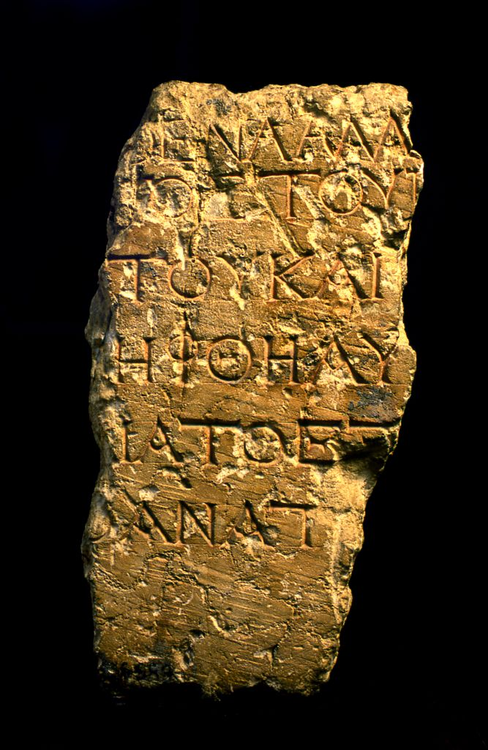
“No foreigner may enter within the balustrade around the sanctuary and the enclosure. Whoever is caught, on himself shall he put blame for the death which will ensue.”

Slide 8
19 Therefore, brethren, having boldness to enter the Holiest by the blood of Jesus, 20 by a new and living way which He consecrated for us, through the veil, that is, His flesh, 21 and having a High Priest over the house of God, 22 let us draw near with a true heart in full assurance of faith, having our hearts sprinkled from an evil conscience and our bodies washed with pure water.
Hebrews 10:19-22
“No foreigner may enter within the balustrade around the sanctuary and the enclosure. Whoever is caught, on himself shall he put blame for the death which will ensue.”

Slide 9
4. We Have Hope in Our Lord’s Return
Hope is a combination of desire and expectation.
“favorable and confident expectation” (Vine’s)
“expectation of good… in the Christian sense, joyful and confident expectation of eternal salvation” (Thayer).

Slide 10
4. We Have Hope in Our Lord’s Return
The “hope of the glory of God” is the hope of our Lord’s Second Coming.
Matthew 16:27, 25:31
Luke 9:26
Romans 8:18
2 Thessalonians 1:7-10

Slide 11
5. We See A Purpose in Our Suffering
Tribulations: The pressures of this life which come upon Christians.
Perseverance (NKJV, NASB), patience (KJV), endurance (ESV): The Christian’s staying power. The willingness and ability to keep on keeping on.
Character (NASV, ESV) experience (KJV), proven character (NASB): Refers to one who can be trusted because he has proven his character through the experiences of his life.
Hope: As we experience trials in light of God’s will and promises to help us, we have greater hope in that which is yet to come.

Slide 12
6. Our Hope Does Not Disappoint
“And hope maketh not ashamed” (KJV)
“and hope does not put us to shame” (ESV)
Because it is grounded upon God’s love for us (Rom. 5:6-8).

Slide 13
Reasons To Become A Christian Romans 5:1-5
We are justified by faith!
We have peace with God!
We stand in the grace of God!
We have hope in our Lord’s return!
We see a purpose in our suffering!
Our hope does not disappoint!

Slide 14
Become a Christian Today!
Believe in Jesus - John 8:24
Repent - Luke 13:3
Confess - Matthew 10:32
Be Baptized - Mark 16:16

