Slide 2
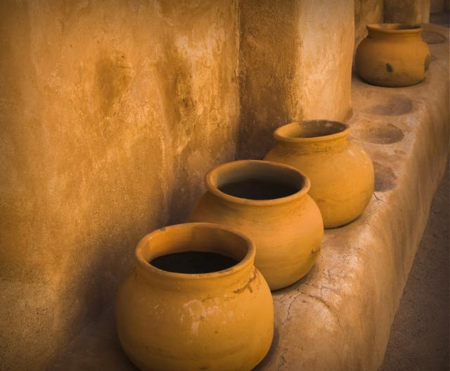
Jesus Turns Water Into Wine
John 2:1-11

Slide 3
Lessons From This Miracle
Jesus Attended Social Gatherings and Festive Events
Jesus Sanctioned and Honored Marriage
Mary Has No Special Influence or Authority Over Jesus

Slide 4
Lessons From This Miracle
Jesus Attended Social Gatherings and Festive Events
Jesus Sanctioned and Honored Marriage
Mary Has No Special Influence or Authority Over Jesus
Mary “is also the Advocate of the whole human race… for she can do what she will with God.”
“We often obtain more promptly what we ask by calling on the name of Mary, than by invoking that of Jesus.”
Alphonse de Liguori, The Glories of Mary, pp. 193, 248

Slide 5
Lessons From This Miracle
Jesus Attended Social Gatherings and Festive Events
Jesus Sanctioned and Honored Marriage
Mary Has No Special Influence or Authority Over Jesus
Mary actually verified the absolute authority of Jesus.
“Whatever He says to you, do it” (John 2:5).
Mary “is also the Advocate of the whole human race… for she can do what she will with God.”
“We often obtain more promptly what we ask by calling on the name of Mary, than by invoking that of Jesus.”
Alphonse de Liguori, The Glories of Mary, pp. 193, 248

Slide 6
Lessons From This Miracle
Jesus Attended Social Gatherings and Festive Events
Jesus Sanctioned and Honored Marriage
Mary Has No Special Influence or Authority Over Jesus
This Miracle Says Several Important Things About Jesus

Slide 7
What This Miracle Says About Jesus
Displays His absolute power over matter.
He didn’t say or do anything, the water simply changed into wine!
It was done immediately.
It was done perfectly.
The wine Jesus made was better (v. 10).

Slide 8
What This Miracle Says About Jesus
Jesus can supply what is lacking.
Phil. 4:19; Matt. 6:33; Col. 2:9-10
Jesus will always change us for the better.
1 Cor. 6:9-11; 1 Thess. 1:9; 1 Tim. 1:13-15

Slide 9
Lessons From This Miracle
Jesus Attended Social Gatherings and Festive Events
Jesus Sanctioned and Honored Marriage
Mary Has No Special Influence or Authority Over Jesus
This Miracle Says Several Important Things About Jesus
This Was Our Lord’s First Miracle

