Slide 2
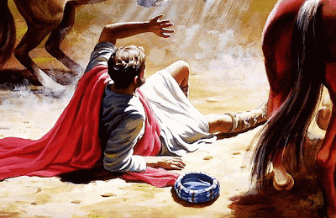
The Conversion of Saul
Acts 22:1-16

Slide 3
1. People Can Change
Saul was the chief of sinners
Acts 26:9-11; Gal. 1:13
1 Tim. 1:12-16
Saul was entrenched in religious error
Gal. 1:14; Phil. 3:5-7

Slide 4
2. Sincerity Alone Is Not Enough To Save Us
The world says, “It doesn’t matter what one believes or thinks, as long as he is sincere.”
Saul was sincere when he persecuted the church: Acts 23:1, 26:9
It does matter what one thinks and believes… and does: Matt. 7:21-23

Slide 5
3. The Sinner’s Prayer
Saul was praying: Acts 9:10-11

Slide 6
3. The Sinner’s Prayer
Saul was praying: Acts 9:10-11
“Lord Jesus, I believe you are the Son of God and that you died on the cross for my sins. I invite you to come into my heart and to be my Lord and Savior. From this moment on I commit my life to you. Amen”

Slide 7
3. The Sinner’s Prayer
No alien sinner was ever told to “pray through” for his salvation.
Cornelius prayed, and God heard it, but he was not saved: Acts 10:4-6
Prayer for the forgiveness of sins is a privilege given to the child of God, but it is not something we must do in order to be saved.

Slide 8
4. Was Saul Saved On the Road To Damascus?
There was no rejoicing: Acts 9:9
There was no peace: Rom. 5:1
He was still in his sins: Acts 22:16
He was saved without calling on the name of the Lord: Acts 2:21, Rom. 10:13
He was sent into Damascus to be told what he must do: Acts 9:6

Slide 9
Lessons From Saul’s Conversion
People can change.
Sincerity alone will not save anyone.
No man is saved with the “Sinner’s Prayer.”
Saul was not saved on the road to Damascus. He was saved when he called on the name of the Lord (was baptized).

