Slide 1
*What Brings the Most Joy in Your Life?
When We Find That Joy, We Want NOTHING To Take It Away From Us…

Slide 2
My joy…

Slide 3
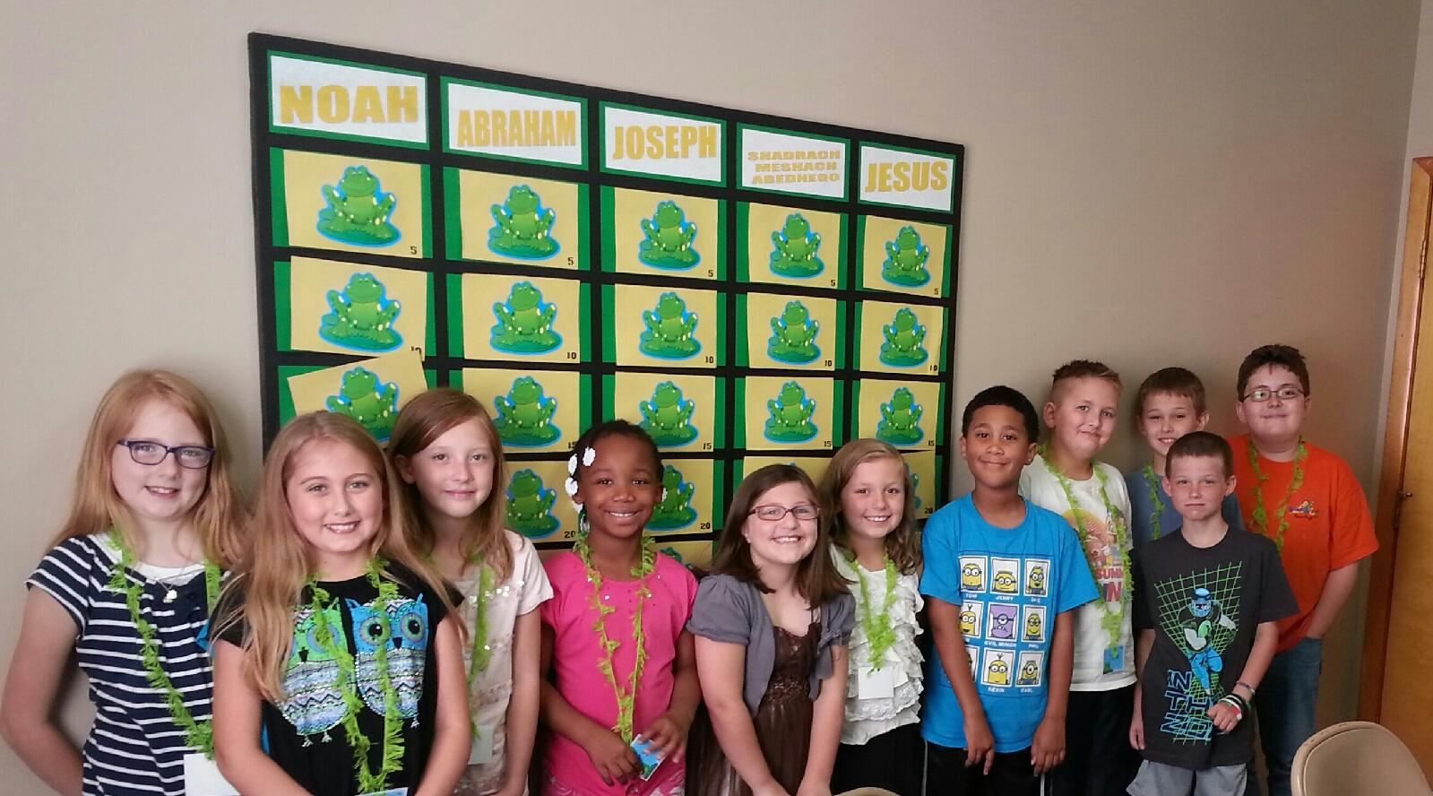
What is your joy…

Slide 4
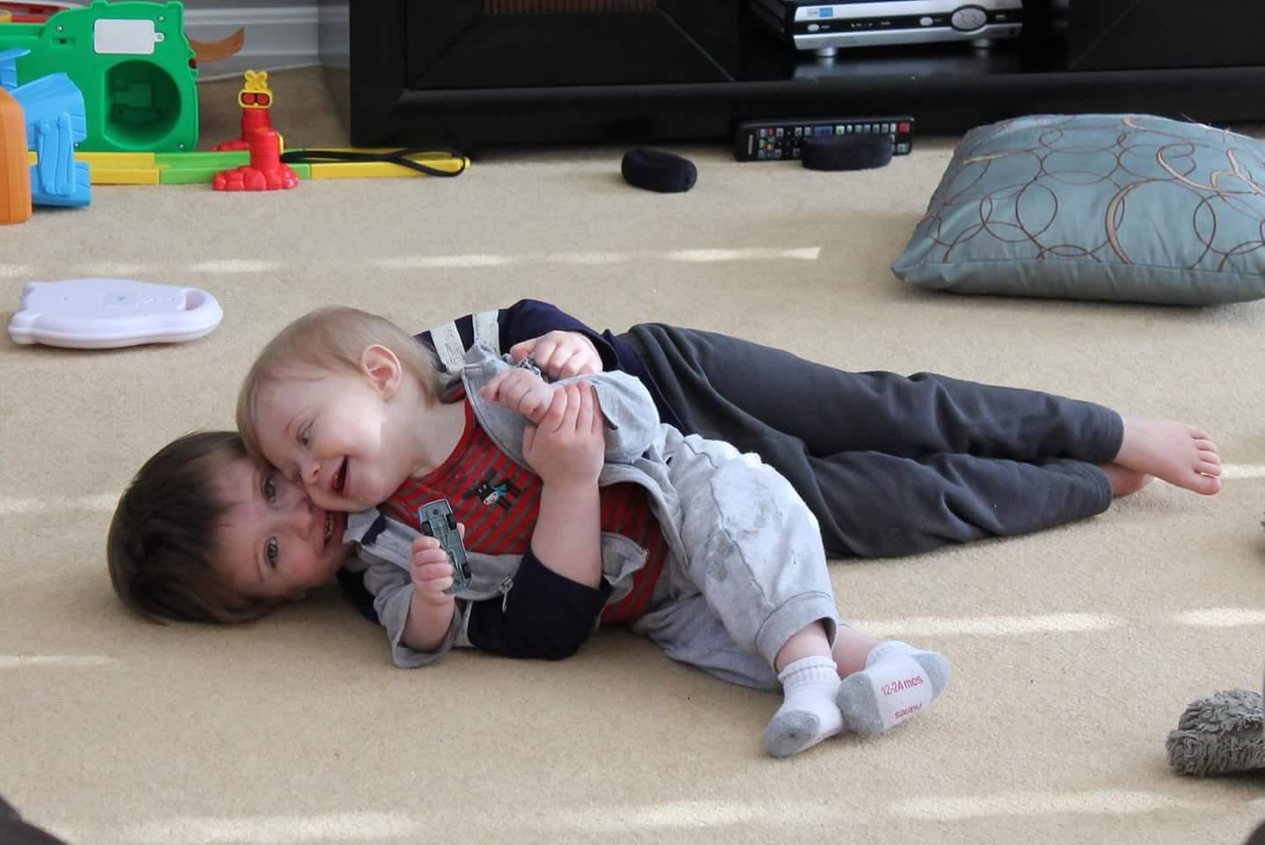
What is your joy…

Slide 5
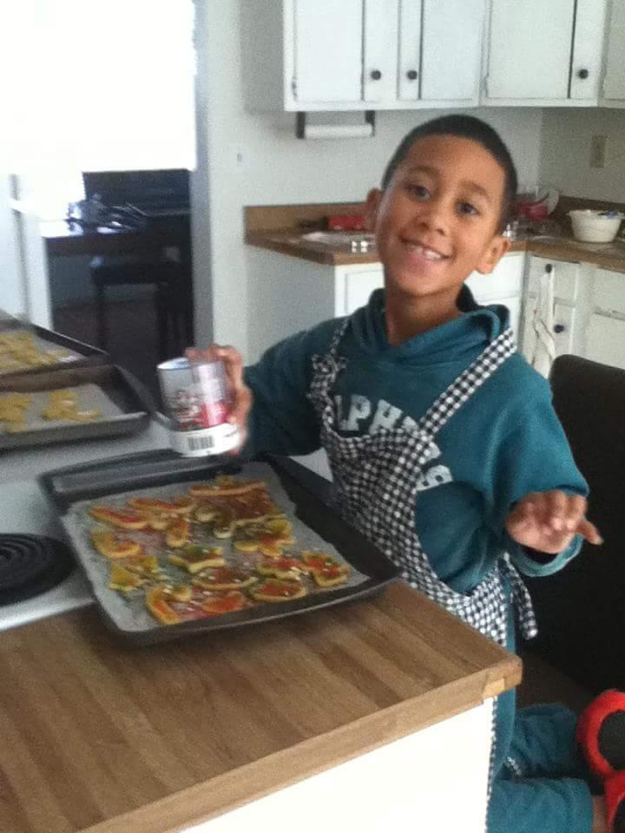
What is your joy…

Slide 6
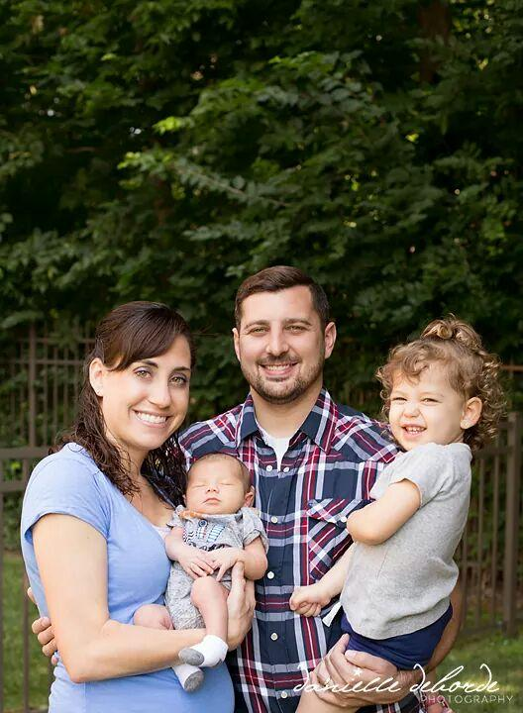
What is your joy…

Slide 7
What is your joy…

Slide 8
What is your joy…

Slide 9
*What Brings the Most Joy in Your Life?
How Do We Keep That Joy In Our Lives?
What Are You Going To Do?
Be The Example
Take An Active Part In Their Life
Teach Them To Love…
How Shall the Young Secure Their Hearts?

Slide 10
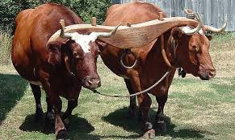
*Separate Yourselves:
Places / People of Sin-
2 Cor. 6:14 – Be ye Not unequally yoked with unbelievers; for what fellowship hath righteousness with unrighteousness? And what communion hath light with Darkness
Ro. 12:2 – And be not conformed to this world, but be ye transformed by the renewing of your mind, that ye may prove what is that good, and acceptable, and perfect will of God.
How Shall the Young Secure Their Hearts?

Slide 11
*Separate Yourselves:
Practices of Sin-
What can we be drawn into?
Language
Drugs / Alcohol
1 Thes. – Abstain from all Appearances of Evil
How Shall the Young Secure Their Hearts?

Slide 12
*Surrender Yourselves:
Through Your Time-
Through Your Speech-
Eph. 4:29 – Let No corrupt communication proceed out of your mouth, but that which is good to the use of edifying, that it may minister grace unto the hearer
How Shall the Young Secure Their Hearts?

Slide 13
*Deny Yourselves:
Deny Our self
Take Up Our Cross
…Follow Me
How Shall the Young Secure Their Hearts?

Slide 14
*Deny Yourselves:
Attention Teenagers:
– If you are tired of being hassled by your parents, now is the time for action!! Leave home and pay your own way while you still know everything…
How Shall the Young Secure Their Hearts?

Slide 15
*Deny Yourselves:
4 Years of Age – My Parents can do anything.
8 Years of Age – My Parents know a lot, a whole lot.
12 Years of Age – My Parents don’t quite know everything.
14 Years of Age – My Parents don’t know ANYTHING.
16 Years of Age – Mom and Dad are Hopeless and Old Fashioned.
18 Years of Age – I know SO much more than my Parent do.
25 Years of Age – It’s amazing how my parents have gotten Wiser.
35 Years of Age – Before we decide anything, let’s ask the Parents.
45 Years of Age – What would our Parents have thought about it.
65 Years of Age – Wish I could talk it over with Mom and Dad.
How Shall the Young Secure Their Hearts?

Slide 16
*Stand Yourselves:
Make your Own Stand for the Lord.
Are you Standing like Daniel?
Would you Trust God in the Fiery Furnace?
Put on your Armor…
How Shall the Young Secure Their Hearts?

Slide 17
Separate Yourselves
Surrender Yourselves
Deny Yourselves
Stand Yourselves
Develop Yourselves
How Shall the Young Secure Their Hearts?

