Slide 2
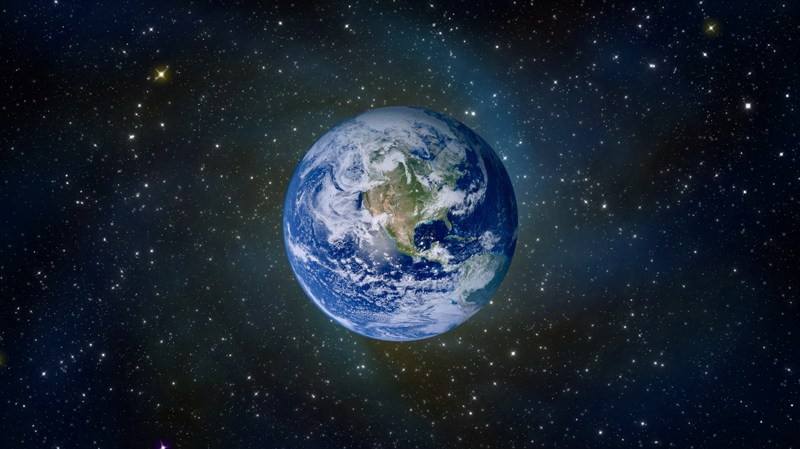
The Age of the Earth

Slide 3
Bible Genealogies
Present - time of Jesus: 2,000 years
Jesus - Abraham: 2,000 years 55 generations - Luke 3:23-34
Abraham - Adam: 2,000 years 20 generations - Luke 3:34-38
The total time: 6,000 years a young earth

Slide 4
The Days of Creation Were Literal, Consecutive, Twenty-Four Hour Days
Remember the Sabbath day, to keep it holy.
Six days you shall labor and do all your work,
but the seventh day is the Sabbath of the Lord your God. In it you shall do no work: you, nor your son, nor your daughter, nor your male servant, nor your female servant, nor your cattle, nor your stranger who is within your gates.
For in six days the Lord made the heavens and the earth, the sea, and all that is in them, and rested the seventh day. Therefore the Lord blessed the Sabbath day and hallowed it.
Exodus 20:8-11

Slide 5
The Foundation of the World
“That the blood of all the prophets which was shed from the foundation of the world may be required of this generation, from the blood of Abel to the blood of Zechariah who perished between the altar and the temple. Yes, I say to you, it shall be required of this generation.”
Luke 11:50-51

Slide 6
The Beginning of Creation
“But from the beginning of the creation, God ‘made them male and female’” (Mark 10:6).
MAN
Bible Model of Origins
MAN
Evolutionary Model of Origins

Slide 7

The Beginning of Creation
“But from the beginning of the creation, God ‘made them male and female’” (Mark 10:6).
“Imagine that all 4.6 billion years of evolutionary time were represented by one 60 minute hour. In this illustration, animals would only have appeared in the last ten minutes, while humans would have only arrived on the scene in the last 1/100 second.”
Joshua Gurtler, “Unraveling Evolution,” page 29
MAN
Bible Model of Origins
MAN
Evolutionary Model of Origins

Slide 8
New Testament View of Creation Account is Literal, Not Figurative
Jesus spoke of the creation of man, the death of Abel, and the flood of Noah’s day as real events.
  Matt. 19:4-6, 23:35, 24:37-38
Paul spoke of Adam and Eve as being real people, and the details surrounding their creation and fall into sin as real events.
  1 Cor. 11:8; 2 Cor. 11:3; 1 Tim. 2:13-14

Slide 9

Does All Scientific Data Point To An Old Earth?

Slide 10

Population Studies
If man had been on the earth for only one million years, the population would be 10⁵⁰⁰⁰.
Using the age of 6,000 years, these same studies predict a population of 5 billion.

Slide 11


Erosion

Slide 12

Depletion of the Earth’s Magnetic Field
1,400 years ago the magnetic field was twice as strong as it is now.
It is predicted that the magnetic field will be completely gone by the year 4000.
10,000 years ago, the magnetic field would have been so strong the earth would have disintegrated from the internal forces.

Slide 13

Shrinkage of the Sun
The sun is shrinking at a rate of 0.1% per century.
Its diameter is decreasing five feet every hour.
100,000 years ago, the sun would have been twice as big as it is today.
20 million years ago, the earth would have been inside the sun.

Slide 14
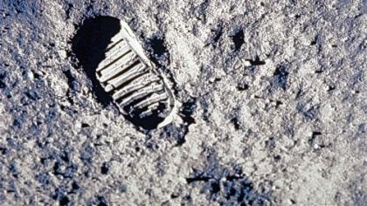
Cosmic Dust
The earth is constantly bombarded by particles of matter from outer space, receiving about 14 million tons every year.
If the earth were 4.5 million years old, there would be a layer of meteoritic dust about 182 feet thick.

Slide 15
Consequences of Compromise
Christians who believe in an old earth must interpret the Genesis account of creation as an allegory or myth.
Doing so gives Evolutionary Science more authority than the Scriptures...
Tempts us to interpret all Scripture as figurative...
And destroys the credibility of the Bible and the foundation of our faith.

