Slide 2
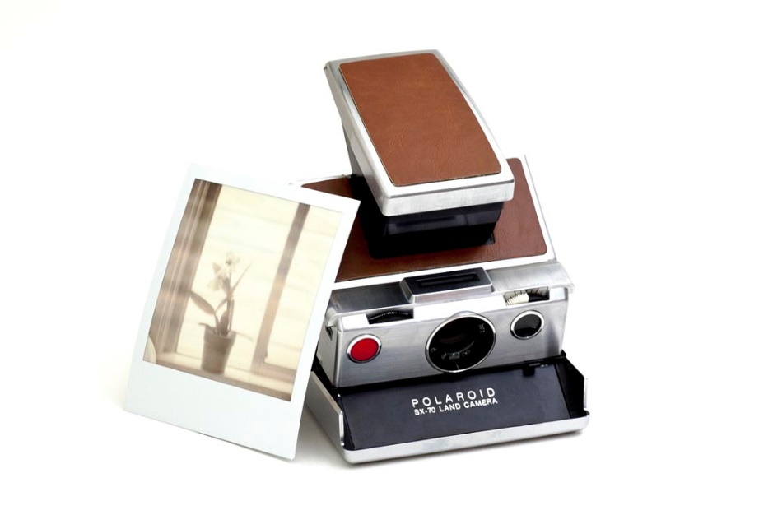
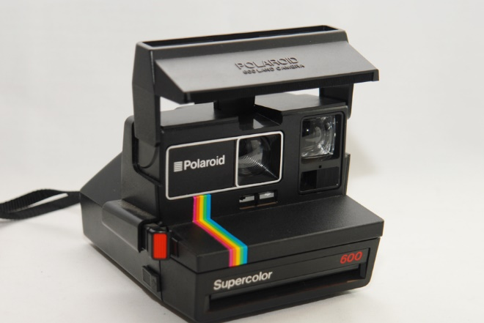

Slide 4
Parenting Polaroids
Toddler
9 year old
Mid-teen practice
What kind of parent do you think I am?

Slide 5
Getting God Right

Slide 6
Snapchats of God
Eden
Flood
Nadab & Abihu
Destruction of Jerusalem
Ananias & Sapphira

Slide 7
Getting The “Picture” Right
God
Creator
Father
Judge
Satan
De-creator
Adversary
Accuser

Slide 8
Getting The “Picture” Right
Jesus
Jesus doesn’t come to explain pain and misery. He comes to take away our real pain.
Jesus didn’t come to save us from God’s wrath, like our Father is the bad guy.

Slide 9
Getting The “Picture” Right
Jesus
Jesus didn’t come to save us from the Law, as if God had a mid-life crisis and changed His mind and His nature.
The plan was always for Jesus to save us from our sin.

Slide 10
Do we have eyes to see and ears to hear?
Or are we satisfied with a 10 second disappearing video snippet?

