Slide 2
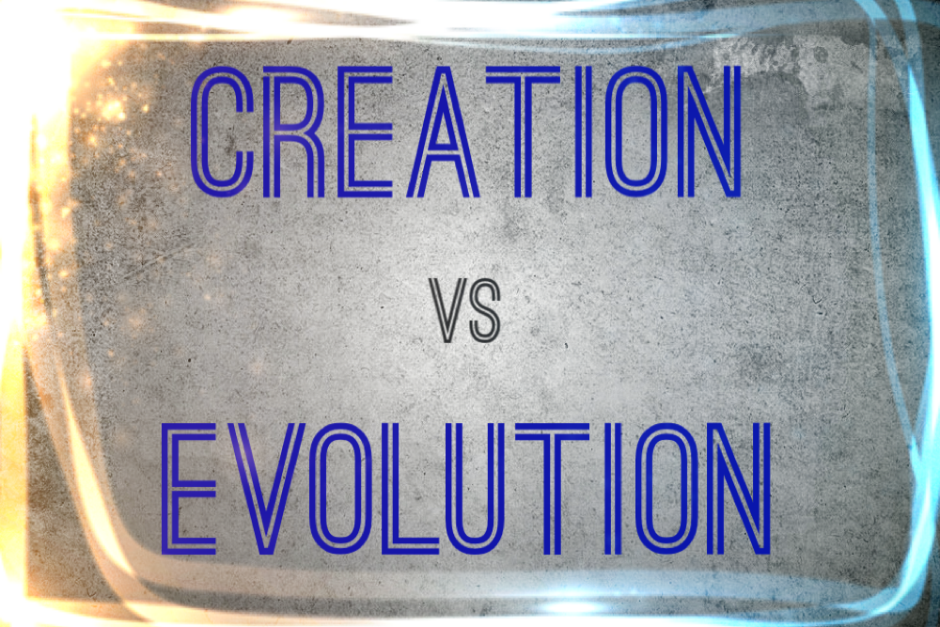

Slide 3
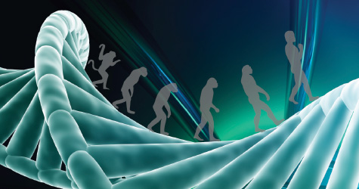
The Theory of Evolution
Makes the argument that all living organisms arose from one simple organism which originally arose from non-living matter.
The variety of life seen on this planet is the result of genetic mutations which took place over billions of years.

Slide 4
Violates the Law of Biogenesis
“Biogenesis” is a compound word: “bio” means life and “genesis” means beginning.
This law states that life can only come from preexisting life, and that living things reproduce after their own kind.
This law is constantly observed in the physical world, and is counted on by farmers, stockmen, and breeders.

Slide 5
Violates the Law of Biogenesis
God established this law in the creation week when He commanded vegetation and animals to reproduce after their own kind.
Genesis 1:11-12, 21, 24-25

Slide 6
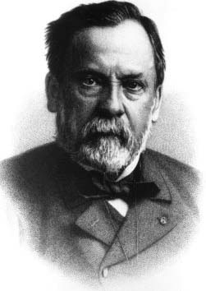
Violates the Law of Biogenesis
In the nineteenth century, French microbiologist Louis Pasteur disproved the popular theory of “spontaneous generation.”

Slide 7
Violates the Law of Biogenesis
Theory of Evolution actually argues against the Law of Biogenesis and in favor of spontaneous generation.
Claims life has arisen from non-living matter.
Claims living organisms “reproduced into” different kinds as a result of genetic mutations.

Slide 8
Violates the Second Law of Thermodynamics
According to this law, as energy is transformed from one form into another, less of the total energy is available to be utilized in further transformations.
In other words, left alone, all natural processes lead to a less ordered, less organized state.

Slide 9
Violates the Second Law of Thermodynamics

Slide 10
Mathematical Impossibility
The odds of getting a hole in one while playing golf are one in 5,000.
The odds of bowling a perfect game are one in 11,500.
The odds of getting struck by lightning are one in a million.
The odds of winning the Powerball lottery grand prize are one in 175, 223, 510.

Slide 11
Mathematical Impossibility
Mathematicians generally consider any event with a probability of less than one chance in 10⁵⁰ (the number one with 50 zeroes after it) as having a zero possibility; in other words, they say it is impossible.

Slide 12
Mathematical Impossibility
The probability of the chance development of a very simple system composed of only 200 integrated parts is 1 out of 10³⁷⁵ (this is the number one with 375 zeroes after it!).
The most basic type of protein molecule that could be classified as living is composed of at least 400 linked amino acids, each made up of a specific arrangement of four or five chemical elements, each with a unique combination of protons, neutrons, and electrons.

Slide 13
Mathematical Impossibility
The chance formation of even the simplest replicating protein molecule is 1 in 10⁴⁵⁰.
The probability of forming the proteins and DNA for the smallest self-replicating entity is 1 in 10^{167,626}.

Slide 14
Mathematical Impossibility
The chance formation of even the simplest replicating protein molecule is 1 in 10⁴⁵⁰.
The probability of forming the proteins and DNA for the smallest self-replicating entity is 1 in 10^{167,626}.
Mathematically we all have a better chance of bowling a perfect game, getting a hole in one, winning the lottery, and then being struck by lightning,
than for a simple protein to be formed out of non-living matter.

Slide 15
The Fossil Record

Slide 16
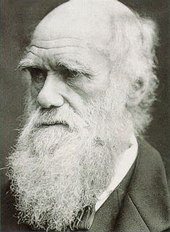
The Fossil Record
“The number of intermediate and transitional links between all living and extinct species must have been inconceivably great.”
Charles Darwin
Origin of the Species

Slide 17
The Fossil Record
What we should find:
What we do find:
Very simple life forms appearing.
Simple life forms gradually changing into complex life forms.
Many transitional links between different kinds of organisms.
The beginnings of new body features, not fully developed, but in the process of development.
Complex life forms suddenly appearing.
Complex life forms multiplying after their own kind.
No transitional links between different biological families.
No partial body features; all parts appear to be complete.

Slide 18
Evolution Does Not Pass the Test of Science
Why do smart people cling to and defend bad science?
Because some people prefer a world without God.
“The fool has said in his heart, ‘There is no God.’ They are corrupt, they have done abominable works, there is none who does good.” Psalm 14:1

