Slide 2
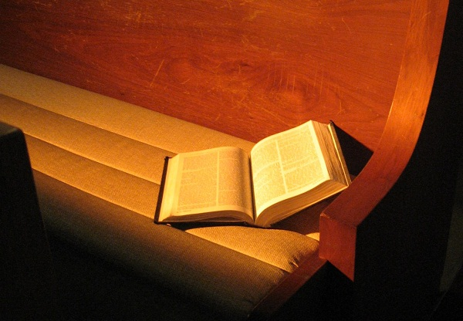
The Responsibilities of Church Membership

Slide 3
Responsibilities of Church Membership
Faithful Attendance
Receive the Word of God
Contribute to the Work of the Church
Submission
Maintaining Unity

