Slide 1
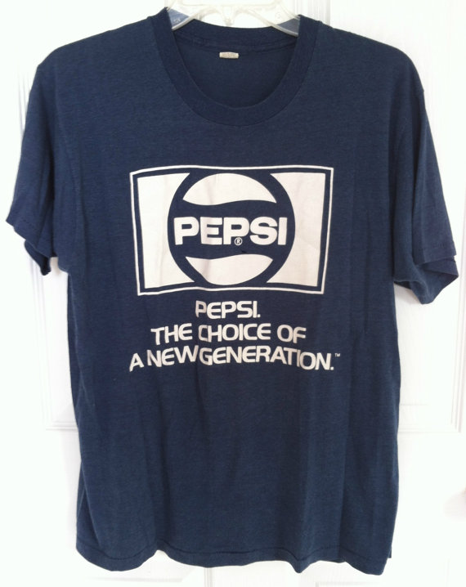

Slide 2
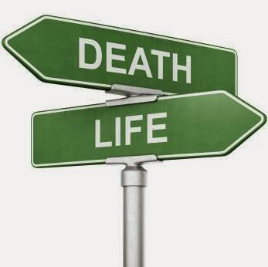
“The Choice of a New Generation”
The book of Deuteronomy is Moses’ farewell address
The generation that refused to enter the Promised Land had perished; now their children were preparing to enter
In chapter 30, Moses summarizes the importance of his message by presenting them with a choice: life or death

Slide 3
The Nature of This Choice
It was a clear choice
Genesis 2:17; Matthew 7:13-14
It was a personal choice
Joshua 24:15
It was a critical choice
2 Corinthians 6:2; Acts 22:16

Slide 4
What is involved in choosing life?
Choosing life involves more than a simple affirmation.
Choosing life involves a total commitment of ourselves to God.
Our entire way of life will be based upon and guided by this decision.

Slide 5
What is involved in choosing life?
“By loving the Lord your God, by obeying His voice, and by holding fast to Him; for this is your life and the length of your days, that you may live in the land which the Lord swore to your fathers, to Abraham, Isaac, and Jacob, to give them.”
Deuteronomy 30:20, NASB

Slide 6
1. Love the Lord our God
Deuteronomy 6:5; Matthew 22:37
Love allows us to keep the entirety of God’s law (Matt. 22:40)
Obedience rendered without love is nothing (1 Cor. 13:1-3)
We love God because He first loved us (1 John 4:10, 19)

Slide 7
2. Obey God’s Voice
The promise of the land of Canaan was dependent upon their obedience to God
The promise of Heaven is dependent upon our obedience to Christ (Heb. 5:8-9)
Our faith is displayed in our obedience (Heb. 11:8; James 2:21-24)
Our love for God is shown in our obedience (1 John 5:3; John 14:15)

Slide 8
3. Cling To God
This admonition stresses faithfulness and steadfastness
we are to cling unto God is because “He is your life and the length of your days”
Illustrated very well in John 6:66-68

Slide 9
Which Will We Choose?
“I call heaven and earth as witnesses today against you, that I have set before you life and death, blessing and cursing; therefore choose life, that both you and your descendants may live.”
Deuteronomy 30:19

