Slide 1
The Bible…
Where did it come from and can it be trusted?

Slide 2
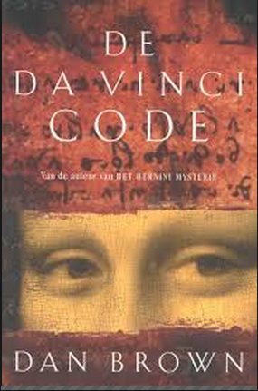
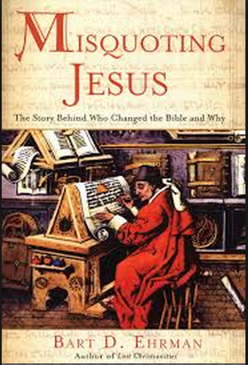
The Bible, under attack…

Slide 3
what is textual criticism?
The scientific process of attempting to ascertain the original wording of a text
Basically what exactly did Paul write down on the original letter to XYZ group or person

Slide 4
How did we get the NT?
The Bible was not faxed over from heaven
It was written over a 40+/- period
Written by 8+ men
Some tax collectors, fishermen and a doctor.
Written in Greek

Slide 5
How did we get the NT?
5336 manuscripts survive
Of those only a few are 100% complete
Most are fragments, incompletes or damaged
Some written on vellum others on papyrus

Slide 6
How did we get the NT?
Before the invention of the printing press all manuscripts were hand written
Hundreds of thousands if not millions of copies were made
Once an original manuscript was copied it was ceremoniously destroyed. This would prevent the physical word of God to fall into disrepair.

Slide 7
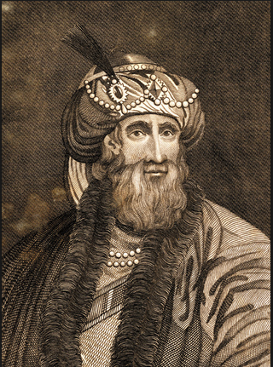
Comparison:
There are only 3 remaining copies of Flavius Josephus History (250AD)
There are only 9 copies remaining of Gaius Julius Caesar’s “Gallic Histories” (900 AD)
Only 1 copy of Cornelius Tacitus’s “Annals of Roman History” remain. (100 AD). (AKA the main document that we base our understanding of Roman history)

Slide 8
Attacks on the NT in Antiquity
In A.D. 303 the Roman Emperor Diocletian issued an edict to destroy Christians and their Bible. The persecution that followed was brutal. Over a burned and extinguished Bible, Diocletian built a monument on which he wrote these triumphant words, "Extincto nomene Christianorum" (the name Christian is extinguished). Twenty-five years later, Diocletian was dead and the new Emperor Constantine commissioned fifty copies of the Bible to be prepared at government expense.

Slide 9
Attacks on the NT
In 1776, Voltaire, the French philosopher, announced, "One hundred years from my day, there will not be a Bible in the earth except one that is looked upon by an antiquarian curiosity-seeker." One hundred years later Voltaire was dead and his own press and house were being used to print and store Bibles by the Geneva Bible Society. One hundred years from the day of Voltaire's prediction, the first edition of his work sold for eleven cents in Paris, but the British government paid the Czar of Russian one-half million dollars for an ancient Bible manuscript.

Slide 10
Claims against the NT
With only 130,000 word there are over 400,000 variants
There are NO autographic text available
The Counsel Of Nicaea voted on what books would be in the NT and if Jesus was even the Son of God
Due to the facts (assumed facts) the NT is corrupted and cannot and should not be believed in

Slide 11
Counsel of Nicaea
They did not vote on whether or not Jesus was GOD
There was however several groups that wanted to change the word of God to say He never came in the flesh
These groups include:
Gnostics (Coptics)
Melitians and Aritians

Slide 12
Counsel of Nicaea
They did meet to vote on what text to include in the NT cannon.
Cannon is simply a standard or rule to follow when determining what to include and or exclude with in a book or series or writings
The counsel was not the first to try to build a list a list to weed out the fakes
List had been collected as early as 145AD

Slide 13
Counsel of Nicaea
How did the Counsel determine what books to include?
The books had to meet the following requirements:
There can be no textual contradictories. Within the texts.
The document must have and claim Holy or apostolic connection (Claim to be inspired)
Must predate the Council’s meeting (by at least 1 year)
When votes were taken there was very little differences of the 318 voting members (most votes were 316/2)

Slide 14
Counsel of Nicaea
Over 50+ books were submitted (outside what we have in our NT) for consideration to be included in the NT
Those 50 fell into the following categories:
Apocrypha
Pseudepigrapha
Books written by “church fathers”
Agrapha
Gnostic Gospels

Slide 15
400,000 Variants
What is a variant?
A variant does not mean an error, just a difference between two manuscripts
Example if there are 5300 manuscripts and in only 1manuscript there is a difference. This would then be counted at 5299 variants.

Slide 16
400,000 Variants
4 areas of variants
Spelling
Word order, additions and deletions
Meaningful yet not viable
Meaningful and viable

Slide 17
Spelling
Over 60% of variants or over 240,000
27 ie/ei replacements
2000+ phonetic spelling issues (may be due to dictaion)

Slide 18
Spelling
Example Matt 1:3. A word that should have been an “a” was instead written as an “e”.
REALLY SHAKES OUR FAITH RIGHT???

Slide 19
Word order
Additions or deletions
Example Jesus the Christ vs Jesus Christ
Mary mother of Jesus vs Mary the mother of Jesus
James brother of John vs James the brother of John

Slide 20
Word order
The “movable” Nu
Just as we in English use ‘a’ and ‘an’ depending on whether a vowel proceeds them. The Greek uses Nu to ease reading. However some manuscripts they are used and in others they are left off but over all they change nothing in reading or meaning.
With out the Nu (v)= They set
With the NU (v) = They set (or will set, can set)

Slide 21
Meaningful and not viable
Matt 1:21
For he will save the world or for he will save his people
Matt 1:23
You will call his name or he will call his name or they will call this name
Rom 5:1
Let us have peace vs we have peace

Slide 22
Meaningful and viable
Mark 16:9-20
Some early manuscripts do not contain this passages
Of those most are incompletes
One script does contain this passage but dates to the 1200AD

Slide 23
Meaningful and viable
John 7:53-8:11
Most manuscripts do not contain this passage
Only one known text places these passages in their current location
Some that contain it, but place it in a different place (either at the end of the book or after John 7:44)

Slide 24
What does God say about his word?
Isa 40:8
Matt 24:35
1 Pet 1:25

Slide 25
The bible is unique
It is unique in its continuity.
It is unique in its circulation.
It is unique in its translation.
It is unique in its survival.
It is unique in withstanding attack.

