Slide 1
The “Greatness” of the Great Commission
Matthew 28:18-20

Slide 2
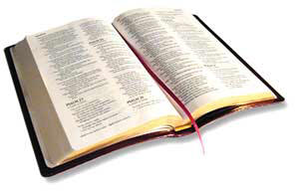
The “All’s” of the Great Commission
All Authority
All Nations
All Things I Have Commanded
I Am With You Always

