Slide 1
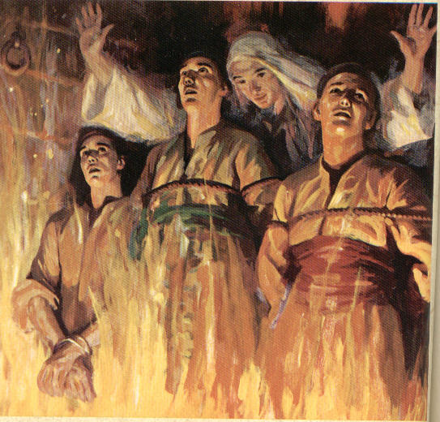
Uncompromising Faith
How To Stand Strong When Pressured
To Do Wrong?
Notes:
Title Page: Uncompromising Faith!---How to Stand Strong When Pressured to do Wrong!

Slide 2
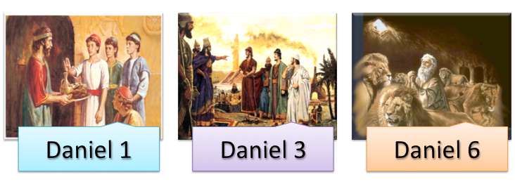
Uncompromising Faith
How To Stand When Pressured to do Wrong
Daniel, Shadrach, Meshach, and Abed-Nego . . . Four young men pressured to compromise their faith but refused to do so! - Daniel 1; 3; 6
Notes:
Daniel, Shadrach, Meshach, Abed-Nego—Daniel 1—3—6-- Refused to Compromise their Faith when Tested!

Slide 3
We too live in a world where we are pressured to “compromise” -
To tolerate evil / accept wickedness / and to participate in sin
Notes:
We too live in a world where we are constantly pressured to “Compromise” our faith and values.
Tolerate evil
Accept Wickedness
Participate in Sin

Slide 4
What gave these young men their strength to defy a king, even in the face of death?
Notes:
What gave these men the courage and strength to defy a powerful king even in the face of death? Lessons can be learned????

Slide 5
Reverence For God
Daniel feared God while the one over him feared the king - 1:8-10
Refused to bow down to the kings image - 3:16-18
Prayed to God without fearing what men would do - 6:10-11
Notes:
Reverence For God
Daniel 1:8-10—Fear God—servants fear the king
Daniel 3:16-18—Refused to submit to the king’s image
Daniel 6:10,11—Prayed to God and not fearing what men would do!

Slide 6
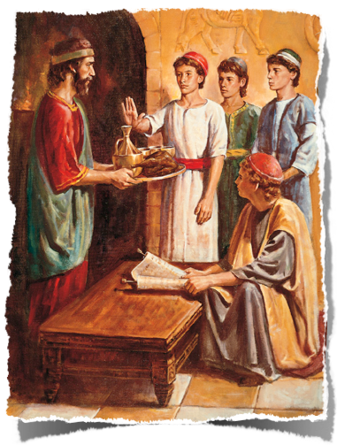
Reverence For God
People who compromise with evil demonstrate that they lack a healthy fear of the Lord! – (Job 28:28; Jeremiah 32:40)
Standing firm against the pressures to compromise our faith requires a healthy fear of God! – (Acts 5:11; Matthew 10:28)
Notes:
Reverence For God
1. People who compromise with evil demonstrate that they lack a healthy fear of the Lord! – (Job 28:28;Jeremiah 32:40)
2. Standing firm against the pressures to compromise our faith requires a healthy fear of God! – (Acts 5:11;Matthew 10:28)

Slide 7
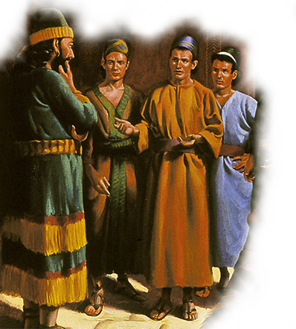
Reverence For God
Deuteronomy 10:12-13
“And now, Israel, what does the Lord your God require of you, but to fear the Lord your God, to walk in all His ways and to love Him, to serve the Lord your God with all your heart and with all your soul, and to keep the commandments of the Lord and His statutes which I command you today for your good?”
Notes:
Text—Deuteronomy 10:12,13…

Slide 8
Reverence For God
Proverbs 1:7
“The fear of the LORD is the beginning of knowledge, But fools despise wisdom and instruction.”
Notes:
Proverbs 1:7…

Slide 9
Reverence For God
Psalms 111:10
“The fear of the LORD is the beginning of wisdom; A good understanding have all those who do His commandments. His praise endures forever.”
Notes:
Psalms 111:10…

Slide 10
Reverence For God
Ecclesiastes 12:13,14
“Let us hear the conclusion of the whole matter: Fear God and keep His commandments, For this is man's all. For God will bring every work into judgment, Including every secret thing, Whether good or evil.”
Notes:
Ecclesiastes 12:13,14…

Slide 11
Understand The Seriousness of Sin
Willing to risk punishment that he not be defiled - 1:8,13
Willing to face a fiery furnace than worship false Gods - 3:16-18
Willing to be thrown to lions than not to pray to God - 6:10-11
Notes:
Understand the Seriousness of Sin!
Willing to risk punishment that he not be defiled—Daniel 1:8,13
Willing to face fiery furnace than worship false gods—Daniel 3:16-18
Willing to be thrown to lions than not to pray to God—Daniel 6:10,11

Slide 12
Understand The Seriousness of Sin
No one will successfully resist temptation if they fail to understand the seriousness of sin -
Brings death - Gen 3; Rom 6:23
Separates from God – Isa. 59:1-3; 1 Jno. 1:5-2:2
Hurts and destroys others - Gen 3; Josh. 7; 1 Cor. 5
Notes:
Understand the Seriousness of Sin
Brings death—Gen.3—Garden of Eden… Rom.6:23—to every sinner
Separates one from God—Isa.59:1-3—results of sin/ 1 John 1:5—2:2—breaks fellowship with God
Hurts and destroys others—Gen.3—death past to all men…Joshua 7—Acan’s sin cost 36 lives…1 Cor. 5—fornicator was causing church sin by ignoring it!

Slide 13
Understand The Seriousness of Sin
All sin is against God, failing to glorify and honor Him-
Root of sin is selfishness
To serve or worship anything other than God is idolatry– Exo.20:3,4; Rom.1:18-25
Man will serve and worship something! (true or false)God or Possessions/ Pleasure/Power/People
Notes:
Understand the Seriousness of Sin
All sin is against God, failing to glorify and honor Him—
Root of sin is selfishness
To serve or worship anything other than God is idolatry– Exo.20:3,4; Rom.1:18-25; Col.3:5
Man will serve and worship something! (true or false) God or Possessions/ Pleasure/Power/People

Slide 14
Purpose/Resolve to Please God
Daniel purpose in his heart not to defile himself- 1:8
Will NOT serve your gods, nor worship the image- 3:16-18
Daniel prayed knowingly violating the law - 6:10-11
Notes:
Purpose/ Resolve to Please God!
Daniel purposed in his heart not be defiled—Daniel 1:8
Will NOT serve your gods, nor worship the image—Daniel 3:16-18
Daniel prayed knowingly violating the law (decree)—Daniel 6:10,11

Slide 15
Purpose/ Resolve To Please God
Proverbs 16:3
“Commit your works to the LORD, And your thoughts will be established.”
Notes:
Proverbs 16:3…

Slide 16
Purpose/ Resolve to Please God
No one will successfully resist the world’s pull without purpose and resolve—Job 31:1;Joshua 24:15; Acts 11:23
The way to heaven is one of purpose and commitment—no one will get their accidentally-Matthew 7:13-14
God will help— 1 Corinthians 10:13
Notes:
Purpose/ Resolve to Please God!
1. No one will successfully resist the worlds pull without purpose and resolve—Job 31:1;Joshua 24:15; Acts 11:23; Psa.119:106
2. The way to heaven is one of purpose and commitment—no one will get their accidentally-Matthew 7:13-14; 2 Peter 1:5-10
3. God will help— 1 Corinthians 10:13; Hebrews 13:5,6

Slide 17
Trust The Lord
Daniel requested one over them to test them-1:11-13
God will deliver us…but if not… - 3:16-18
Daniel prayed just like he always done despite the threats- 6:10-11
Notes:
Trust the Lord
Daniel requested one over them to test them—Daniel 1:11-13
God will deliver them…but if not…--3:16-18
Daniel prayed just like he had always done despite the threats—Daniel 6:10,11

Slide 18
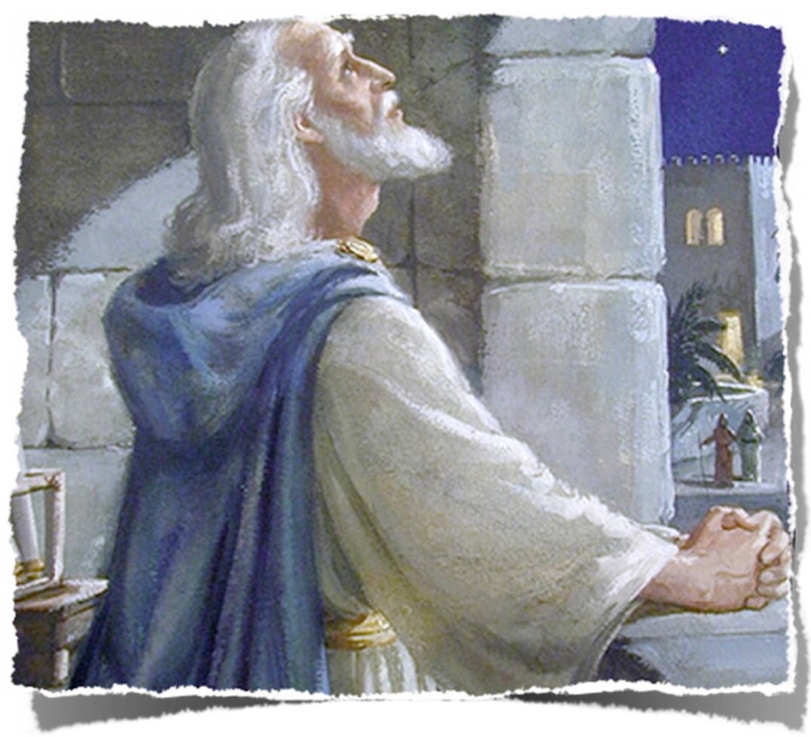
Trust the Lord
God will do what He has said! – (Romans 4:19-21; Acts 27:25; 2 Timothy 1:12)
We must know what God has said in order to have the faith necessary to resist compromise - (Romans 10:17; Hosea 4:6; Ephesians 6:16)
Notes:
Trust the Lord
1. God will do what He has said! – (Rom. 4:19-21; Acts 27:25; 2 Tim. 1:12)
2. We must know what God has said in order to have the faith necessary to resist compromise - (Rom. 10:17; Hos. 4:6; Eph. 6:16)
3. Those who trust the Lord will keep pure - (1 John 3:3; 2 Cor. 7:1; 2 Pet. 3:14)

Slide 19
Trust the Lord
Those who trust the Lord will keep pure - (1 John 3:3; 2 Corinthians 7:1; 2 Peter 3:14)
Notes:
Trust the Lord
1. God will do what He has said! – (Rom. 4:19-21; Acts 27:25; 2 Tim. 1:12)
2. We must know what God has said in order to have the faith necessary to resist compromise - (Rom. 10:17; Hos. 4:6; Eph. 6:16)
3. Those who trust the Lord will keep pure - (1 John 3:3; 2 Cor. 7:1; 2 Pet. 3:14)

Slide 20
Strengthened By Each Victory
Daniel, Shadrach, Meshach, and Abed-Nego refused to be defiled
Shadrach, Meshach, and Abed-Nego would only bow to God
Daniel prayed ONLY to God as was his custom since early days
Notes:
Strengthened by Each Victory
Daniel, Shadrach, Meshach, and Abed-Nego refused to be defiled
Shadrach, Meshach, and Abed-Nego would only bow to God
Daniel prayed ONLY to God as was his custom since early days

Slide 21
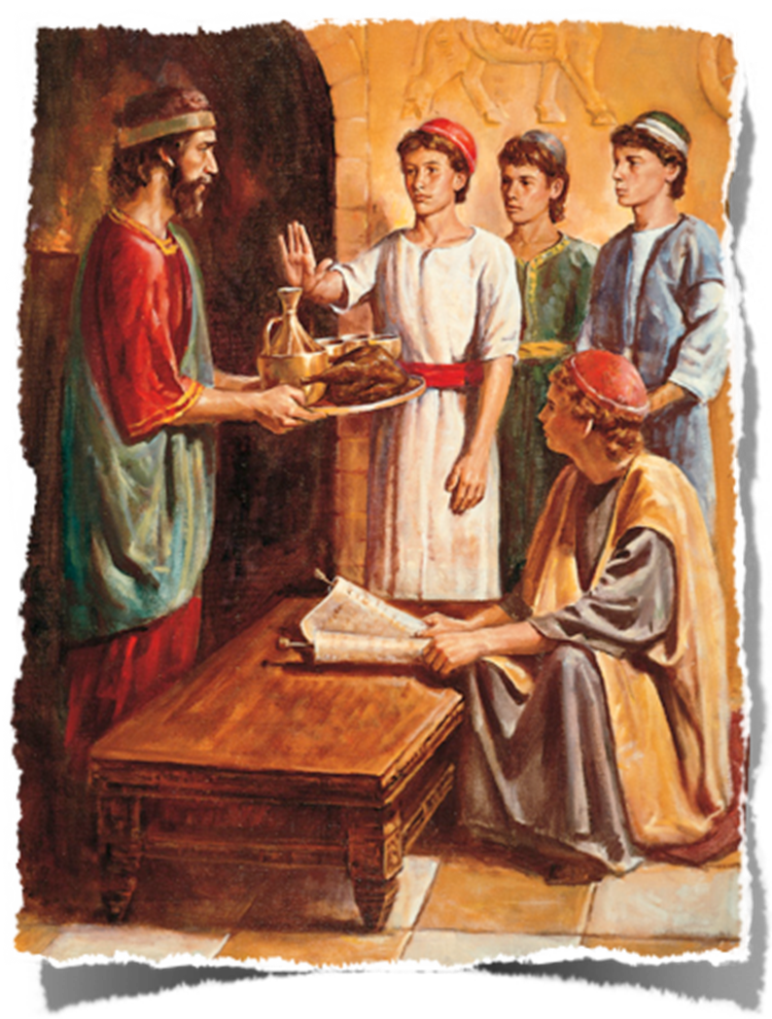
Strengthened By Each Victory
Those who are faithful in little matters will be faithful in larger matters – (Luke 16:10,11; 19:17; Matthew 25:21)
How can I face the big battles if I have failed to be victorious in the smaller ones? (Jeremiah 12:5)
Trials will come!! Young people need to begin now to develop a strong faith in God!
Notes:
Strengthened By Each Victory
1. Those who are faithful in little matters will be faithful in larger matters – (Luke 16:10,11; 19:17; Matt. 25:21)
2. How can I face the big battles if I have failed to be victorious in the smaller ones? (Jere. 12:5)
3. Trials will come!! Young people need to begin now to develop a strong faith in God!

Slide 22
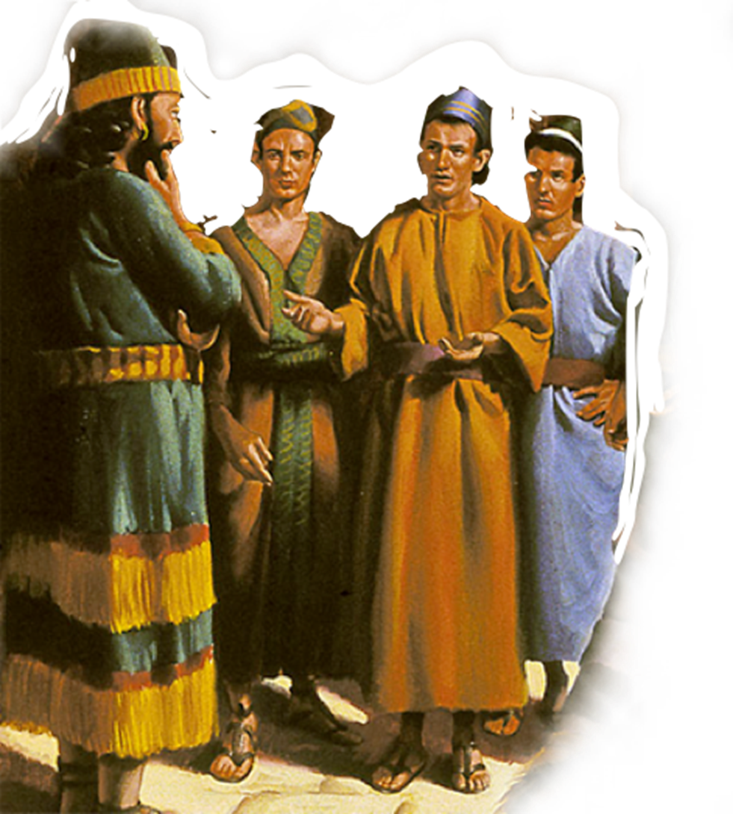
Will We Apply The Lessons Learned?
What great examples of uncompromising faith!
We can have the courage to resist the pressures of this world and say no to sin!
Fear God / Hate sin / Purpose to please God / Trust God / One victory at a time / Receive the reward!
Notes:
Will We Apply The Lessons Learned?
1. What great examples of uncompromising faith!
2. We can have the courage to resist the pressures of this world and say no to sin!
3. Review---Fear God / Hate sin / Purpose to please God / Trust God / One victory at a time / Receive the reward!

Slide 23
Will We Apply The Lessons Learned?
To be committed to serving God, no matter the temporal consequence?
To Persevere so our faith will lead to greater things?
To trust God’s ability to deliver us in the end? To be obedient that others may praise God?
We can refuse to compromise our convictions without being abrasive!
Notes:
Will We Apply The Lessons Learned?
1. To be committed to serving God, no matter the temporal consequence?
2. To Persevere so our faith will lead to greater things?
3. To trust God’s ability to deliver us in the end? To be obedient that others may praise God?
4. We can refuse to compromise our convictions without being abrasive!

Slide 24
The Reward Is Worth It
Daniel, Shadrach, Meshach, and Abed-Nego blessed
Shadrach, Meshach, and Abed-Nego saved and exalted
Daniel saved and exalted while the enemies destroyed
Notes:
The Reward Is Worth It
Daniel, Shadrach, Meshach, and Abed-Nego blessed
Shadrach, Meshach, and Abed-Nego saved and exalted
Daniel saved and exalted while the enemies destroyed!

Slide 25
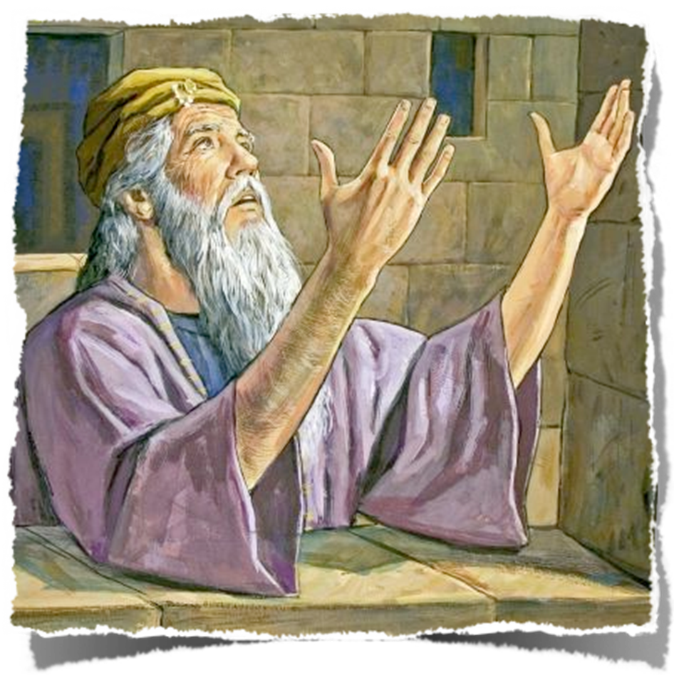
The Reward Is Worth It
The faithful will receive the crown of life – (Revelation 2:10)
Like Paul – if we fight the good fight, finish the race, and keep the faith – (2 Timothy 4:6-8)
Eternal life if we patiently continue in doing good – seeking for glory, honor & immortality – (Rom. 2:7)
NO such thing as accidental salvation!! – (Matthew7:13,14)
Notes:
The Reward Worth It
1. The faithful will receive the crown of life – (Rev. 2:10)
2. Like Paul – if we fight the good fight, finish the race, and keep the faith – (2 Tim. 4:6-8)
3. Eternal life if we patiently continue in doing good – seeking for glory, honor & immortality – (Rom. 2:7)
4. NO such thing as accidental salvation!! – (Matt. 7:13,14)

Slide 26
The Reward Is Worth It
If you believe that Jesus is the Christ - act upon that faith today by confessing Him as the Son of God - Repent of your sins - and be baptized for the remission of your sins TODAY!
If you are a Christian but guilty of compromising your faith - repent, confess and pray TODAY!
Notes:
The Reward Worth It
1. Invitaion…

