Slide 1
The Devil’s Lies About Evangelism
“For I am not ashamed of the gospel of Christ, for it is the power of God to salvation for everyone who believes, for the Jew first and also for the Greek” (Rom. 1:16).

Slide 2
1. No one is interested in the gospel.
1 Kings 19:14-18
Acts 16:9

Slide 3
2. They will not obey the gospel.
1 Thessalonians 1:9
1 Timothy 1:12-15
Ezra 10:10-12, 44

Slide 4
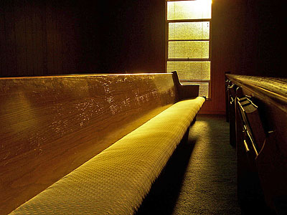
3. Gospel Meetings don’t work anymore.
1 Corinthians 1:21
Isaiah 55:10-11

Slide 5
4. We have to make the church more “visitor friendly.”
1 Corinthians 14:23
James 2:2-4
Psalm 89:7
1 Timothy 3:15

Slide 6
5. You cannot do personal work.
Matthew 28:18-20
Acts 8:4
Exodus 3-4

Slide 7
The Devil’s Lies About Evangelism
No one is interested in the gospel.
They will not obey the gospel.
Gospel Meetings do not work anymore.
We have to make the church more “visitor friendly.”
You cannot do personal work.

Slide 8
The Devil’s Lies About Evangelism
No one is interested in the gospel.
They will not obey the gospel.
Gospel Meetings do not work anymore.
We have to make the church more “visitor friendly.”
You cannot do personal work.
People are interested in the gospel.
People will obey the gospel.
Gospel Meetings do work.
The church must remain “God” and “gospel” centered.
I can do personal work.

