Slide 1
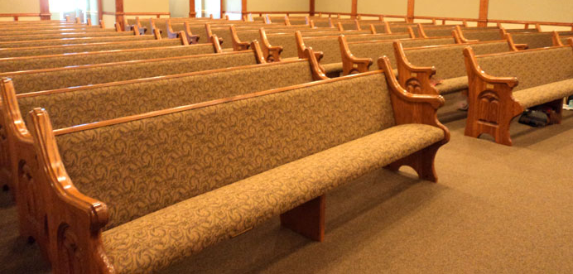
How To Treat the Brethren
1 Timothy 5:1-2

Slide 2
First Timothy 4:12-16
He is to be an example.
He is to give attention to (make a priority of) reading and teaching.
He is to use his gift/talents.
He is to give himself entirely to his work, that his progress is evident before all.
He is to take heed to himself and his teaching

Slide 3
How does a young preacher survive his youth?
He does his work to the best of his ability - 1 Tim. 4:12-16; 2 Tim. 4:5
He learns how to get along with the brethren - 1 Tim. 5:1-2

Slide 4
Young Preacher…
Do not rebuke an older man, but exhort him as a father, younger men as brothers,
older women as mothers, younger women as sisters, with all purity.
1 Tim. 5:1-2

Slide 5
All Members…
Do not rebuke an older man, but exhort him as a father, younger men as brothers,
older women as mothers, younger women as sisters, with all purity.
1 Tim. 5:1-2

Slide 6
“Be kindly affectionate to one another with brotherly love, in honor giving preference to one another.”
Romans 12:10

Slide 7
I, therefore, the prisoner of the Lord, beseech you to walk worthy of the calling with which you were called,
with all lowliness and gentleness, with longsuffering, bearing with one another in love,
endeavoring to keep the unity of the Spirit in the bond of peace.
Ephesians 4:1-3

Slide 8
Therefore, as the elect of God, holy and beloved, put on tender mercies, kindness, humility, meekness, longsuffering;
bearing with one another, and forgiving one another, if anyone has a complaint against another; even as Christ forgave you, so you also must do.
But above all these things put on love, which is the bond of perfection.
Colossians 3:12-14

