Slide 1
Is the Bible Relevant Today?

Slide 2
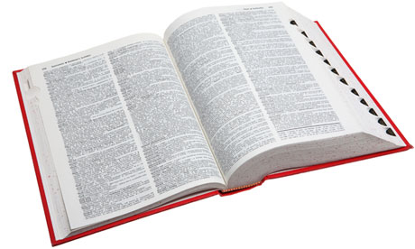
Relevant
“bearing upon or relating to the matter in hand; pertinent, to the point”
applicable
appropriate

Slide 3
1. God and His Word Have Not Changed
“For I am the Lord, I do not change…” (Malachi 3:6).
“Jesus Christ is the same yesterday, today, and forever” (Heb. 13:8).
“Forever, O Lord, Your word is settled in heaven” (Ps. 119:89).

Slide 4
1. God and His Word Have Not Changed
“…contend earnestly for the faith which was once for all delivered to the saints” (Jude 3).
“You shall not add to the word which I command you, nor take from it, that you may keep the commandments of the Lord your God which I command you” (Deut. 4:2).

Slide 5
2. The Needs of Man Have Not Changed
Philosophical Needs
Acts 17:24-31
Spiritual Needs
Romans 3:23, 5:6-10

Slide 6
2. The Needs of Man Have Not Changed
Philosophical Needs
Acts 17:24-31
Spiritual Needs
Romans 3:23, 5:6-10
“What Must I Do To Be Saved?”
Believe in Christ - John 8:24
Repent of Sins - Acts 17:30
Confess Faith - Romans 10:9-10
Be Baptized - Mark 16:16, Acts 22:16
Remain Faithful - Revelation 2:10

Slide 7
3. The Needs of Society Have Not Changed

Slide 8
3. The Needs of Society Have Not Changed
Crime and Punishment - Eccl. 8:11
Role of Government - Rom. 13:1-6
Prejudice - Rom. 2:11; Matt. 7:12
Welfare Abuse - 2 Thess. 3:10
Drugs and Alcohol - 1 Cor. 6:12; Prov. 23:31
Teen Pregnancy - Heb. 13:4; 1 Cor. 6:18
Same-Sex Marriage - Matt. 19:4-6
Divorce and Remarriage - Matt. 19:4-9
Family Problems - Col. 3:18-21
Money Problems - 1 Tim. 6:9-10

Slide 9
4. The Needs of the Christian Have Not Changed

Slide 10
4. The Needs of the Christian Have Not Changed
“All Scripture is given by inspiration of God, and is profitable for doctrine, for reproof, for correction, for instruction in righteousness, that the man of God may be complete, thoroughly equipped for every good work” (2 Timothy 3:16-17).

Slide 11
4. The Needs of the Christian Have Not Changed
“All Scripture is given by inspiration of God, and is profitable for doctrine, for reproof, for correction, for instruction in righteousness, that the man of God may be complete, thoroughly equipped for every good work” (2 Timothy 3:16-17).

Slide 12
The Bible IS Relevant Today

