Slide 1
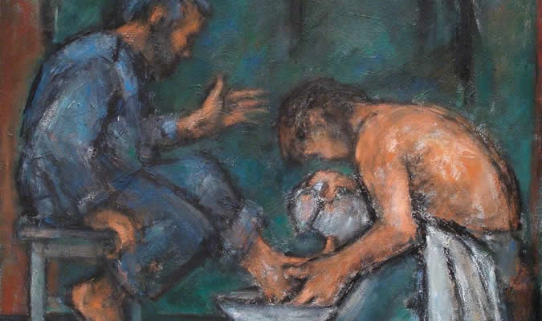
“He who is greatest among you shall be your servant.”

Slide 2
The Rewards of Being A Servant
“What shall we have?”
Matthew 19:23-27

Slide 3
The Rewards of Being A Servant?
God knows about our service - Matt. 6:1-4; Heb. 6:10

Slide 4
The Rewards of Being A Servant?
Temporal Blessings
Knowing we please God - Matt. 25:21
Joy of growing to be more like the Lord - 2 Cor. 4:10-11
Knowing we have God’s help - Matt. 28:20
Knowing we helped others - Mark 10:28-30

Slide 5
The Rewards of Being A Servant?
God knows about our service - Matt. 6:1-4; Heb. 6:10
Temporal blessings
Prepared for greater service - James 1:2-4

Slide 6
The Rewards of Being A Servant?
God knows about our service - Matt. 6:1-4; Heb. 6:10
Temporal blessings
Prepared for greater service - James 1:2-4
Eternal blessings - Rev. 22:3-4

