Slide 1
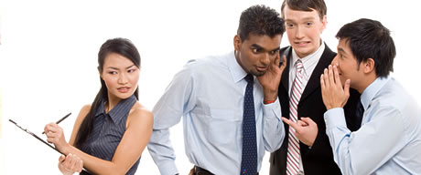
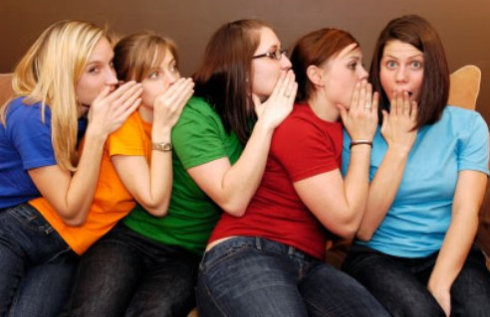
Gossip

Slide 2
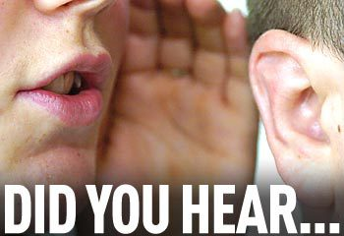
What is Gossip?
The repeating of “idle talk and rumors, especially about the private affairs of others” (Webster’s Dictionary).
Rumor: “general talk not based on definite knowledge; an unconfirmed report, story, or statement in general circulation.”

Slide 3
What is Gossip?
Slander: “the utterance in the presence of another person of a false statement or statements, damaging to a third person’s character or reputation.”

Slide 4
Gossip Reveals Secrets
“He who goes about as a talebearer reveals secrets, but he who is trustworthy conceals a matter.”
Prov. 11:13, NASB

Slide 5
Gossip Kindles Strife
“Where there is no wood, the fire goes out; and where there is no talebearer, strife ceases.”
Prov. 26:20

Slide 6
Gossip Separates Friends
“An ungodly man digs up evil, and it is on his lips like a burning fire. A perverse man sows strife, and a whisperer separates the best of friends.”
Prov. 16:27-28

Slide 7
Is all talk about others considered “gossip”?
Jesus warned of the leaven of the Pharisees and Sadducees (Matt. 16:6-12; Luke 12:1).
Paul warned Timothy about Alexander the coppersmith (2 Tim. 4:14-15).
Those in Chloe’s household reported things to the apostle Paul (1 Cor. 1:11).
These were not private matters, nor were they attempts to injure one’s character.

Slide 8
Before we repeat something…
1. Is It True?
“He who answers a matter before he hears it, it is folly and shame to him” (Prov. 18:13).
“The first one to plead his cause seems right, until his neighbor comes and examines him” (Prov. 18:17).

Slide 9
Before we repeat something…
2. Is It Going To Build Up Or Tear Down?
“Therefore let us pursue the things which make for peace and the things by which one may edify another” (Rom. 14:19).

Slide 10
Before we repeat something…
3. Have I Talked To Them First?
“Moreover if your brother sins against you, go and tell him his fault between you and him alone. If he hears you, you have gained your brother” (Matt. 18:15).

Slide 11
Before we repeat something…
4. Have I Examined Myself?
“And why do you look at the speck in your brother’s eye, but do not consider the plank in your own eye?... Hypocrite! First remove the plank from your own eye, and then you will see clearly to remove the speck from your brother’s eye” (Matt. 7:3-5).

Slide 12
Before we repeat something…
5. Why Am I Really Wanting To Do This?
“The words of a talebearer are like tasty trifles, and they go down into the inmost body” (Prov. 18:13).
“He who covers a transgression seeks love, but he who repeats a matter separates friends” (Prov. 17:9).

Slide 13
Before we repeat something…
6. Is This What I Want Done To Me?
“Therefore, whatever you want men to do to you, do also to them, for this is the Law and the Prophets” (Matt. 7:12).

Slide 14
“You shall not go about as a talebearer among your people…”
Leviticus 19:16

