Slide 1
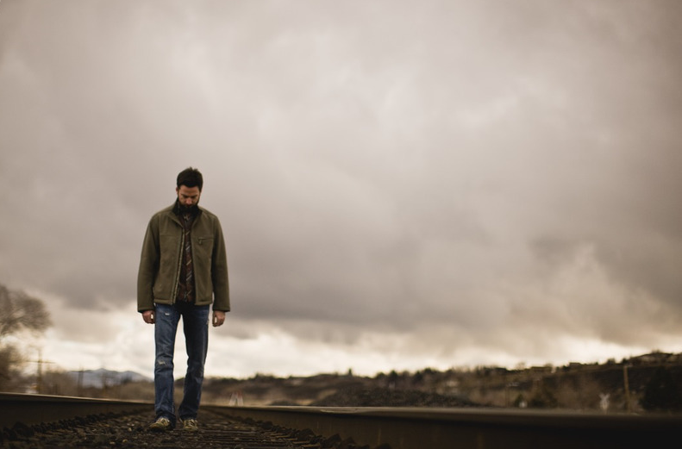
The Single Christian
The Forgotten Demographic in the Lord’s Church

Slide 2
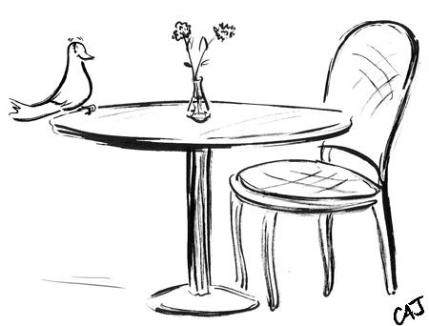
Reasons One is a Single Christian
No desire to get married
Cannot find someone to marry
Not a scriptural candidate for marriage - 1 Cor. 7:10-11; Matt. 19:9, 11-12
Their spouse has passed away - Rom. 7:2-3

Slide 3
Challenges of Being a Single Christian
Moral Challenges
Controlling sexual desires
  Heb. 13:4; 1 Cor. 7:2-3
  Some can do this - 1 Cor. 7:7-9
  Others will have to learn - Matt. 19:12
Idle, pursuing various sins - 1 Tim. 5:11-14

Slide 4
Challenges of Being a Single Christian
Physical Challenges
Surviving on one income
Wearing both “hats”
Challenges for widows/widowers
Challenges for divorcees

Slide 5
Challenges of Being a Single Christian
Psychological Challenges
Being single in world of couples
How one is viewed by others
Loneliness - Gen. 2:18

Slide 6
Unique Opportunities of Being a Single Christian
Avoid Hardships of Potentially Bad Marriage
“The only thing worse than wishing you were married is wishing you weren’t.”

Slide 7
Unique Opportunities of Being a Single Christian
Avoid Hardships of Potentially Bad Marriage
“The only thing worse than wishing you were married is wishing you weren’t.”
“Better to dwell in a corner of a housetop, than in a house shared with a contentious woman.”
Prov. 21:9

Slide 8
Unique Opportunities of Being a Single Christian
Avoid Hardships of Potentially Bad Marriage
“The only thing worse than wishing you were married is wishing you weren’t.”
“Better to dwell in a corner of a housetop, than in a house shared with a contentious woman.”
Prov. 21:9
“Better to dwell in the wilderness, than with a contentious and angry woman.”
Prov. 21:19

Slide 9
Unique Opportunities of Being a Single Christian
Avoid Hardships of Potentially Bad Marriage
“The only thing worse than wishing you were married is wishing you weren’t.”
“He who finds a wife finds a good thing, and obtains favor from the Lord.”
Prov. 18:22

Slide 10
Unique Opportunities of Being a Single Christian
Avoid Hardships of Potentially Bad Marriage
“The only thing worse than wishing you were married is wishing you weren’t.”
“He who finds a wife finds a good thing, and obtains favor from the Lord.”
Prov. 18:22
Ahab had Jezebel
Hosea had Gomer
Abigail had Nabal

Slide 11
Unique Opportunities of Being a Single Christian
Undistracted Service to the Lord
1 Cor. 7:8, 32-33, 35
A single Christian has more time, energy, and money to give in their service to the Lord and to their brethren.

Slide 12
Do’s and Don’ts for the Single Christian
Accept your singleness – for now - Phil. 4:11
Don’t let your marital status define who you are - Col. 2:10; Matt. 22:30
Remember, there is a place for single people in the Kingdom of God
Draw close to God - 2 Tim. 4:16-17
Do not resent married Christians

