Slide 2
What is a Christian?
Study of 1 Peter 2

Slide 3
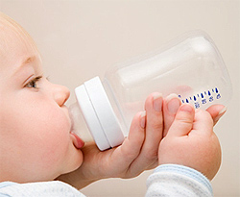
1. A Babe Desiring To Grow
“As newborn babes, desire the pure milk of the word, that you may grow thereby.”
1 Peter 2:2

Slide 4
1. A Babe Desiring To Grow
Infants feed at all times; their appetite must be satisfied.
Jesus promised a blessing for those who hunger and thirst for righteousness – they will be filled (Matt. 5:6).
We must receive nourishment from the word (1 Tim. 4:6).

Slide 5
2. Living Stones in a Spiritual House
“You also, as living stones, are being built up a spiritual house…”
1 Peter 2:4-6

Slide 6
2. Living Stones in a Spiritual House
We have an important heritage - Eph. 2:19-22
We have an important purpose
We have an important nature

Slide 7
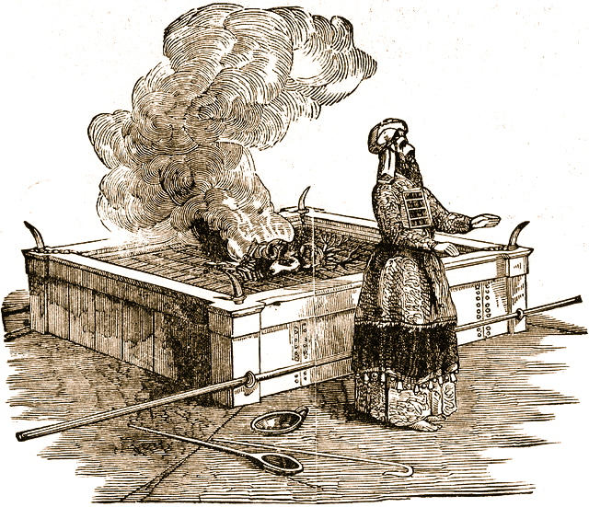
3. Holy Priesthood Offering Sacrifices
“You also, as living stones, are being built up a spiritual house, a holy priesthood, to offer up spiritual sacrifices acceptable to God through Jesus Christ.”
1 Peter 2:5

Slide 8
3. Holy Priesthood Offering Sacrifices
Christians are priests who offer spiritual sacrifices to God through Jesus Christ, our High Priest (Hebrews 13:15-16).
These sacrifices must be both spiritual and acceptable before God.

Slide 9
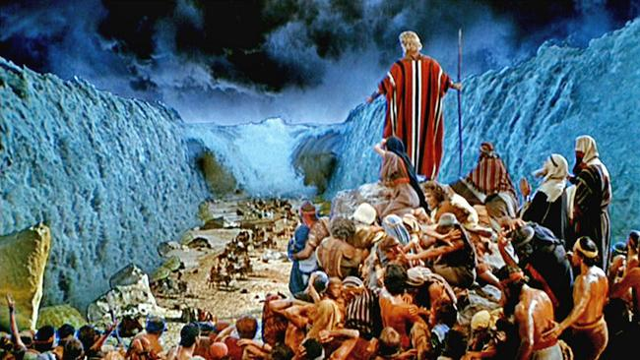
4. A People Who Belong To God
“But you are a chosen generation, a royal priesthood, a holy nation, His own special people…”
1 Peter 2:9

Slide 10
4. A People Who Belong To God
Physical Israel was delivered them from Egyptian bondage, made a nation of priests, and told to remain separate from the nations around them.
The church enjoys a similar distinction today.

Slide 11
4. A People Who Belong To God
chosen generation - Gal. 3:7, 29
royal priesthood - Rev. 1:6
holy nation - 2 Cor. 6:17-18
His own special people - 1 Cor. 6:19-20

Slide 12
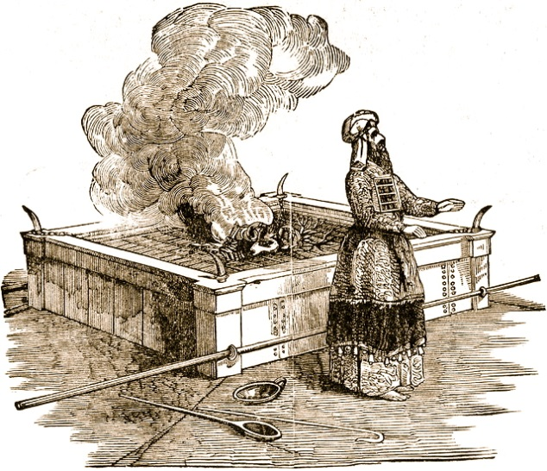
What is a Christian? - 1 Peter 2
Babes Desiring Growth
Living Stones
Holy Priests Offering Sacrifices
God’s Own Special People

Slide 13
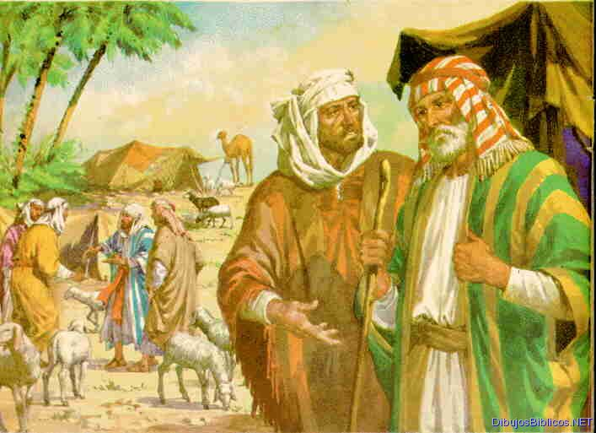
5. Sojourners and Pilgrims
“Beloved, I beg you as sojourners and pilgrims, abstain from fleshly lusts which war against the soul.”
1 Peter 2:11

Slide 14
5. Sojourners and Pilgrims
Stranger: “a stranger, foreigner, one who lives in a place without the right of citizenship.”
Pilgrim: refers to a resident foreigner, one who lives among a people who are not his own. This person does not have the rights of a citizen, nor is he seeking a permanent residence. He is sojourning in a place for a time.

Slide 15
5. Sojourners and Pilgrims
We are citizens of Heaven - Phil. 3:20.
We are to abstain from the sinful things of this world.
We are to have our conduct honorable among unbelievers - Phil. 2:15.

Slide 16
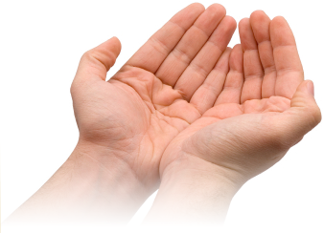
6. Obedient & Submissive Servants
1 Peter 2:13-17

Slide 17
6. Obedient & Submissive Servants
Submit To Every Ordinance of Man for the Lord’s Sake - v. 13.
It is what God has told us to do - Rom. 13:1-7.
We are not at liberty to decide which laws we will obey.
Only one exception - Acts 5:29.

Slide 18
6. Obedient & Submissive Servants
Thus we will put to silence the ignorance of foolish men - v. 15.
Hypocrites give unbelievers a reason to blaspheme - Rom. 2:21-24; 1 Tim. 6:1.
When we “walk the walk,” we take away this avenue of opposition.

Slide 19
6. Obedient & Submissive Servants
honor all people
love our brethren
fear God
honor the governing authorities

Slide 20
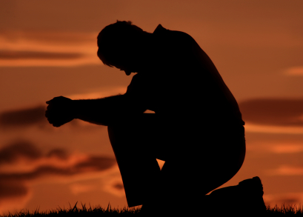
7. Patient Sufferers
1 Peter 2:18-20

Slide 21
7. Patient Sufferers
These instructions are given to Christians who were slaves.
The spirit of their submission and the fervency of their service was not dependent upon the nature of their master.

Slide 22
7. Patient Sufferers
When we do evil, we can expect to suffer the consequences of our actions.
If we patiently endure suffering because we do what is right, it is commendable before God.
Christians are going to be called upon to suffer in this world - 2 Tim. 3:12.

Slide 23
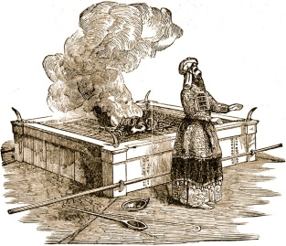
What is a Christian? - 1 Peter 2
Babe Desiring Growth
Living Stones
Holy Priests Offering Sacrifices
God’s Own Special People
Sojourners and Pilgrims
Obedient and Submissive Servants
Patient Sufferers

