Slide 2
“Nailed to the Cross”
The End of the Law of Moses
Colossians 2:14-15

Slide 3
Colossians Two
Paul wants them to be rooted and built up in Christ, established in the faith (v. 7).
He warns them of those who would take them captive through philosophy and deceit (v. 8).
He stresses that they are complete in Christ (vs. 9-10).
He reminds them that they have been circumcised spiritually through baptism (vs. 11-13), and have received the forgiveness of their sins.

Slide 4
“having wiped out the handwriting of requirements that was against us, which was contrary to us” (NKJV).
“Blotting out the handwriting of ordinances that was against us, which was contrary to us” (KJV).
“having canceled out the certificate of debt consisting of decrees against us and which was hostile to us” (NASB).
“by canceling the record of debt that stood against us with its legal demands” (ESV).

Slide 5
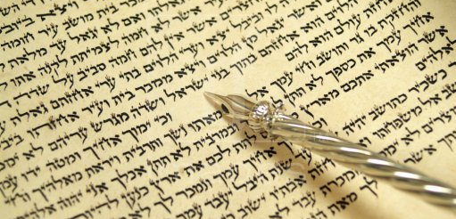
The Handwriting of Requirements
Refers to requirements, decrees, or legal demands.
The commands, statutes, or decrees of the Law of Moses which had been put in writing.

Slide 6
Represents the Entire Law of Moses
The Bible never makes any distinction between parts of the Law of Moses.
The word “handwriting” means “what one has written with his own hand.” The Ten Commandments were written, first by the finger of God (Ex. 31:18), then by Moses.
Hebrews 8:7-10 indicates that the Ten Commandments were the beginning part of the covenant which had become obsolete (v. 13).

Slide 7
Against Us and Contrary To Us
The Law of Moses made no provision for the forgiveness of sin (Gal. 3:10; Heb. 10:1-4).
The Law of Moses kept Jews locked up in sin and Gentiles locked out in sin.
Peter called it a yoke that no man could bear (Acts 15:10).
Paul called it the ministry of death (2 Cor. 3:7).

Slide 8
What Happened to the Law of Moses?
Wiped Out – the writing was removed and the decree was thus canceled.
Taken Out of the Way – permanently removed.
Having Nailed it to the Cross –
Matt. 5:17-18
Rom. 10:4

Slide 9
The Triumph of Christ
Disarmed Principalities and Powers
Eph. 1:20-21; Heb. 2:14
Made a Public Spectacle of Them
Acts 2:22-24, 36; Rom. 1:4
Triumphing Over Them In It
John 12:32-33

