Slide 1
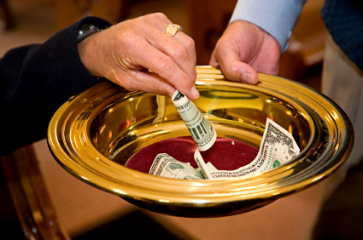
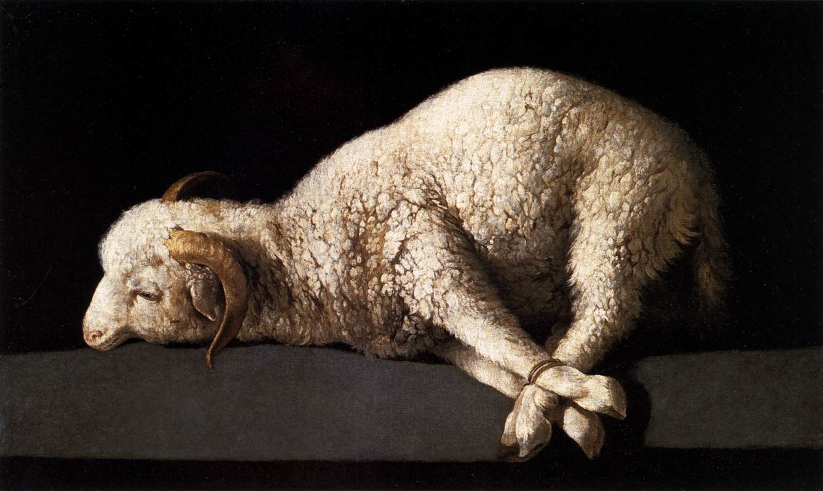
Sacrifice

Slide 2
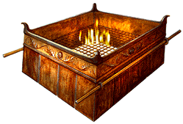
Biblical Principles of Sacrifice
Must Be Acceptable To God
1 Pet. 2:5; Lev. 22:19-25; Heb. 11:4
Must Cost Us Something
2 Sam. 24:24; Luke 21:1-4
Must Be the Best
Lev. 22:19-25; Mal. 1:8, 13-14

Slide 3
Biblical Principles of Sacrifice
Must Be Given Freely
Lev. 22:19, 29; 2 Cor. 8:12, 9:7
Must Be Given Without Desire For Recognition Or Reward From Men
Matt. 6:1-4; Acts 5:1-11

Slide 4
Areas of Sacrifice for the Christian

Slide 5
Areas of Sacrifice for the Christian
1 Peter 2:4-5 - Christians are priests, offering spiritual service and sacrifice unto God through Jesus Christ.
2 Corinthians 8:5 - we must first give ourselves unto the Lord.
Romans 12:1-2 - our bodies are to be presented as living sacrifices, offered unto God in His service.

Slide 6
Areas of Sacrifice for the Christian
Money - Phil. 4:18
Praise and Prayer - Heb. 13:15
Service - Heb. 13:16
Time - Mark 1:35

