Slide 1
“Rejoice in the Lord Always”
The Secret to Paul’s Happiness From the Book of Philippians

Slide 2
1. Focused On the Success of the Gospel, Not On Himself
Philippians 1:12-14
Paul realized that God had used his adverse circumstances as a unique opportunity to spread the gospel.
Our attitude is contagious.
What matters is the success of the gospel (v. 18).

Slide 3
2. Willing to Lose in Order to Gain
Philippians 3:7-11
Lost: the prestige of his Hebrew heritage, advancements in Judaism.
Gained:
1. The knowledge or understanding that Christ Jesus is Lord (v. 8)
2. The righteousness of Christ (v. 9)
3. Fellowship with Christ (v. 10)
4. Hope of the resurrection (v. 11)

Slide 4
3. A “Pressing On” Mentality
Philippians 3:12-16
forgetting those things which are behind (v. 13)

Slide 5
4. Finding Peace in Prayer
Philippians 4:6-7
be anxious for nothing

Slide 6
4. Finding Peace in Prayer
Philippians 4:6-7
be anxious for nothing
casting all your care upon Him (1 Pet. 5:7)

Slide 7
4. Finding Peace in Prayer
Philippians 4:6-7
be anxious for nothing
casting all your care upon Him (1 Pet. 5:7)
with thanksgiving

Slide 8
5. Meditating on the Right Things
Philippians 4:8
Finally, brethren, whatever things are true, whatever things are noble, whatever things are just, whatever things are pure, whatever things are lovely, whatever things are of good report, if there is any virtue and if there is anything praiseworthy — meditate on these things.

Slide 9
5. Meditating on the Right Things
Philippians 4:8
Finally, brethren, whatever things are true, whatever things are noble, whatever things are just, whatever things are pure, whatever things are lovely, whatever things are of good report, if there is any virtue and if there is anything praiseworthy — meditate on these things.
Meditate on these things.

Slide 10
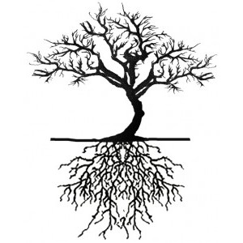
6. Learning To Be Content
Philippians 4:11-13
The word “content” actually means to be contained. It describes a person who has all they need, satisfied and self-sufficient.
learned
I can do all things through Christ who strengthens me

Slide 11
How Was Paul Able To Rejoice?
He Focused on the Success of the Gospel, Not on Himself
He Was Willing To Lose in Order to Gain
He Had A “Pressing-On” Mentality
He Found Peace in Prayer
He Meditated on the Right Things
He Learned To Be Content

