Slide 1
How Husbands Can Help Their Wives Be Better Wives

Slide 2
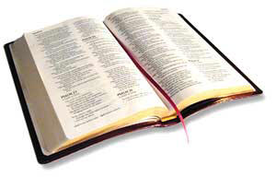
“Husbands, likewise, dwell with them with understanding, giving honor to the wife, as to the weaker vessel, and as being heirs together of the grace of life, that your prayers may not be hindered.”
1 Peter 3:7

Slide 3
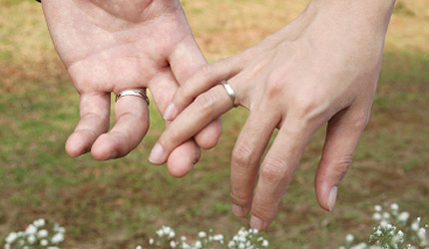
Dwell With Her
Live Together - 1 Cor. 7:5
Spend Time Together

Slide 4
With Understanding
Colossians 3:19
Titus 2:5
Psalm 128:3

Slide 5
Honor Her
Be a Man
Be a Leader
Be a Provider

Slide 6
As the Weaker Vessel
Love Her - Eph. 5:25, 28-29
Be Affectionate
Kind and Courteous - Eph. 4:32; 1 Pet. 3:8
Grateful
Praise Her - Prov. 31:28-31

Slide 7
Be Heirs Together
Genesis 2:24
Help her be the best Christian she can be.
Work together towards spiritual goals and spiritual service.

Slide 8
That Your Prayers Be Not Hindered
Ephesians 5:33
What Christian woman can respect a man who is out of fellowship with God because he mistreats her?

Slide 9
How Husbands Can Help Their Wives
Dwell With Her
With Understanding
Honor Her
As the Weaker Vessel
Be Heirs Together
That Your Prayers Be Not Hindered

