Slide 2
The Miraculous Gifts of the Holy Spirit
“ There are diversities of gifts, but the same Spirit.”
1 Corinthians 12:4

Slide 3
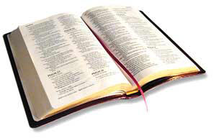
“For to one is given the word of wisdom through the Spirit, to another the word of knowledge through the same Spirit, to another faith by the same Spirit, to another gifts of healings by the same Spirit, to another the working of miracles, to another prophecy, to another discerning of spirits, to another different kinds of tongues, to another the interpretation of tongues.”
1 Corinthians 12:8-10

Slide 4
These gifts existed and served an important purpose in the First Century.
Does the Bible teach that these gifts were for all believers of all time?
Or have they served their purpose and ceased to exist?
Are they for us today?
What does the Bible say?

Slide 5
The Purpose For Miraculous Gifts
To Confirm the Word
Mark 16:20; Acts 8:5-6
To Deliver the Truth in the Absence of Completed Revelation
1 Cor. 14:26; Rom. 1:11
The Word has been confirmed (Heb. 2:3-4) and delivered in its entirety (Jude 3).

Slide 6
Means of Receiving These Gifts
The miraculous gifts of the Holy Spirit were given through the laying on of the hands of an apostle.
Acts 8:14-19
Romans 1:11
2 Timothy 1:6

Slide 7
Means of Receiving These Gifts
If people have the miraculous gifts of the Holy Spirit today…
An apostle is still alive.
Some one who received these gifts from an apostle is still alive.
God is now imparting these gifts in a different way.

Slide 8
The Bible Addresses the Duration of the Miraculous Gifts of the Holy Spirit

Slide 9
The Bible Addresses the Duration of the Miraculous Gifts of the Holy Spirit
Love never fails. But whether there are prophecies, they will fail; whether there are tongues, they will cease; whether there is knowledge, it will vanish away.
For we know in part and we prophesy in part.
But when that which is perfect has come, then that which is in part will be done away.
1 Corinthians 13:8-10

Slide 10
The Bible Addresses the Duration of the Miraculous Gifts of the Holy Spirit
Love never fails. But whether there are prophecies, they will fail; whether there are tongues, they will cease; whether there is knowledge, it will vanish away.
For we know in part and we prophesy in part.
But when that which is perfect has come, then that which is in part will be done away.
1 Corinthians 13:8-10

Slide 11
The Bible Addresses the Duration of the Miraculous Gifts of the Holy Spirit
Love never fails. But whether there are prophecies, they will fail; whether there are tongues, they will cease; whether there is knowledge, it will vanish away.
For we know in part and we prophesy in part.
But when that which is perfect has come, then that which is in part will be done away.
1 Corinthians 13:8-10

Slide 12
The Bible Addresses the Duration of the Miraculous Gifts of the Holy Spirit
Love never fails. But whether there are prophecies, they will fail; whether there are tongues, they will cease; whether there is knowledge, it will vanish away.
For we know in part and we prophesy in part.
But when that which is perfect has come, then that which is in part will be done away.
1 Corinthians 13:8-10

Slide 13
The Bible Addresses the Duration of the Miraculous Gifts of the Holy Spirit
What is “that which is perfect”?
Love never fails. But whether there are prophecies, they will fail; whether there are tongues, they will cease; whether there is knowledge, it will vanish away.
For we know in part and we prophesy in part.
But when that which is perfect has come, then that which is in part will be done away.
1 Corinthians 13:8-10

Slide 14
The Bible Addresses the Duration of the Miraculous Gifts of the Holy Spirit
What is “that which is perfect”?
The “perfect” has to correspond to the “part.”
Love never fails. But whether there are prophecies, they will fail; whether there are tongues, they will cease; whether there is knowledge, it will vanish away.
For we know in part and we prophesy in part.
But when that which is perfect has come, then that which is in part will be done away.
1 Corinthians 13:8-10

Slide 15
The Bible Addresses the Duration of the Miraculous Gifts of the Holy Spirit
What is “that which is perfect”?
The “perfect” has to correspond to the “part.”
The “part” was the revelation of God’s will piece by piece, so the “perfect” is God’s complete revelation – the New Testament.
Love never fails. But whether there are prophecies, they will fail; whether there are tongues, they will cease; whether there is knowledge, it will vanish away.
For we know in part and we prophesy in part.
But when that which is perfect has come, then that which is in part will be done away.
1 Corinthians 13:8-10

Slide 16
The Bible Addresses the Duration of the Miraculous Gifts of the Holy Spirit
What is “that which is perfect”?
The “perfect” has to correspond to the “part.”
The “part” was the revelation of God’s will piece by piece, so the “perfect” is God’s complete revelation – the New Testament.
Love never fails. But whether there are prophecies, they will fail; whether there are tongues, they will cease; whether there is knowledge, it will vanish away.
For we know in part and we prophesy in part.
But when that which is perfect has come, then that which is in part will be done away.
1 Corinthians 13:8-10
The perfect has come (the New Testament).
So the means of receiving God’s will in “part” has been done away; no longer necessary.

Slide 17
The Bible Addresses the Duration of the Miraculous Gifts of the Holy Spirit
When I was a child, I spoke as a child, I understood as a child, I thought as a child; but when I became a man, I put away childish things.
1 Corinthians 13:11

Slide 18
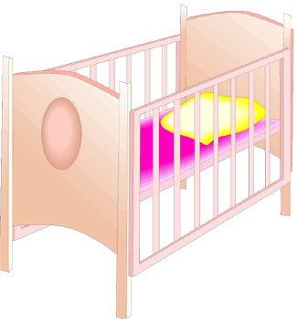
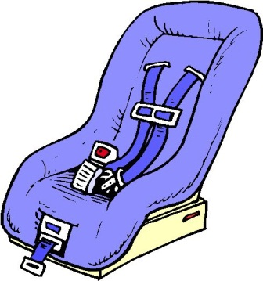
The Bible Addresses the Duration of the Miraculous Gifts of the Holy Spirit
When I was a child, I spoke as a child, I understood as a child, I thought as a child; but when I became a man, I put away childish things.
1 Corinthians 13:11

Slide 19
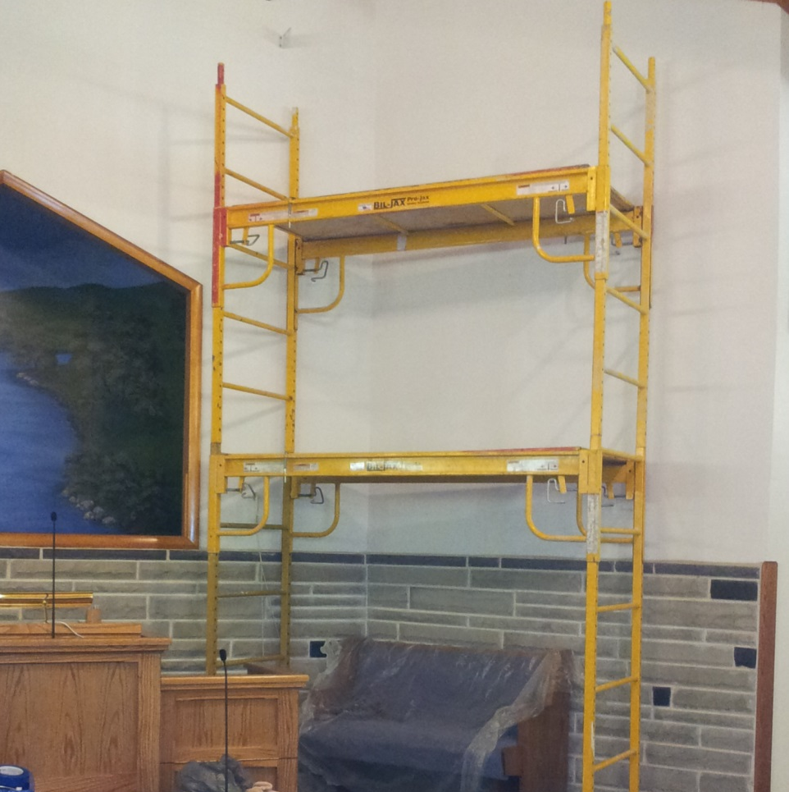
The Bible Addresses the Duration of the Miraculous Gifts of the Holy Spirit
When I was a child, I spoke as a child, I understood as a child, I thought as a child; but when I became a man, I put away childish things.
1 Corinthians 13:11

Slide 20
The Bible Teaches That Miraculous Gifts of the Holy Spirit Have Served Their Purpose and No Longer Exist
Their Intended Purpose
The Means of Receiving the Gifts
Their Intended Duration

