Slide 1
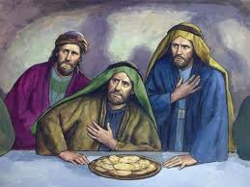
“Lord, Is It I?”
Matthew 26:20-25

Slide 2
“Lord, Is It I?”

Slide 3
“Lord, Is It I?”
“Therefore let him who thinks he stands take heed lest he fall.”
1 Corinthians 10:12

Slide 4
“Lord, Is It I?”
I Can Forsake Him - 2 Tim. 4:9-10; Heb. 3:12-13
I Can Be Ashamed of Him - Mark 8:38; Matt. 10:32-33; Rom. 1:16
I Can Tolerate Sin and Error - 1 Cor. 5:1-2; Rev. 2:20

Slide 5
“Lord, Is It I?”
I Can Contend Earnestly For the Faith - Jude 3; 2 Tim. 2:15; Phil. 1:17
I Can Give My Life in Service to Others - Matt. 25:34-40; Gal. 6:10; Mark 14:8
I Can Win the Crown of Life - 2 Tim. 4:6-8; Rev. 2:10

Slide 6
“Lord, Is It I?”
We are created with free will, which means each one of us is capable of choosing faithfulness or unfaithfulness.
We can betray the Lord and forfeit our salvation.
We can be faithful until death and receive the crown of life.

