Slide 1
Can’t Afford One
Don’t Like the Sound
No one Able to Play
Our unique “Tradition”
Don’t Believe in Music
Wish to be Different
Just Argumentative
Why don’t
you use instruments of music in your Worship?

Slide 2
All we can know about music in worship, or any religious subject, is by consulting the Bible!

Slide 3
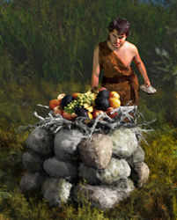
Consider God’s Attitude Toward Obedience
Cain – Gen 4:3-5
Cain disobeyed God and his worship was rejected

Slide 4
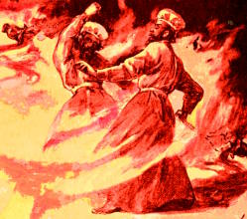
Consider God’s Attitude Toward Obedience
Nadab & Abihu – Lev 10:1-2
N/A disobeyed God and were destroyed by fire

Slide 5
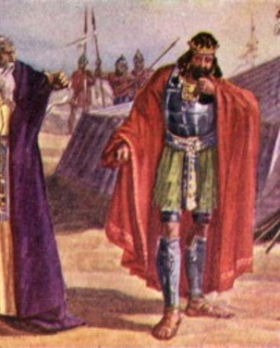
Consider God’s Attitude Toward Obedience
King Saul – 1 Sam 15:15, 22
Saul disobeyed God and lost his kingdom

Slide 6
Consider God’s Attitude Toward Obedience
Jesus Christ – Matthew 9:13
True love & devotion is not bound up in token “worship” but in faithfulness (mercy)

Slide 7
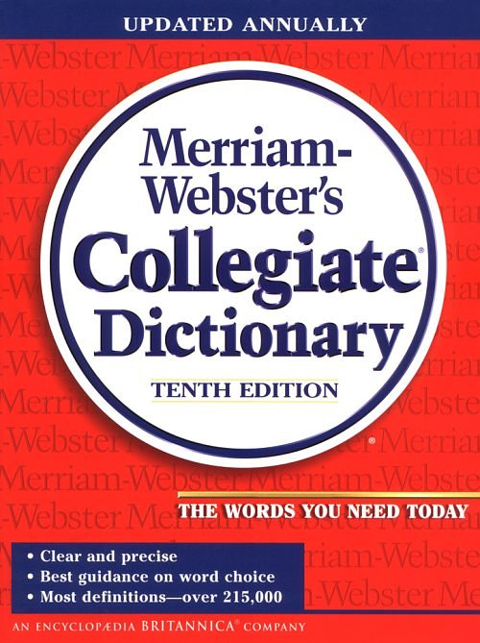
Music n
“The art of combining tones into a composition having structure and continuity; vocal or instrumental sounds having rhythm, melody, or harmony; an agreeable sound.”
May be
May be

Slide 8
The New Testament and Music
Hebrews 2:12
James 5:13
Colossians 3:16
1 Corinthians 14:15
Romans 15:9
Acts 16:25
Matthew 26:30

Slide 9
The New Testament and Music
Who? “All Christians” (not choirs, groups, solos).
Kind? “Vocal” (Sing, not play).
How? “Sincerely” (Engage the mind and the mouth).
What? “P / H / SS” (Not country, rock, Hip Hop).
“Speaking to one another in psalms and hymns and spiritual songs, singing and making melody in your heart to the Lord”
“Speaking to one another in psalms and hymns and spiritual songs, singing and making melody in your heart to the Lord”
“Speaking to one another in psalms and hymns and spiritual songs, singing and making melody in your heart to the Lord”
“Speaking to one another in psalms and hymns and spiritual songs, singing and making melody in your heart to the Lord”
“Speaking to one another in psalms and hymns and spiritual songs, singing and making melody in your heart to the Lord”
Ephesians 5:19

Slide 10
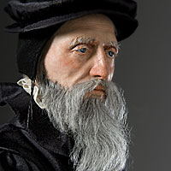
What Others Have Said about Music in Worship
“Musical instruments in the celebration of praises of God would be no more suitable than the burning of incense, the lighting of lamps, and the restoration of other shadows of the Law . . . Men who are fond of outward pomp may delight in the noise.”
John Calvin

Slide 11
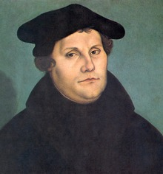
What Others Have Said about Music in Worship
“An organ in the worship of God is an ensign (badge) of Baal.”
Martin Luther

Slide 12
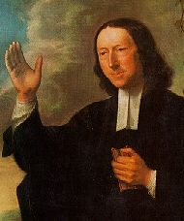
What Others Have Said about Music in Worship
“I have no objection to instruments of music in our chapels, provided they are neither seen nor heard.”
John Wesley

Slide 13
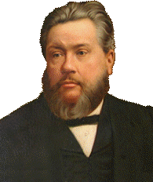
What Others Have Said about Music in Worship
“I’d as soon pray to God with machinery as to sing to God with machinery.”
Charles Spurgeon

Slide 14
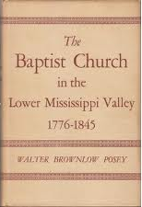
What Others Have Said about Music in Worship
“For years the Baptists fought the introduction of instrumental music into the churches . . . Installation of the organ brought serious difficulties in many churches.”
Walter Brownlow Posey

Slide 15
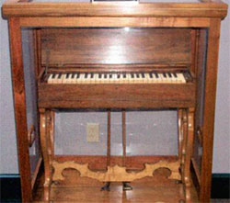
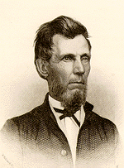
What Others Have Said about Music in Worship
L. L. Pinkerton introduced this melodeon into worship. In caused so much trouble in Midway that Adam Hibler, an elder of the church, removed the “instrument of Satan” from the church late one night with the assistance of a servant who passed it out to Hibler through a window.
Midway, Kentucky

Slide 16
Can’t Afford One
Don’t Like the Sound
No one Able to Play
Our unique “Tradition”
Don’t Believe in Music
Wish to be Different
Just Argumentative
Why don’t
you use instruments of music in your Worship?
Christ has not given us permission (authority) for their use!

Slide 17
“. . . though He was a Son, yet He learned obedience by the things which He suffered. And having been perfected, He became the author of eternal salvation to all who obey Him . . .”
(Hebrews 5:8-9)
“. . . though He was a Son, yet He learned obedience by the things which He suffered. And having been perfected, He became the author of eternal salvation to all who obey Him . . .”
(Hebrews 5:8-9)

