Slide 1
Gambling On God’s Indifference
Zephaniah 1:12

Slide 2
God Calls Man Out Of Indifference
Deuteronomy 30:19
Joshua 24:15
1 Kings 18:21

Slide 3
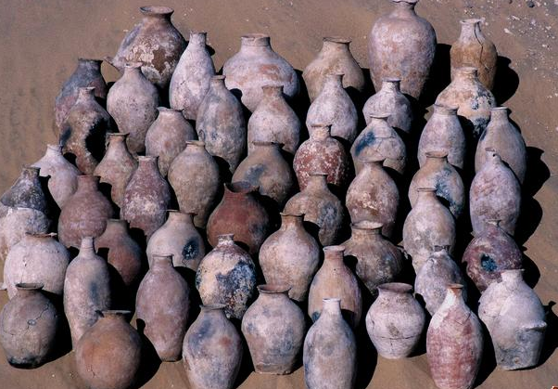
Zephaniah 1:12
“settled on their lees” KJV
“settled in complacency” NKJV
“stagnant in spirit” NASV

Slide 4
What Causes Indifference?
Idolatry - 1:5-6
Prosperity - 1:8
Lack of Suffering - Jer. 48:11

Slide 5
Gambling On God’s Indifference
It is not unusual for people’s notions about God to be shaped by their own points of view.
Such people assume that God is indifferent toward what they do.
It is foolish to mistake divine longsuffering with indifference - 2 Peter 3:3-10

